Slide 1
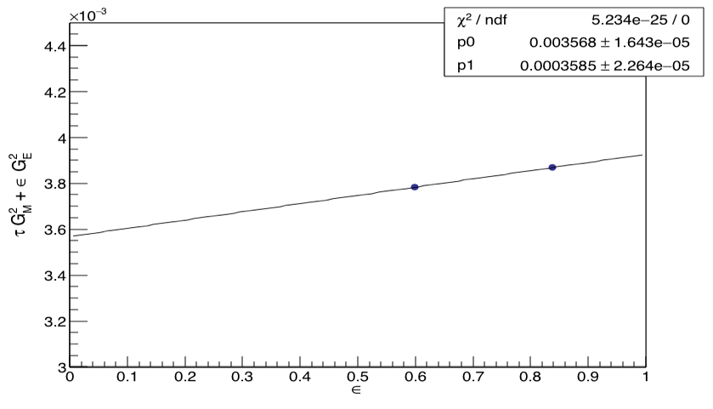
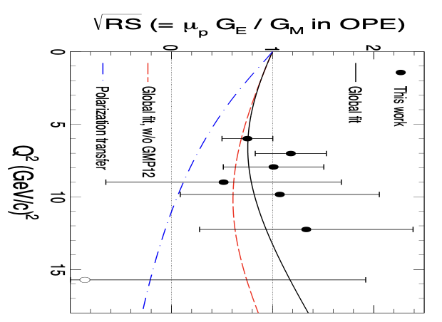
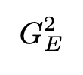
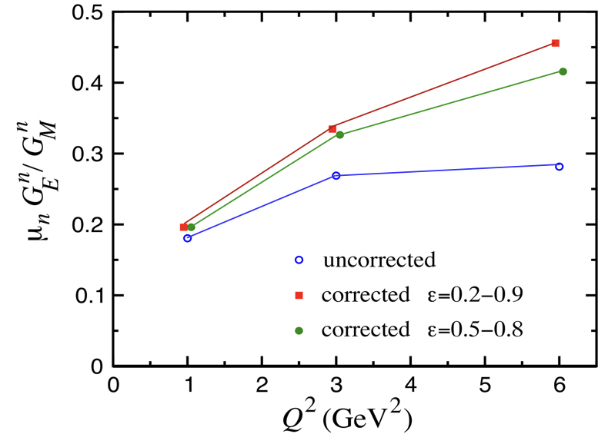
Two Photon Exchange Contribution to Elastic e-n Scattering (nTPE)
In Born approx. separate Sach’s FF with Rosenbluth technique
Can extract FF from y-intercept and slope where reduced cross section τG_{M}²+εG_{E}² linear in ε
Obtain Rosenbluth slope (RS) for neutron at our kinematics with measurements at different ε (world data are sparse!)
Discrepancy between recoil polarimetry result in one photon exchange (OPE) and Rosenbluth technique result can be explained by TPE
Will extract S^{n}, the Rosenbluth slope for the neutron, and be able to distinguish between theoretical TPE corrections
nTPE
ε
ε

Slide 2
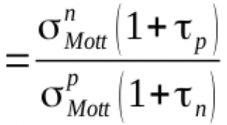
Kinematics and Projected Uncertainty
SBS8 and SBS9 provide the two measurements of ε (SBS9 data collection ongoing!)
Will measure ε via ratio method for simultaneous measurement of D(e,e’n) and D(e,e’p) (Durand technique) reducing systematic uncertainties
Kin | Q² (GeV/c)² | E (GeV) | E’ (GeV) | θ_{BB} (deg) | θ_{SBS} (deg) | ε
SBS9 | 4.5 | 4.03 | 1.63 | 49 | 22 | 0.523
SBS8 | 4.5 | 5.97 | 3.59 | 16.5 | 29.4 | 0.915
Systematic Uncertainty
ε | 0.599 | 0.838
Acceptance | 0.5% | 0.4%
Inelastic contamination | 0.9% | 0.6%
Nucleon misidentification | 0.6%
Syst. uncertainty on (quadratic sum of the above) | 1.3% | 1.0%
Using the experimental observable A
where
and
where
Syst. uncertainty on slope | ±0.01
Projected systematic uncertainty | ±0.01
, Eur. Phys. J. A51, 19 (2015) | ±0.05
Combined uncertainty on TPE contribution to S^{n} | ± 0.016
And with
We expect S^{n} = 0.063 ± 0.010 (stat) ± 0.012 (syst)

Slide 3
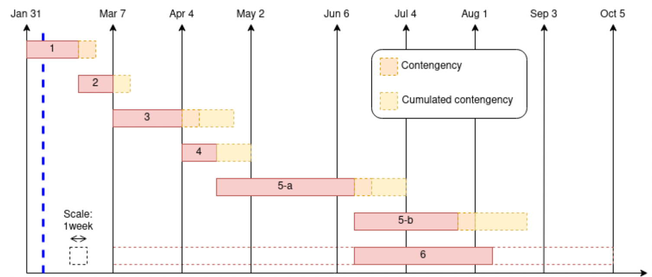
Analysis Timeline and Current Status
First pass calibrations of BBCal and HCal for all kinematics -calibration scripts written and tested, most calibrations complete
First mass replay and analysis -mass replay and analysis shell scripts written and tested
Refined calibrations (BBCal, HCal, Optics) -pending second replay
Second mass replay and analysis -pending second replay
Physics
HCal uniformity and systematics analysis -HCal uniformity analysis script written
Combination of kinematics and extraction of observables -Ongoing
Preparation of publication
We’re nearly ready to do some serious analysis!

Slide 4
Kinematics and Projected Uncertainty
SBS8 and SBS9 provide the two measurements of ε (SBS9 data collection ongoing!)
Will measure ε via ratio method for simultaneous measurement of D(e,e’n) and D(e,e’p) (Durand technique) reducing systematic uncertainties
Kin | Q² (GeV/c)² | E (GeV) | E’ (GeV) | θ_{BB} (deg) | θ_{SBS} (deg) | ε
SBS9 | 4.5 | 4.03 | 1.63 | 49 | 22.5 | 0.523
SBS8 | 4.5 | 6.0 | 3.59 | 26.5 | 29.9 | 0.804
Systematic Uncertainty
ε | 0.599 | 0.838
Acceptance | 0.5% | 0.4%
Inelastic contamination | 0.9% | 0.6%
Nucleon misidentification | 0.6%
Syst. uncertainty on (quadratic sum of the above) | 1.3% | 1.0%
Using the experimental observable A
where
and
where
Syst. uncertainty on slope | ±0.01
Projected systematic uncertainty | ±0.01
, Eur. Phys. J. A51, 19 (2015) | ±0.05
Combined uncertainty on TPE contribution to S^{n} | ± 0.016
And with
We expect S^{n} = 0.063 ± 0.010 (stat) ± 0.012 (syst)

Slide 5
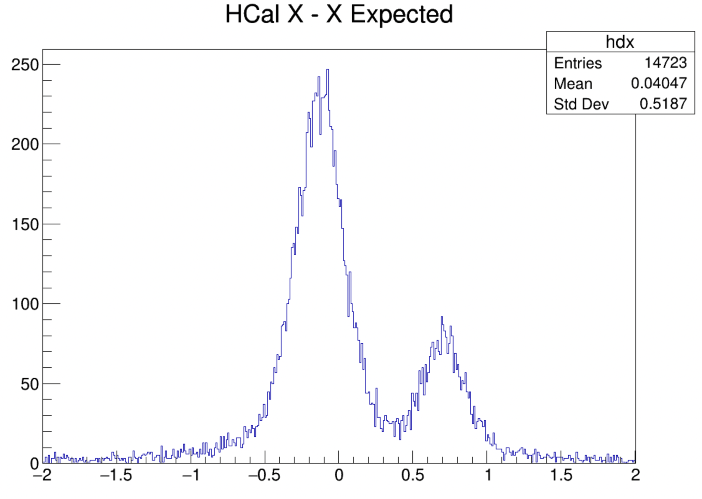
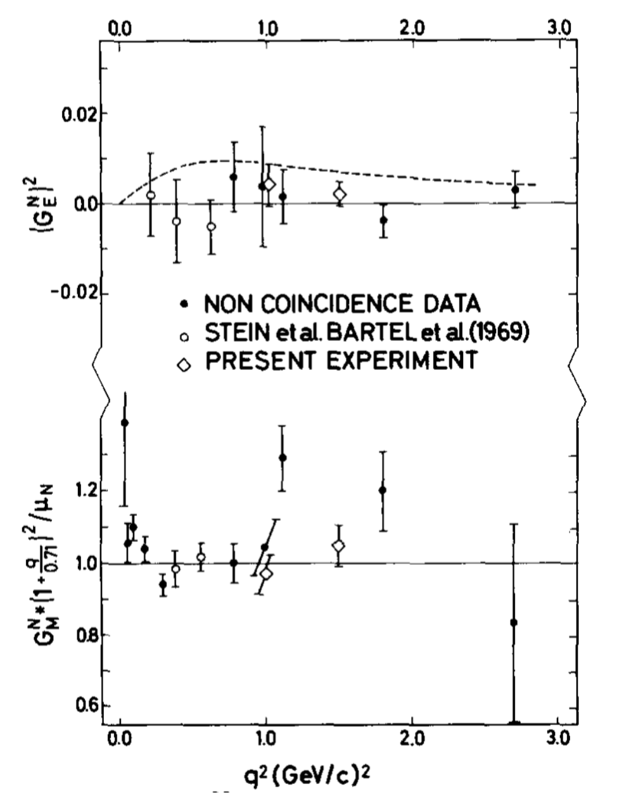
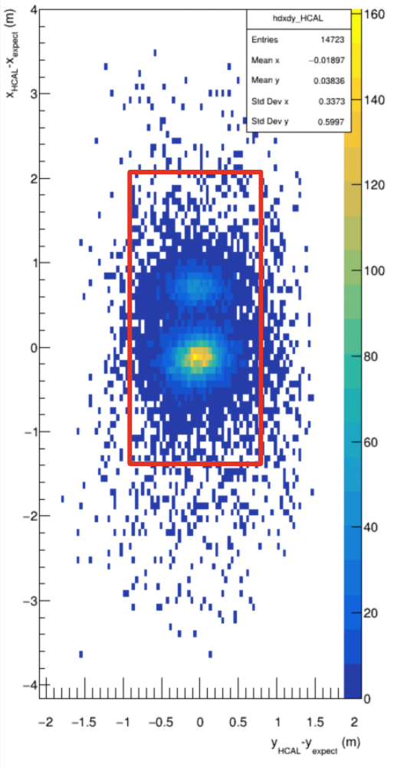
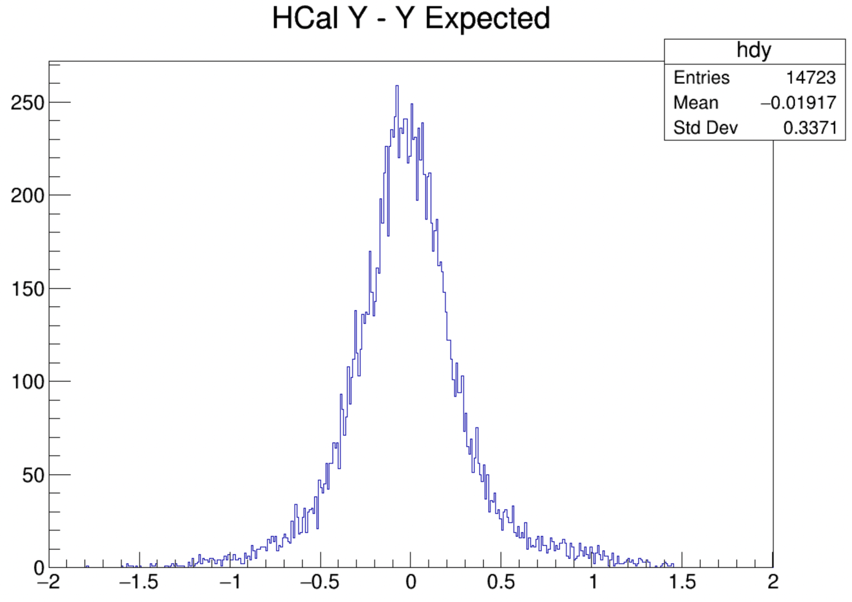
G_{M}^{n} Performance - Nucleon Position, Deuterium
Nucleon Position HCal
Neutrons
Protons

