Slide 1
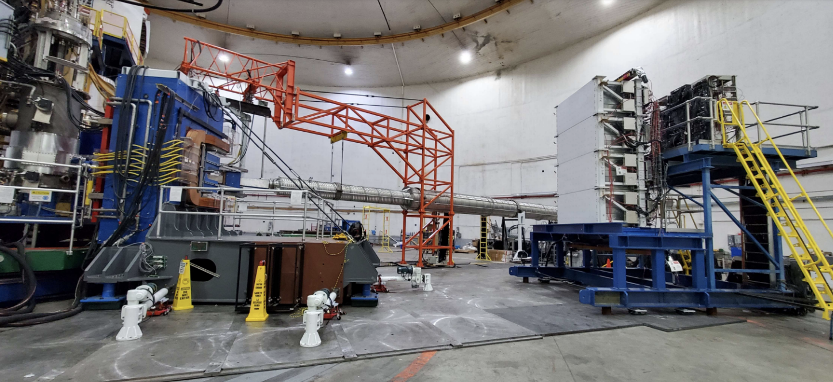
The SBS Hadronic Calorimeter
Design, Calibration, Status, and Performance
Sebastian Seeds
On behalf of the HCal working group
August 29, 2022
Jefferson Lab

Slide 2
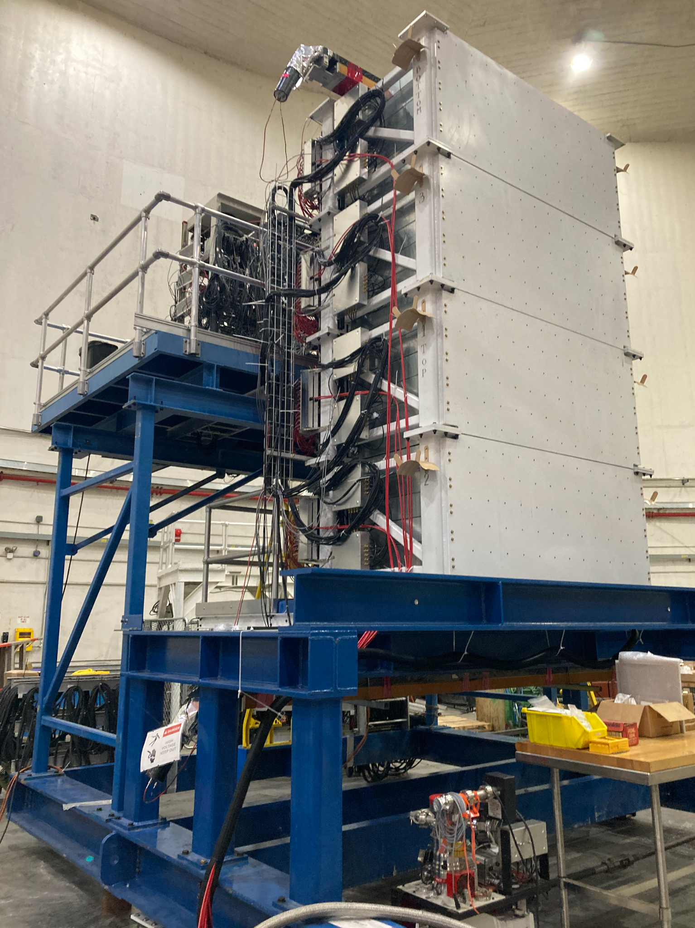
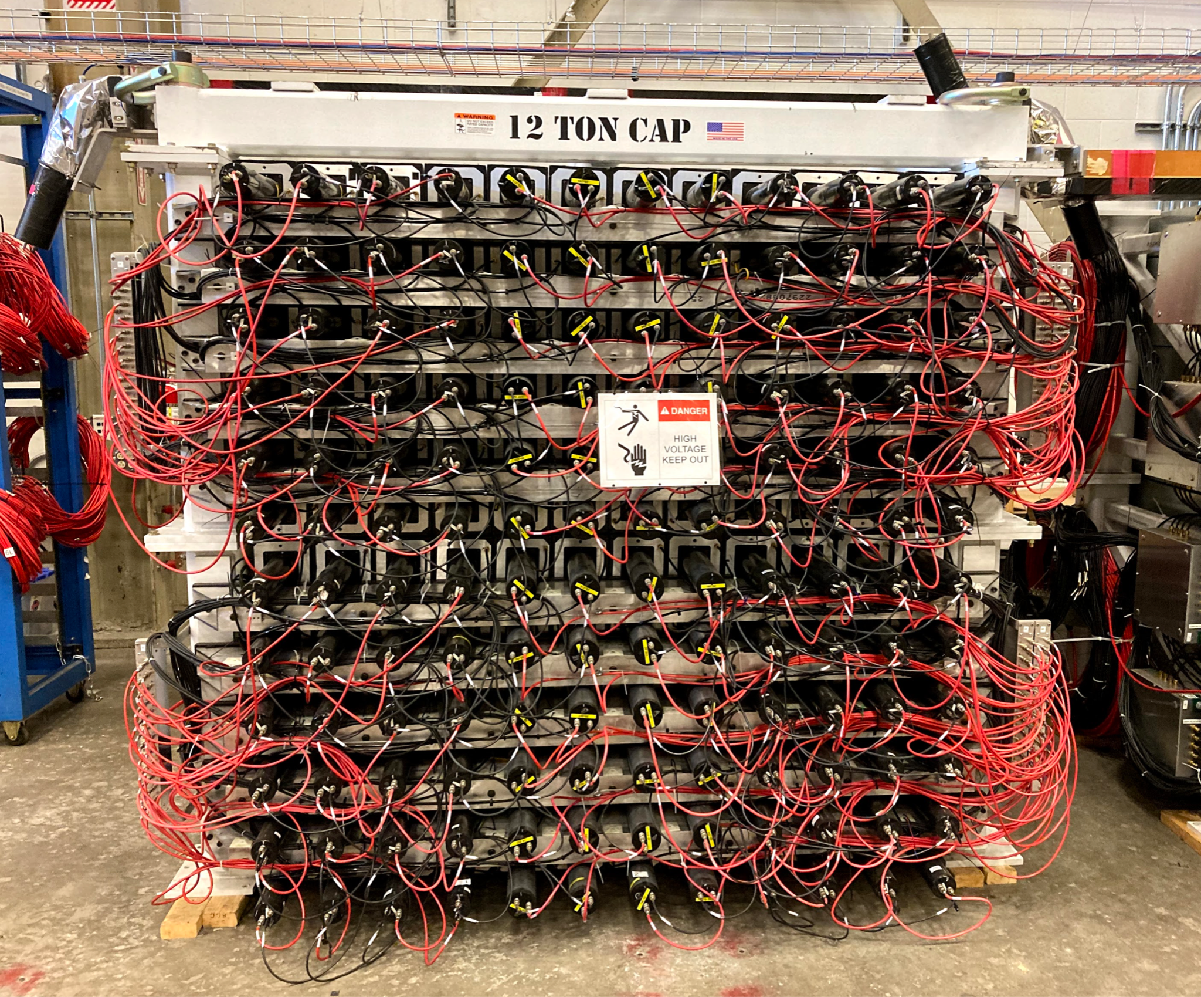
Design - Overview
Segmented calorimeter designed to detect hadrons via electromagnetic showers
Energy from incoming hadrons sampled by calorimeter
Simulated energy sampling fraction: 6.6%
Simulated energy resolution: ~30%
288 individual showering modules (12 columns, 24 rows)
Detected hadron from target located by clusters of signals from modules
Each module equipped with fADC and TDC readout and pulsed LED array
Full Acceptance: 180cm x 360cm
Simulated position resolution: 3-4cm at 8 GeV
Simulated timing resolution (TDC): 0.5ns
Particle ID via SBS magnet between HCal and target chamber
Neutrons unaffected, protons bent by magnetic field
Simulated Neutron/Proton detection ratio: 0.985 at 8 GeV
HCal, Target-facing-side, Hall A
HCal, PMT-side, Test Lab

Slide 3
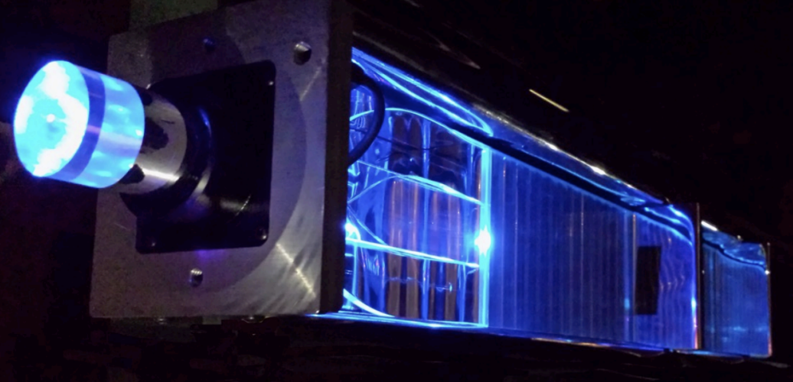
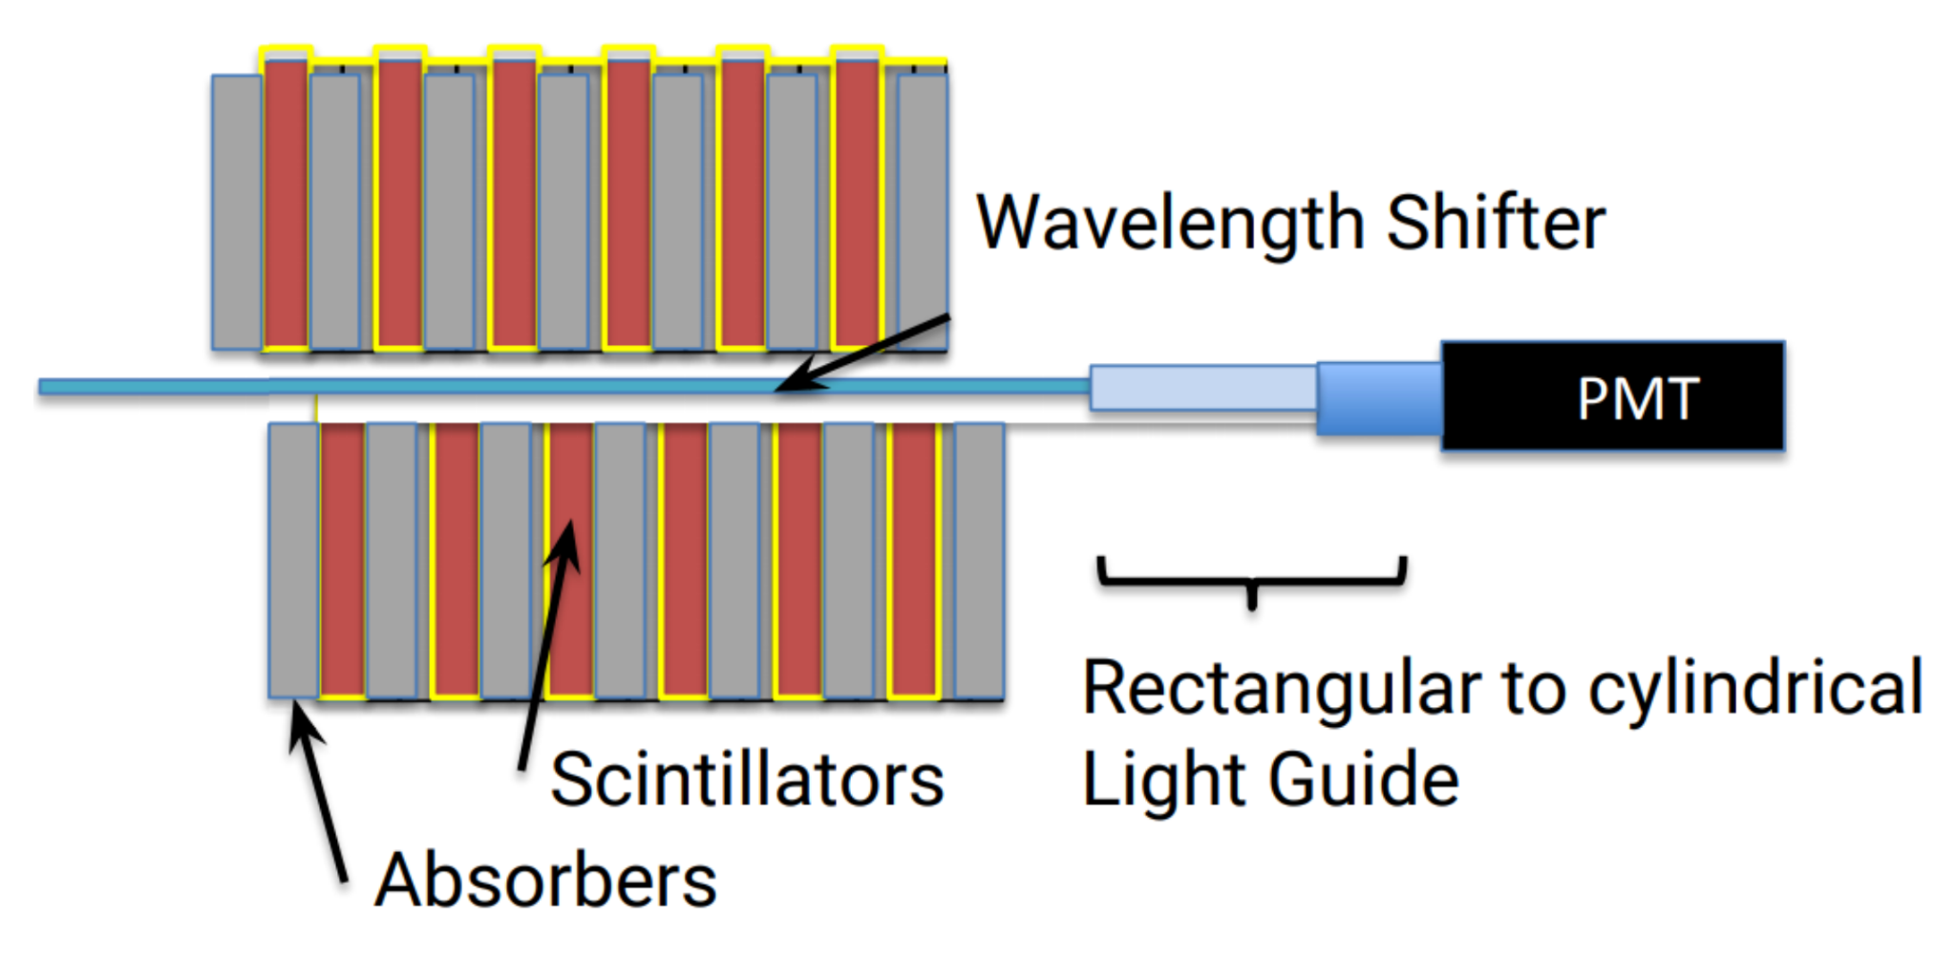
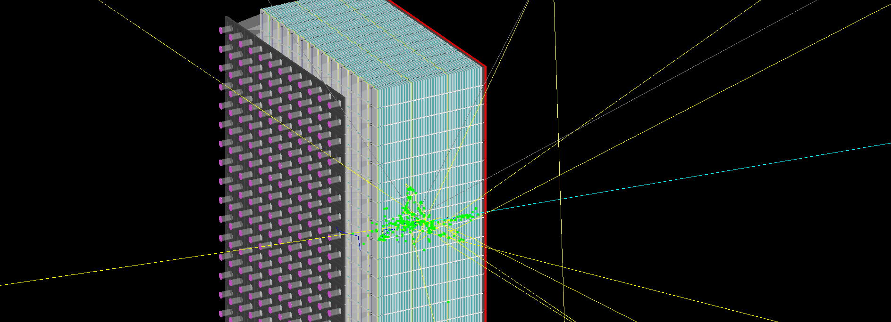
Design - Module
Single module
Iron absorbers create electromagnetic showers via collisions with incoming protons and neutrons.
Scintillators sample the energy from these showers and emit photons proportional to energy sampled into wavelength shifter
Wavelength shifter converts photons to optimal wavelength range for PMTs, improving detection efficiency
Light guide directs photons to PMT with minimal light loss where photons are converted to electrical signal
192 12-stage “CMU” Photonis XP2262 PMTs
96 8-stage “JLAB” Photonis XP2282 PMTs
(p, n)
modules
PMTs
(p, n)

Slide 4
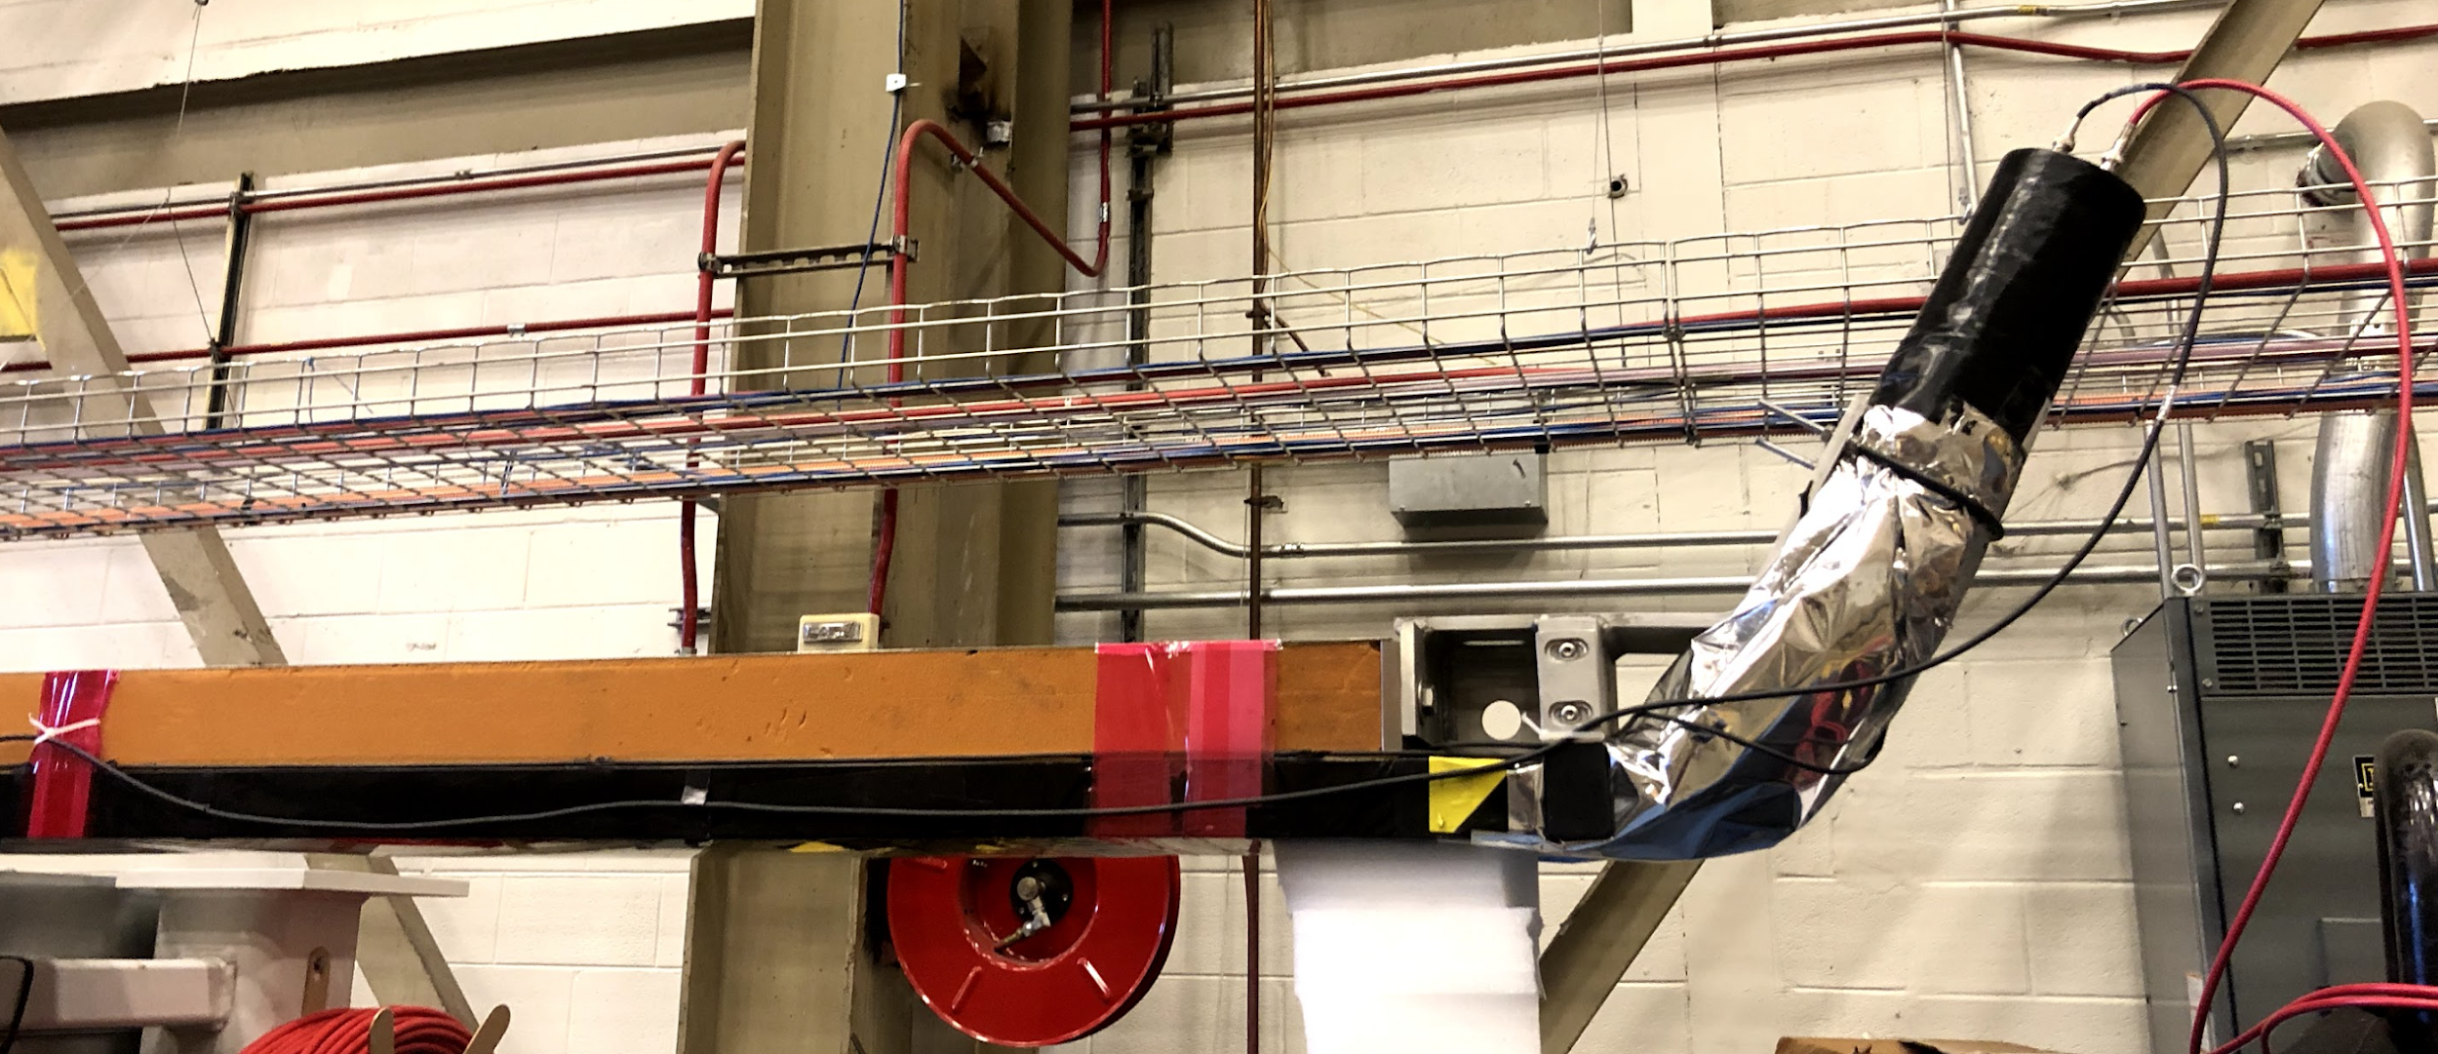
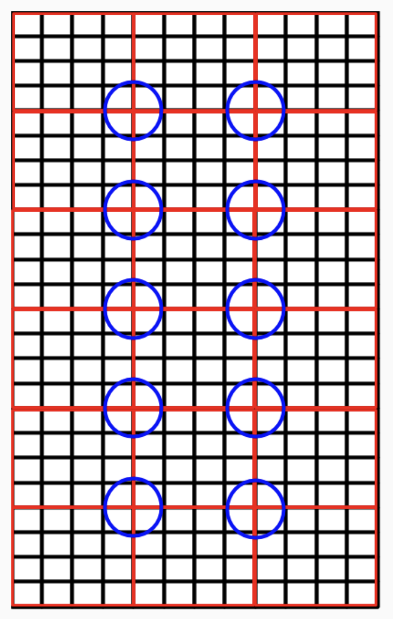
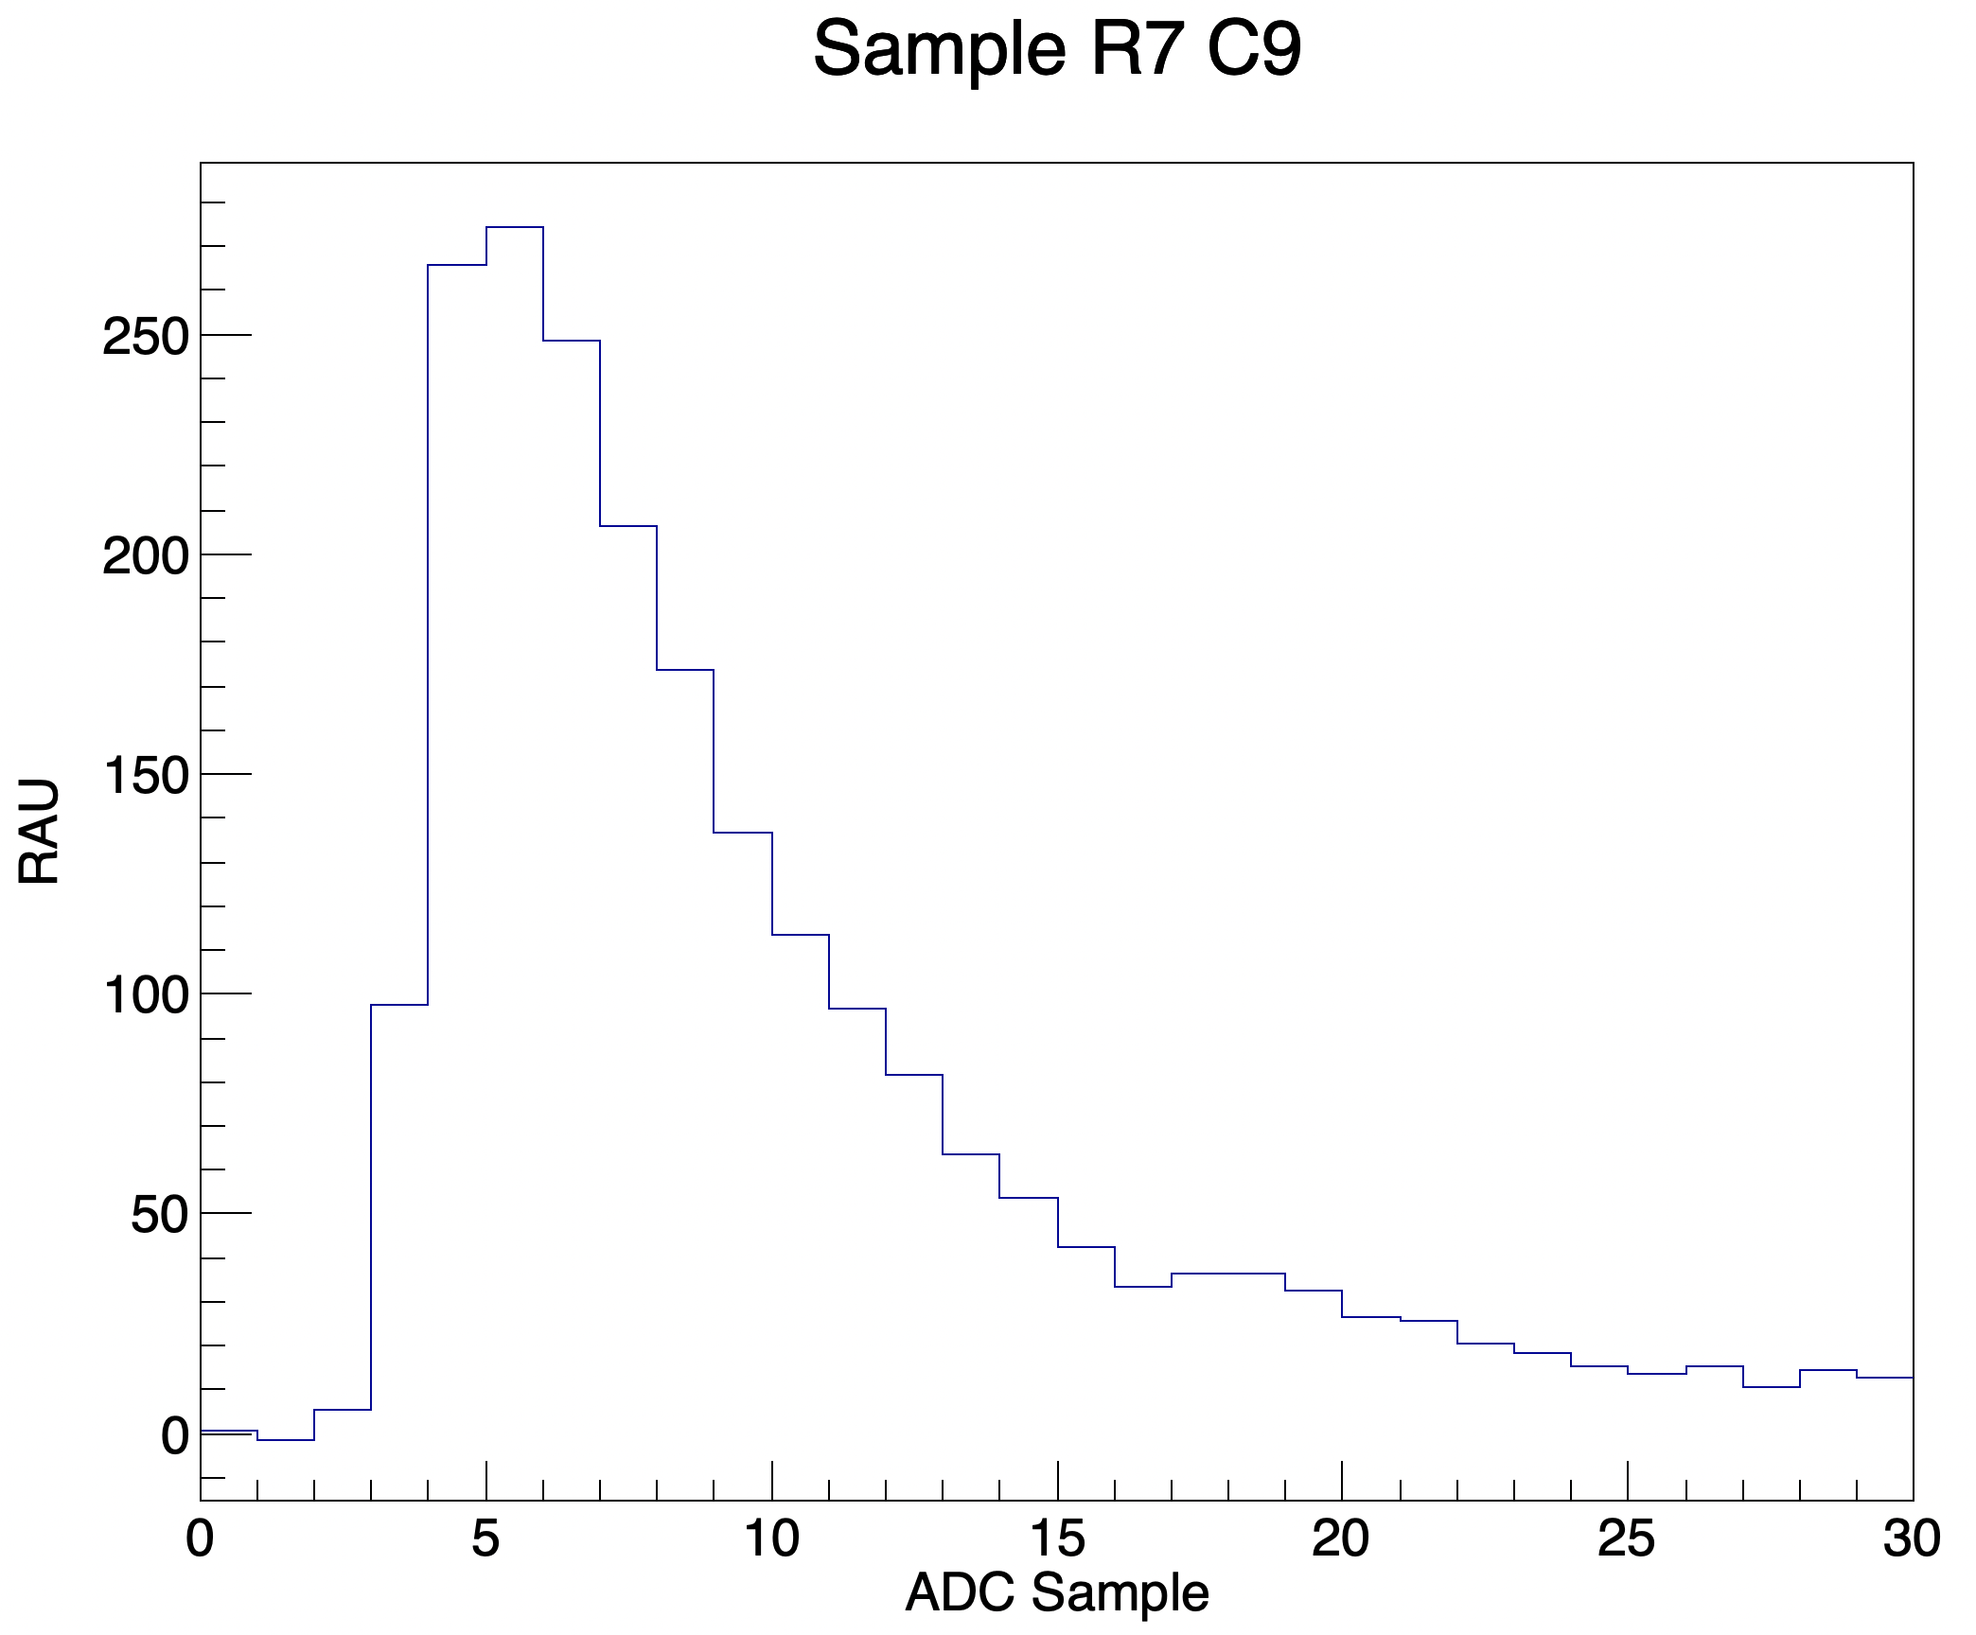
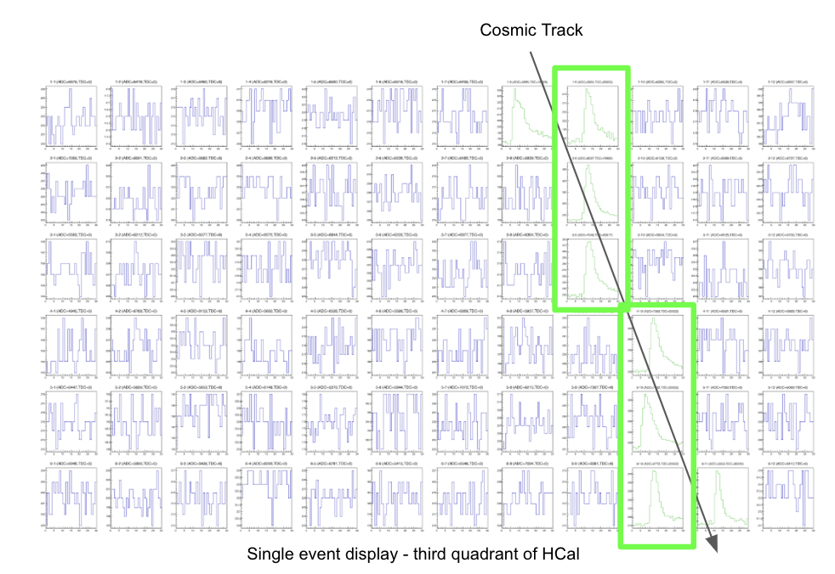
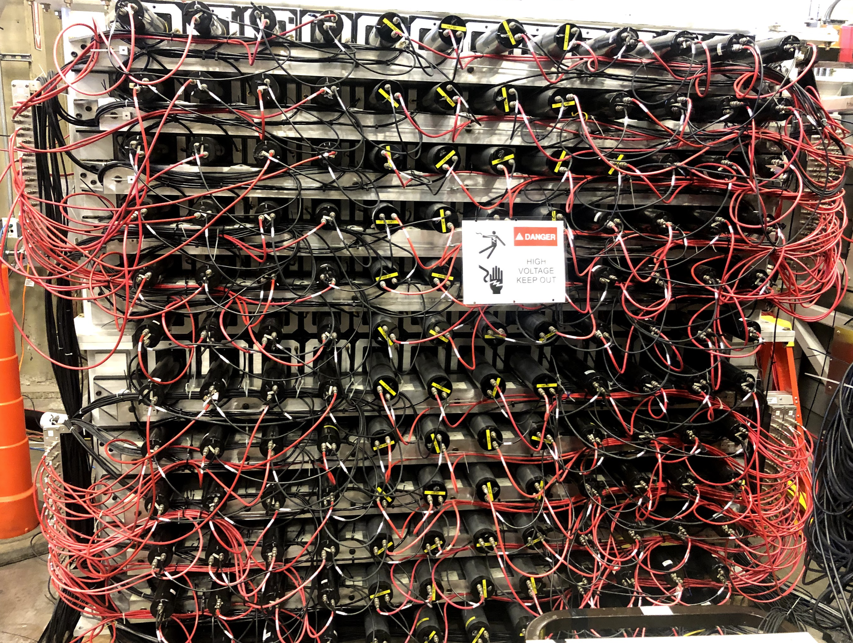
Front End (FE) and Data Acquisition (DAQ)
(FE) Signal 10x amplified with two outputs from amp.
One to fADC
One split from module (50:50), half to trigger logic and half to TDC
(FE) Cosmic Trigger: 2x coincidence paddles, one above and one below HCal
(FE) Overlapping Regions Trigger: Sums of 4x4 modules (red) summed into 8x8 (blue circles), trigger over threshold
(FE) LED Pulser Trigger
HCal
Cosmic paddle
𝛍
Overlapping Regions Trigger Map
(DAQ) 2x VXS Crates
19 16-channel fADC250 configured mode 1 (recording full waveforms)
4ns samples, 250 MHz sample rate Analog-to-Digital Converter
5 64-channel F1TDCs
Multi-hit rolling Time-to-Digital Converter referenced to BigBite Trigger

Slide 5
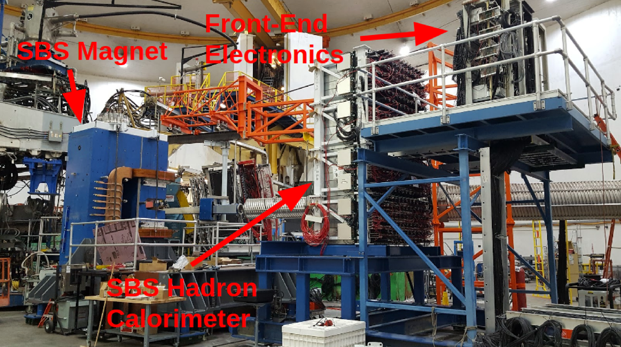
HCal Broad View
Protons
Neutrons

Slide 6
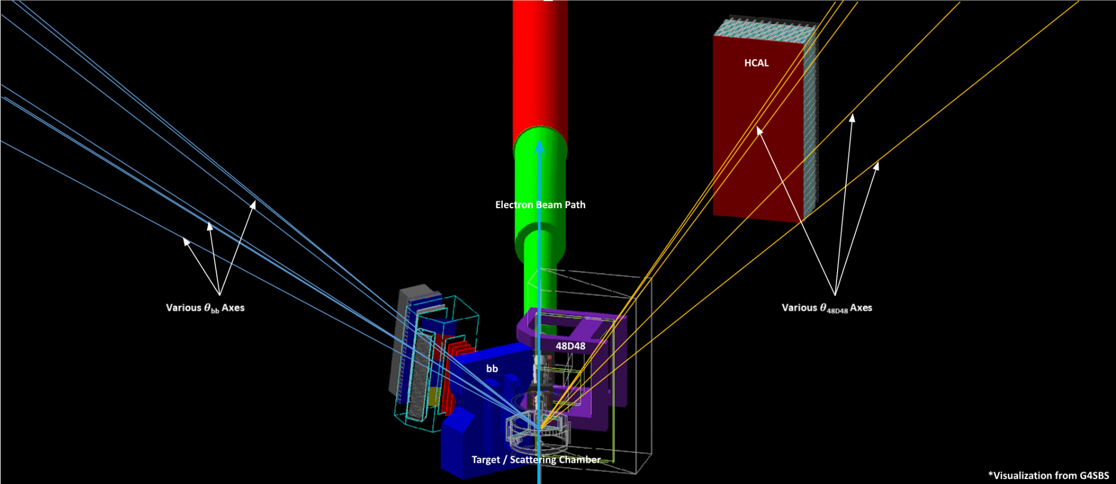
SBS Program
PAC approved experiments (6 over several years)
Nucleon Form Factors: G_{M}^{n} (E12-09-019), G_{E}^{n} (E12-17-004), and G_{E}^{p} /G_{M}^{p} (E12-07-109).
nTPE (E12-09-010), GEn-rp (E12-17-004), SIDIS (E12-09-018)
G_{M}^{n} and nTPE ran in the winter of 2021-2022, the first two in the SBS program
(G_{M}^{n}) Via the ratio method to minimize systematic errors, neutron magnetic form factor will be extracted from deuterium quasielastic cross sections d(e,en)p / d(e,ep)n
(nTPE) With simultaneous e-n / e-p measurements at two virtual photon polarizations, the contribution of two-photon-exchange to the elastic e-n cross section will be extracted
BigBite spectrometer detects scattered electrons and HCal detects protons and neutrons separated by SBS Dipole
GMn configuration: Coordinate Detector (CDet), SBS GEMs, and RICH not shown
PID: 48D48 10T Dipole (aka SBS Dipole)
BigBite (BB) spectrometer: BB dipole, BBCal, Hodoscope, GRINCH, BB GEMs
10-cm liquid deuterium/hydrogen target. Luminosity ~ 2 x 10³⁸

Slide 7
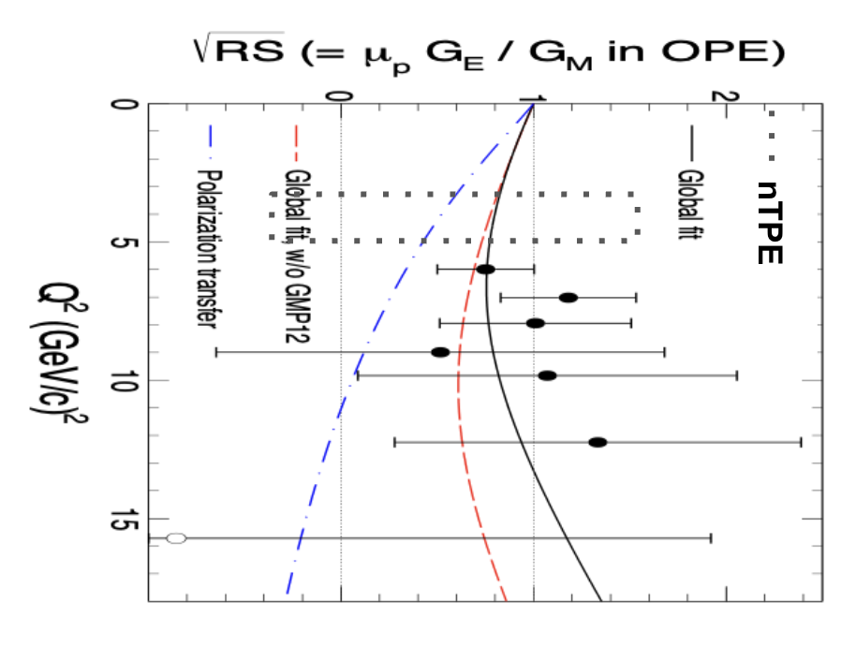
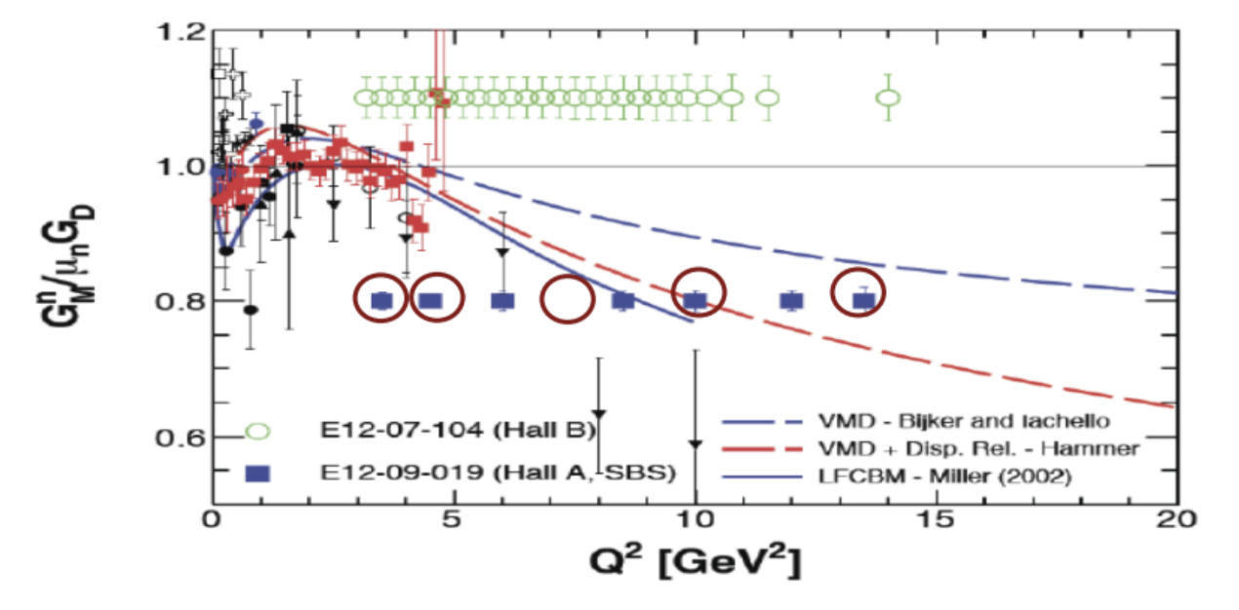
G_{M}^{n} Program and Kinematics
G_{M}^{n} completed in winter with five Q² points and six kinematics
Q² = 3,4.5,7.5,10,13.6 GeV² completed, extending global data significantly
One extra kinematic at Q² = 4.5 GeV² at a different virtual photon polarization for nTPE
G_{M}^{n} will constrain global parton distributions (GPDs) for broader physics applications and increased understanding of hadronic structure
As first measurement of electron-neutron Rosenbluth slope for 50 years, nTPE will help to resolve the Form Factor Ratio Puzzle (FFRP)
GMn Q2 Region of Interest
nTPE Q2 Region of Interest
Plots: Andrew Puckett

Slide 8
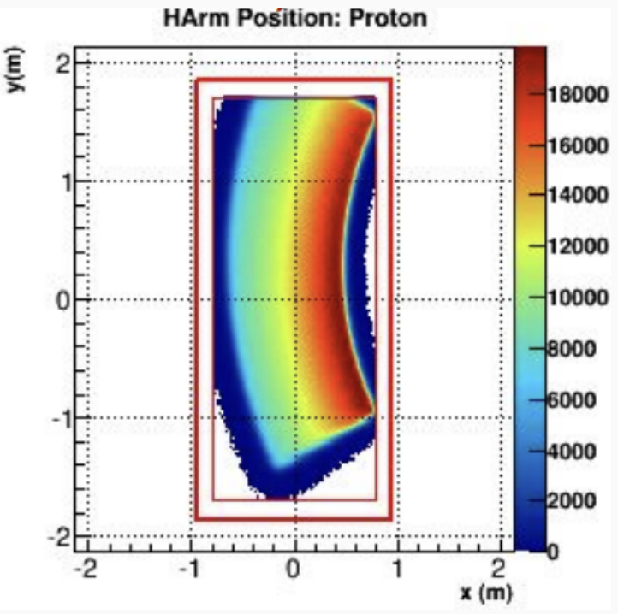
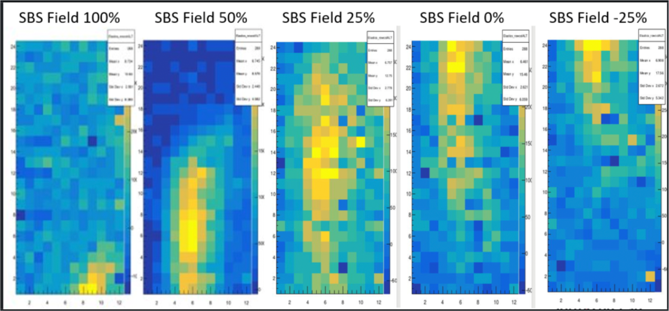
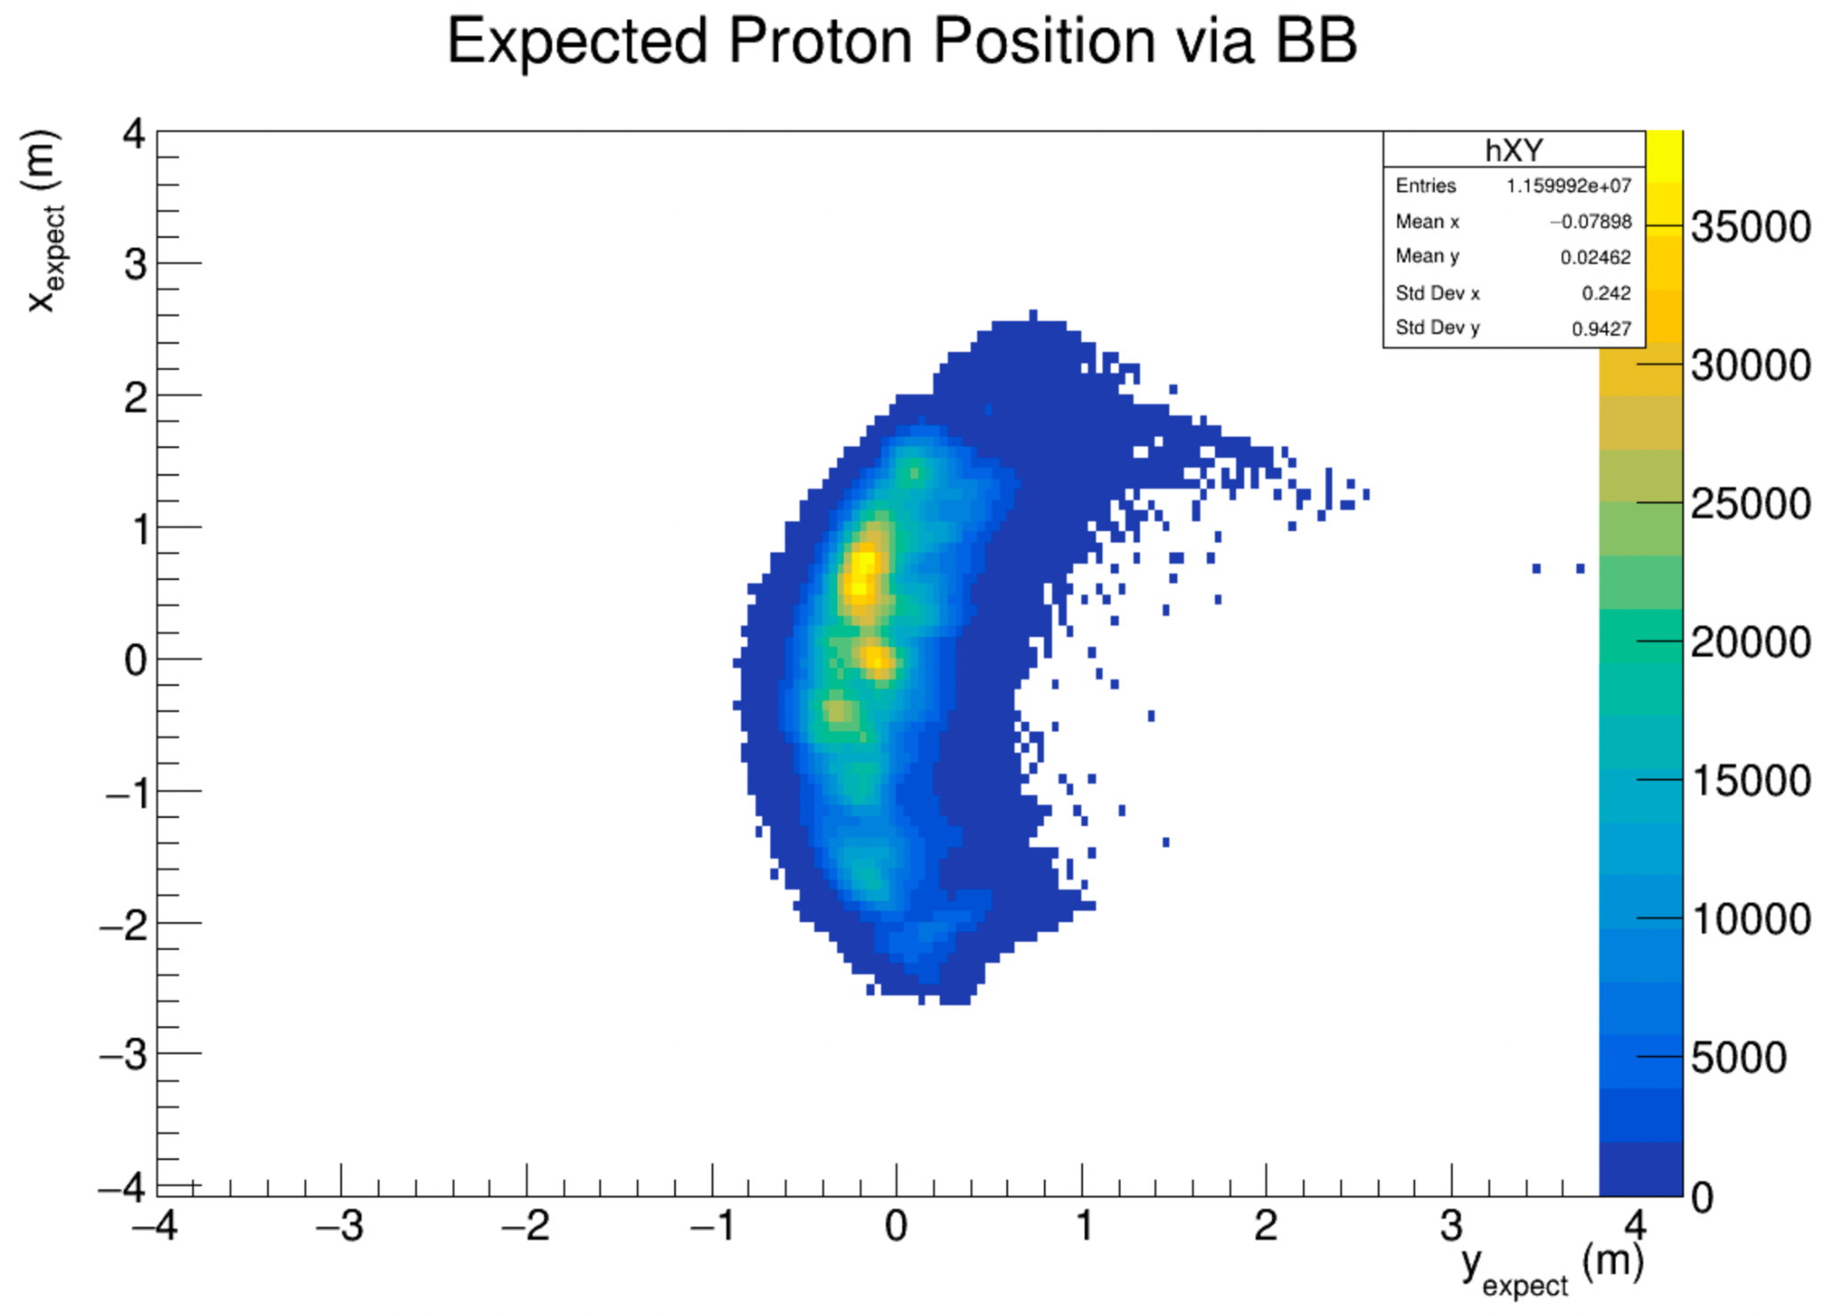
G_{M}^{n} Performance - Elastic Protons
Commissioning of HCal with elastic protons
Liquid hydrogen target at Q² = 1 GeV² for protons high elastic yield
Verification of proton detection with SBS Dipole sweep over several field strengths
Simulated Expectation
G4SBS
SBS Field 0%
Expectation from BigBite Arm electron track
SBS Field 0%
Data in HCal with rough elastic timing cut during commissioning
Simulated Expectation Plot: Scott Barcus

Slide 9
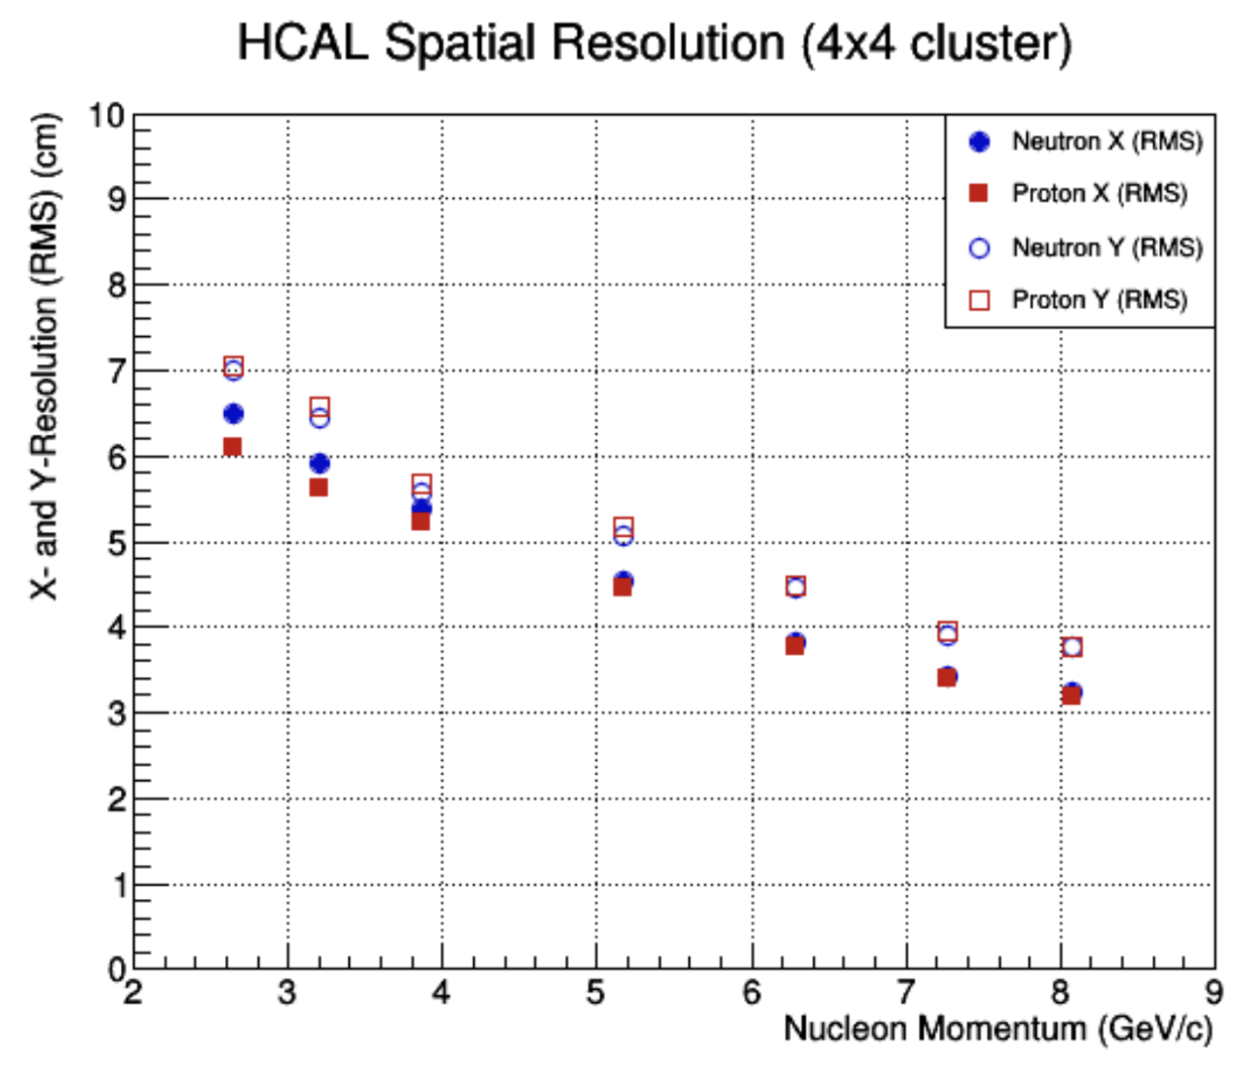
G_{M}^{n} Performance - Position Resolution Simulations
SBS experiments require HCal to have high position resolution, especially for high Q² measurements
2.5 GeV nucleons are expected to have 6-7 cm resolution in dispersive direction.
8 GeV nucleons are expected to have 3-4 cm resolution in dispersive direction.
Plot: Juan Carlos Cornejo

Slide 10
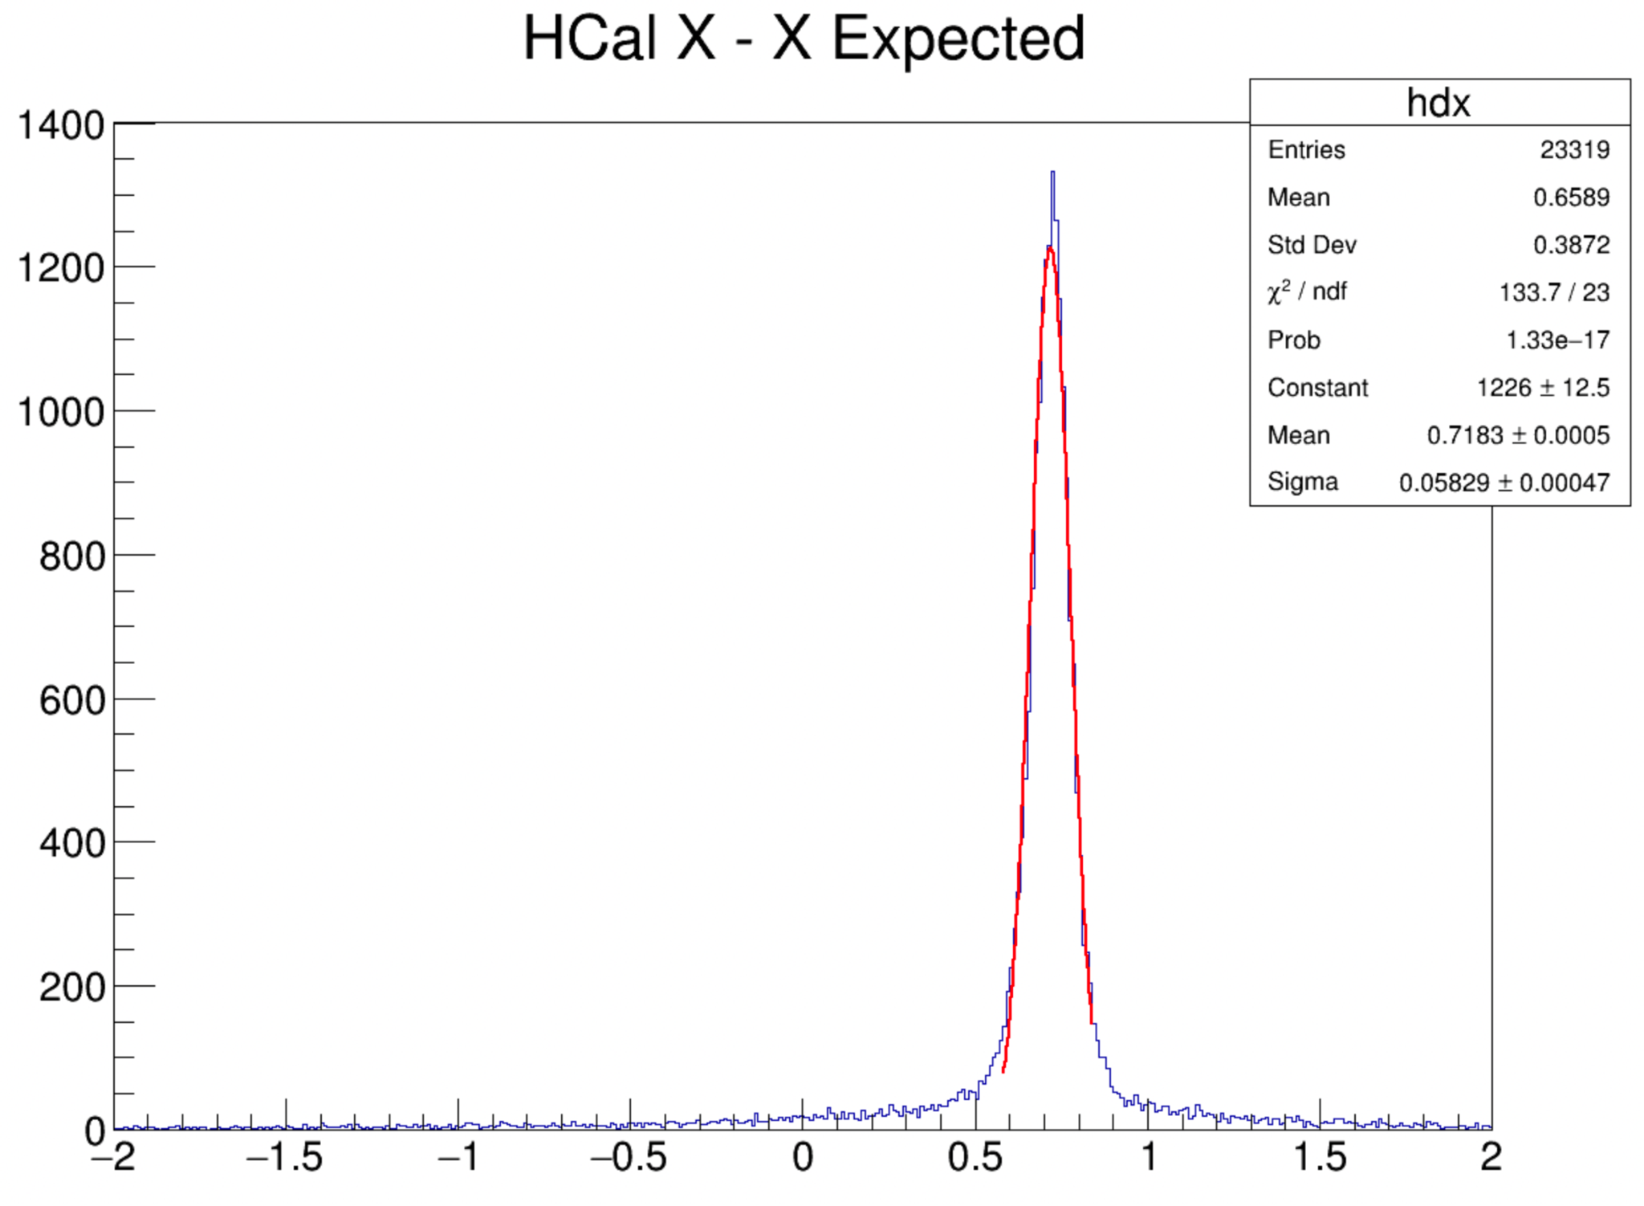
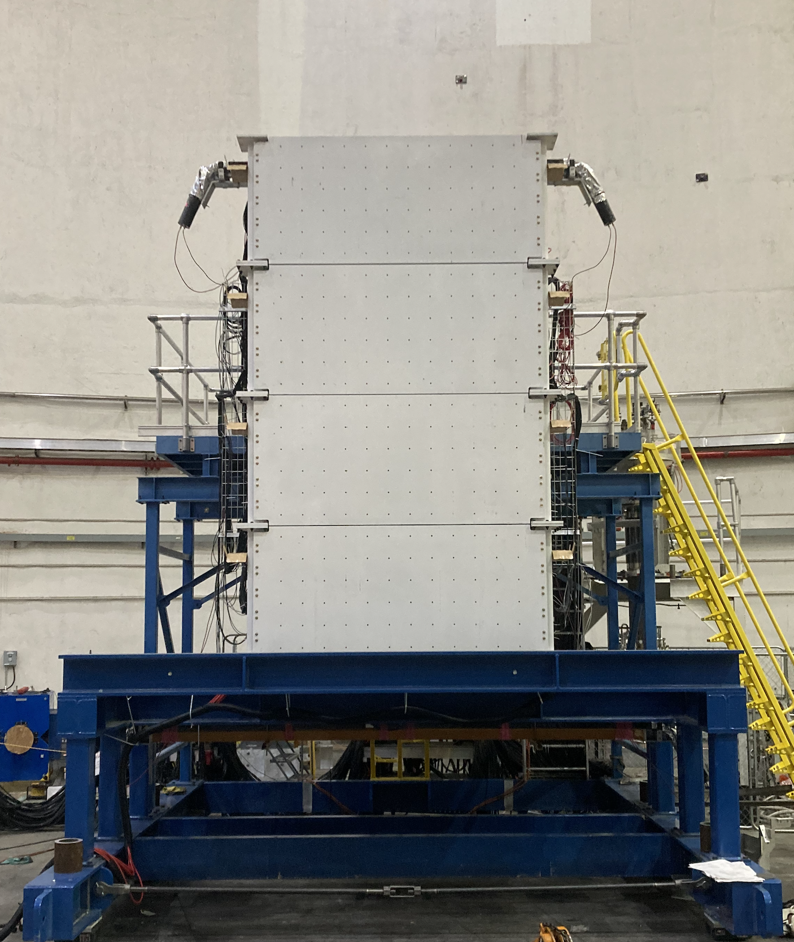
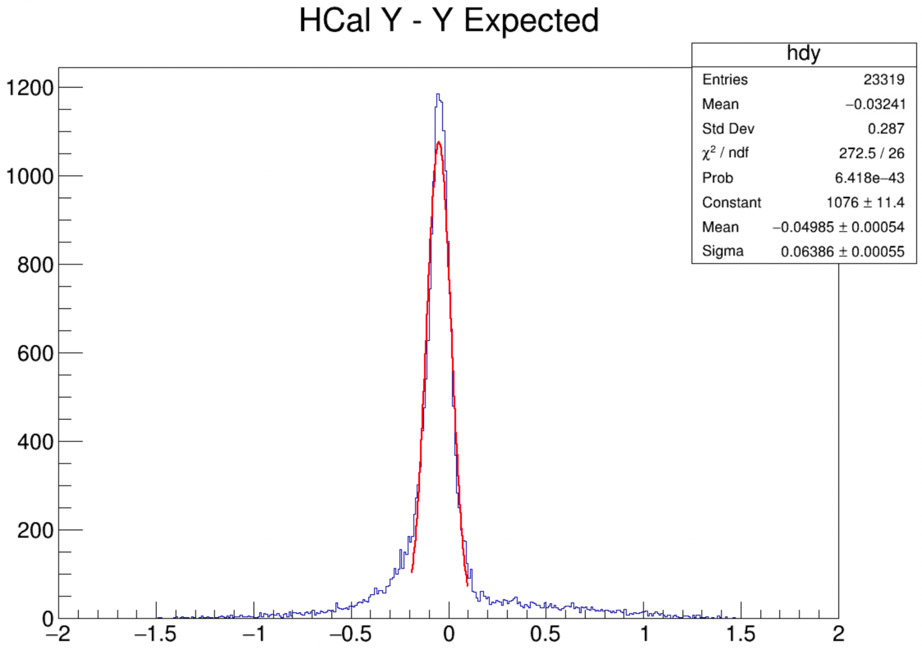
G_{M}^{n} Performance - Position Resolution Preliminary
Hydrogen target (scattered protons)
SBS field 0% (no proton displacement)
Expected position of scattered nucleons calculated from reconstructed quasielastic electron tracks in BigBite
Take the difference between energy-weighted center of cluster in HCal and expected position
Nucleon momentum for these data ~ 2.9 GeV (SBS-8)
Dispersive Direction (X) Resolution ~ 5.8 cm
Transverse Direction (Y) Resolution ~ 6.3 cm
Preliminary position resolution meets simulated expectations!
Dispersive Direction
Transverse Direction

Slide 11
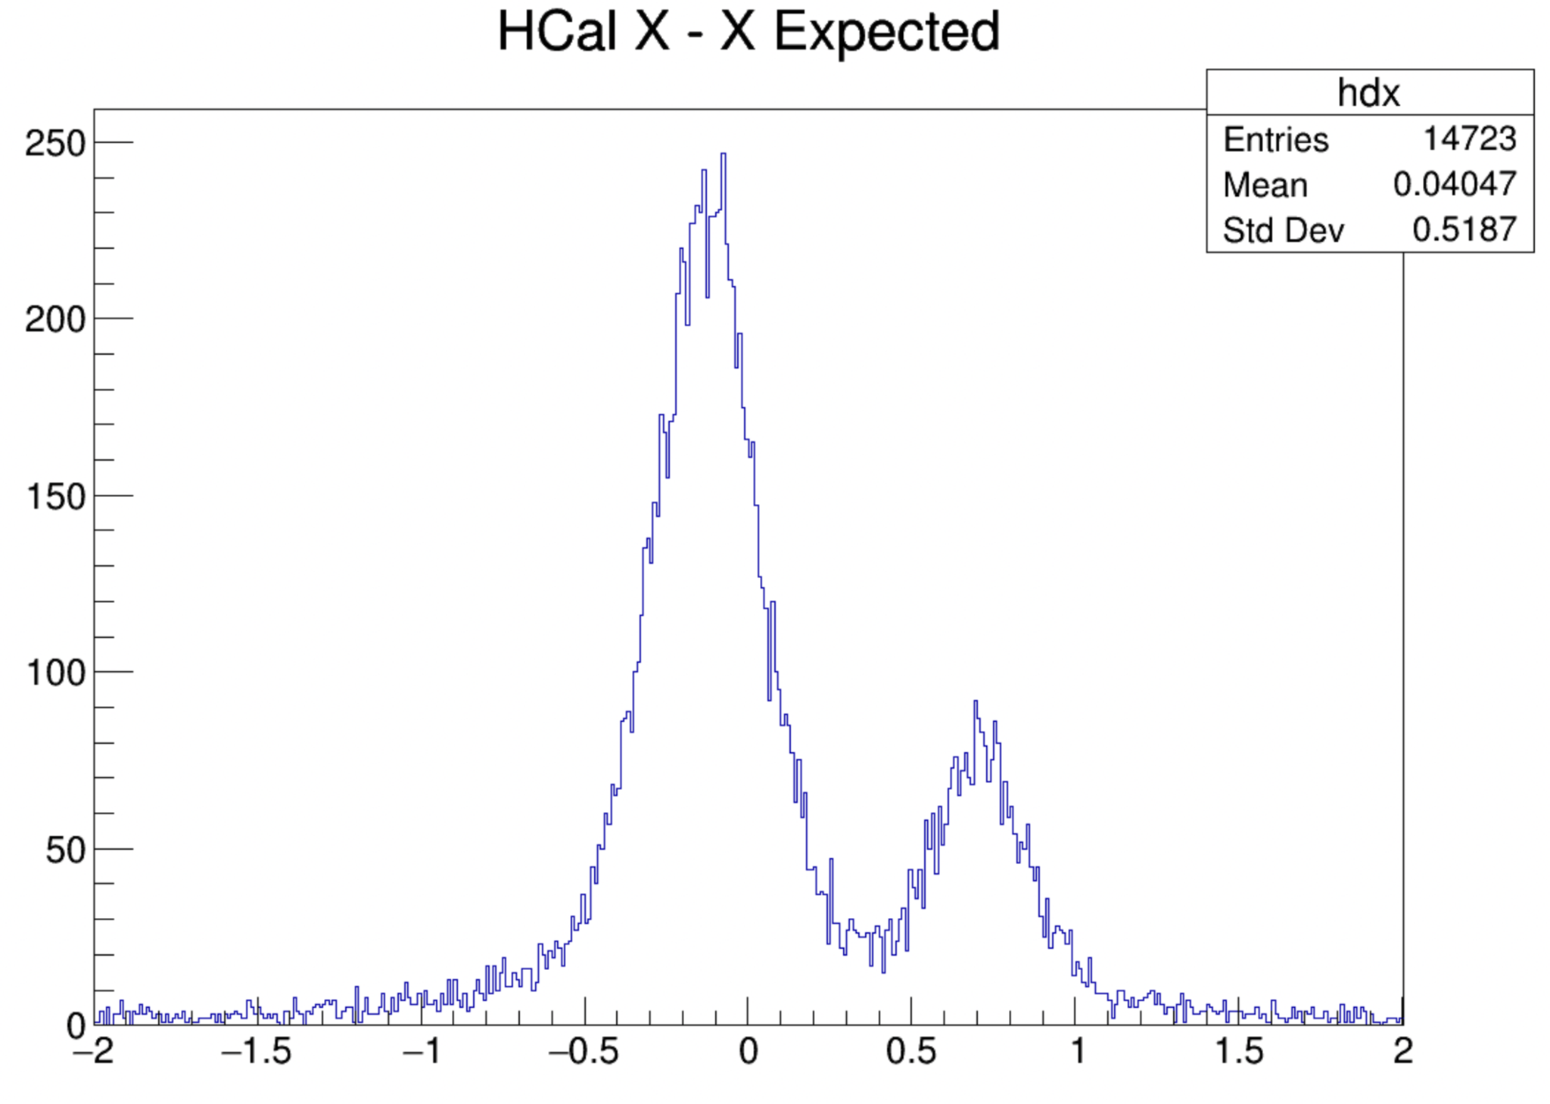
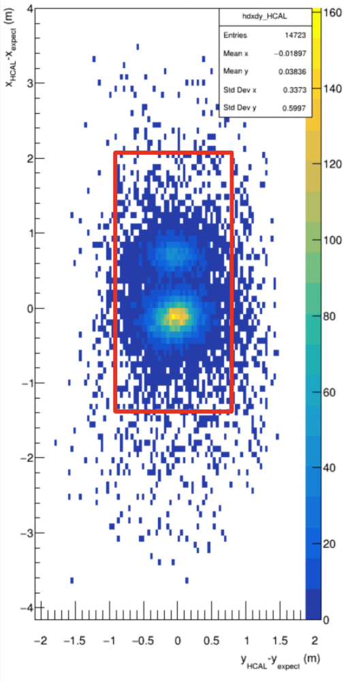
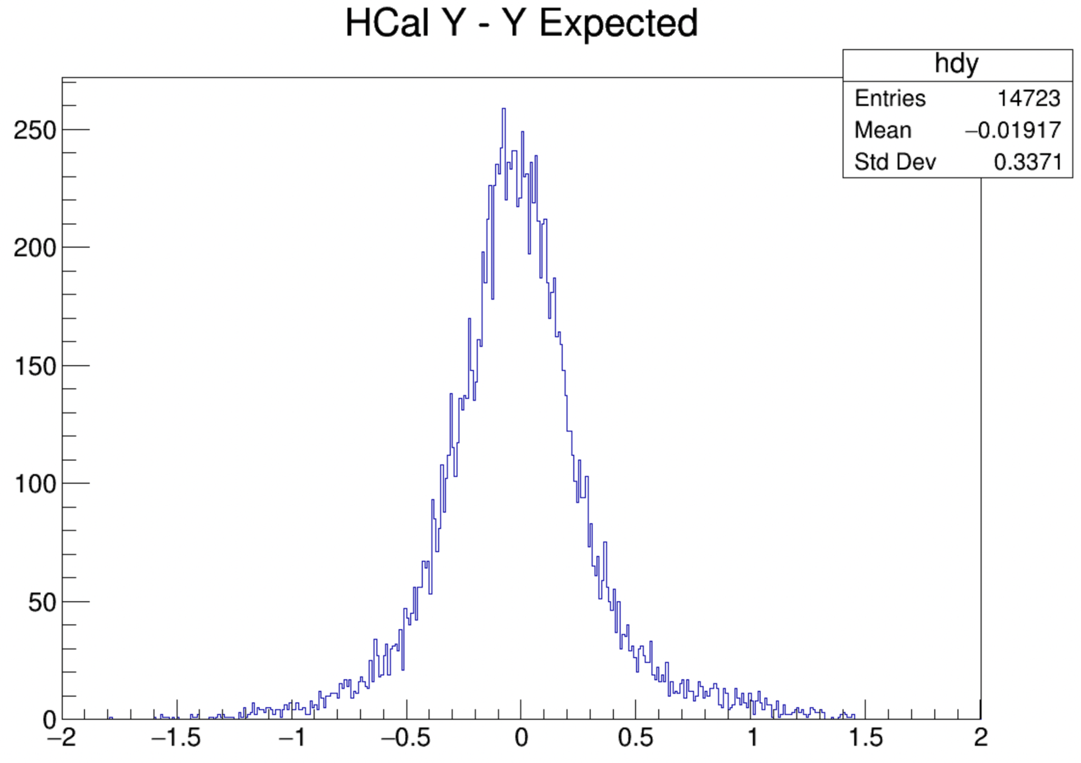
G_{M}^{n} Performance - Nucleon Position, Deuterium
Deuterium target (scattered protons and neutrons)
SBS field 30% (protons displaced ~90 cm)
Once again, take the difference between energy-weighted center of cluster in HCal and expected position
Nucleon momentum for these data ~ 3.0 GeV (SBS-8)
Distributions broadened due to fermi smearing and other effects
Neutron peak in clear view

Slide 12
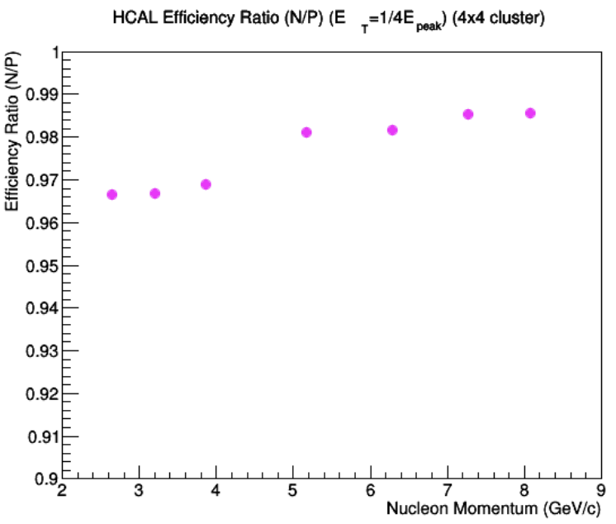
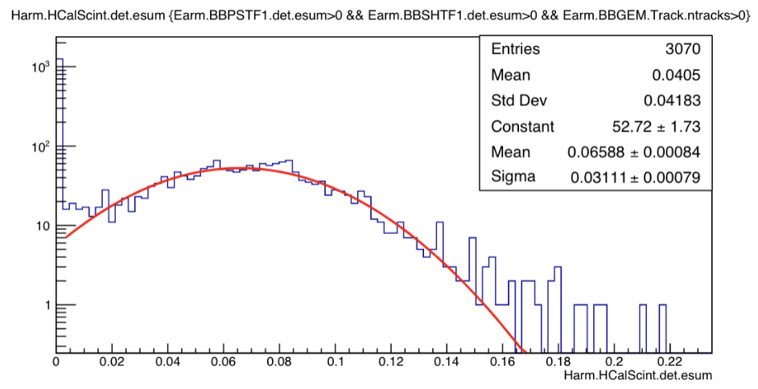
G_{M}^{n} Performance - Sampling Fraction
Ratio measurements require comparable detection efficiencies across HCal
n/p cross section ratio becomes inaccurate if detection is biased to one scattered nucleon
n/p efficiency ratio expected from simulation
eff ≈ 0.985 at 7-8 GeV
eff ≈ 0.966 at 2.5-4 GeV.
Detection efficiency must be uniform!
SBS Dipole field displaces protons on HCal
Calculate expected position of scattered nucleon with reconstructed electron track in BigBite
Check uniformity of detected energy / expected energy across HCal - this is the sampling fraction
Simulations predict sampling fraction of 6.6%
Sampling Fraction (With Cut on BB Track)
Simulation Plots: Juan Carlos Cornejo (top) and Eric Fuchey (bottom)

Slide 13
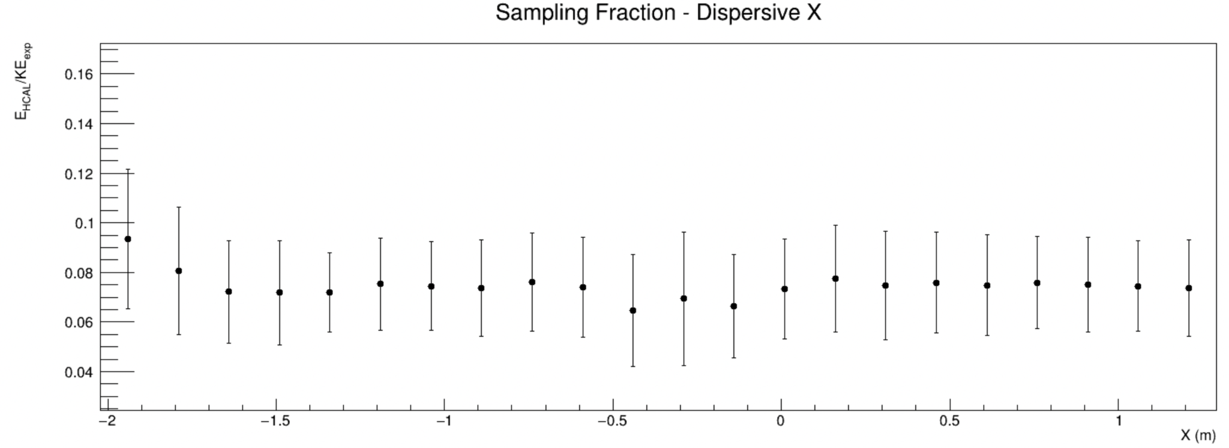
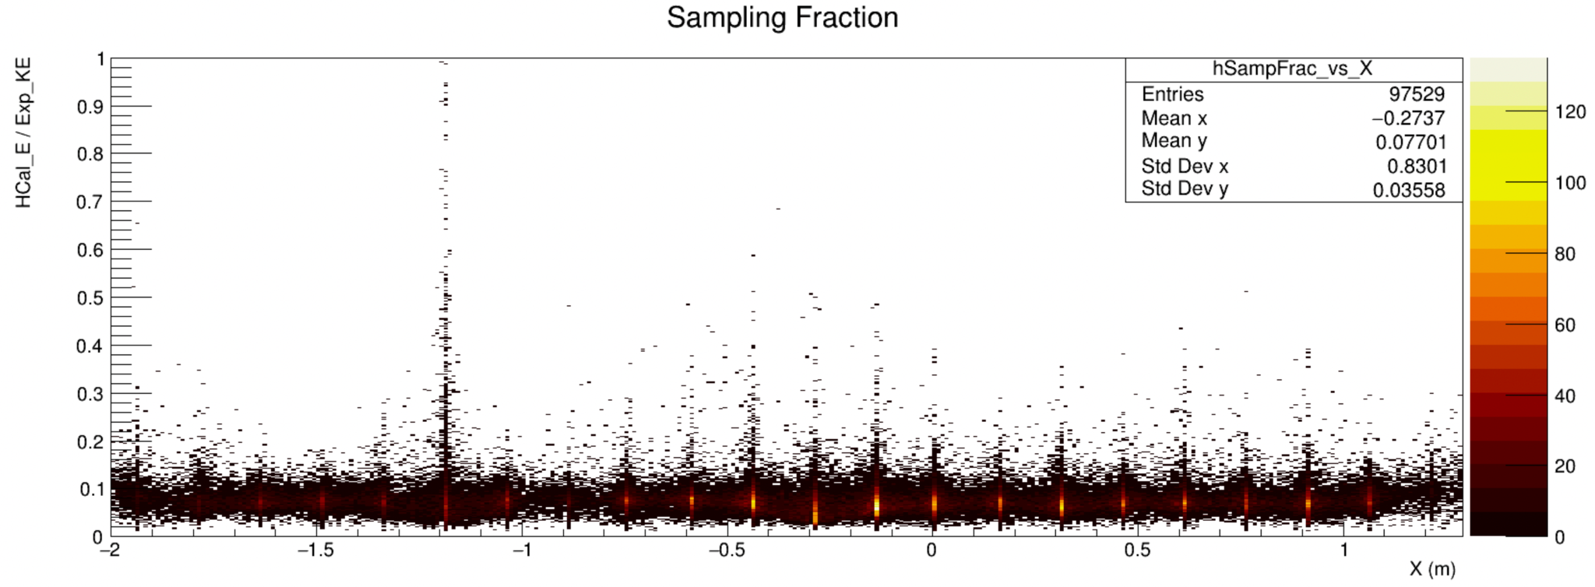
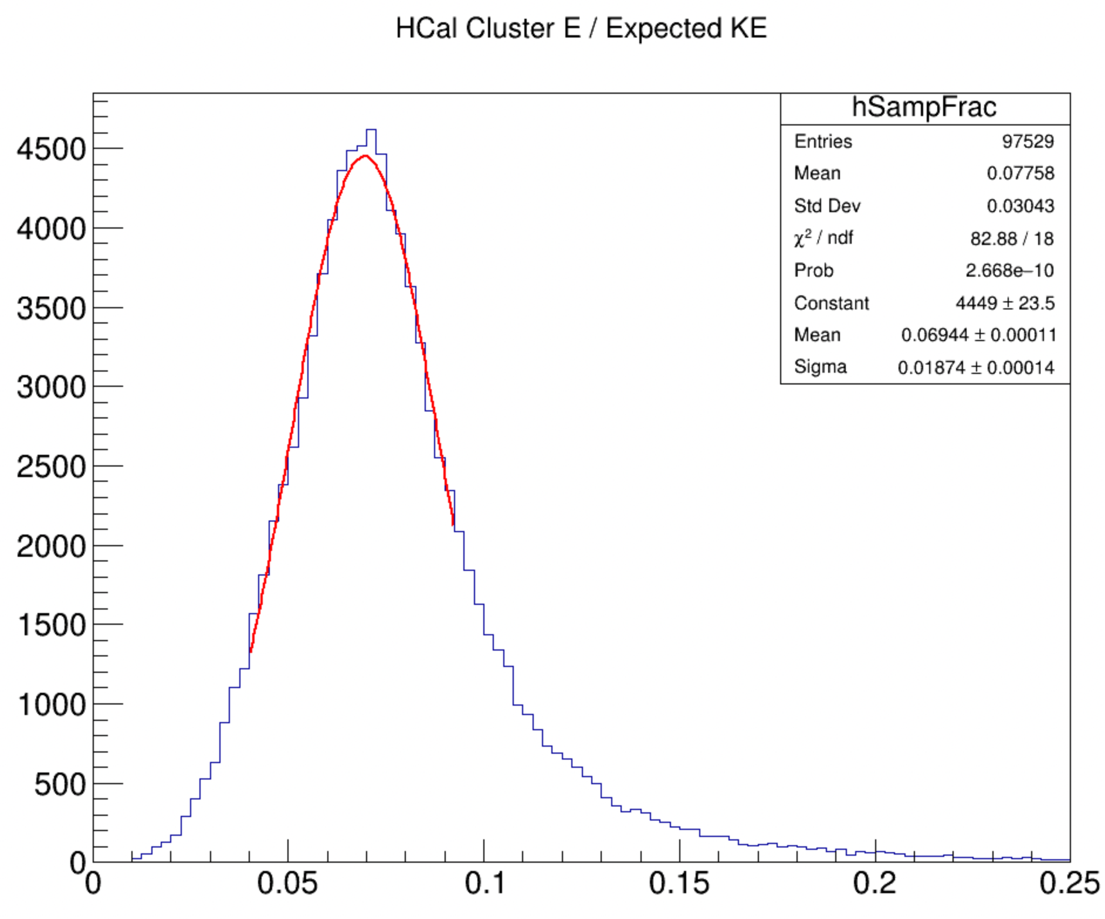
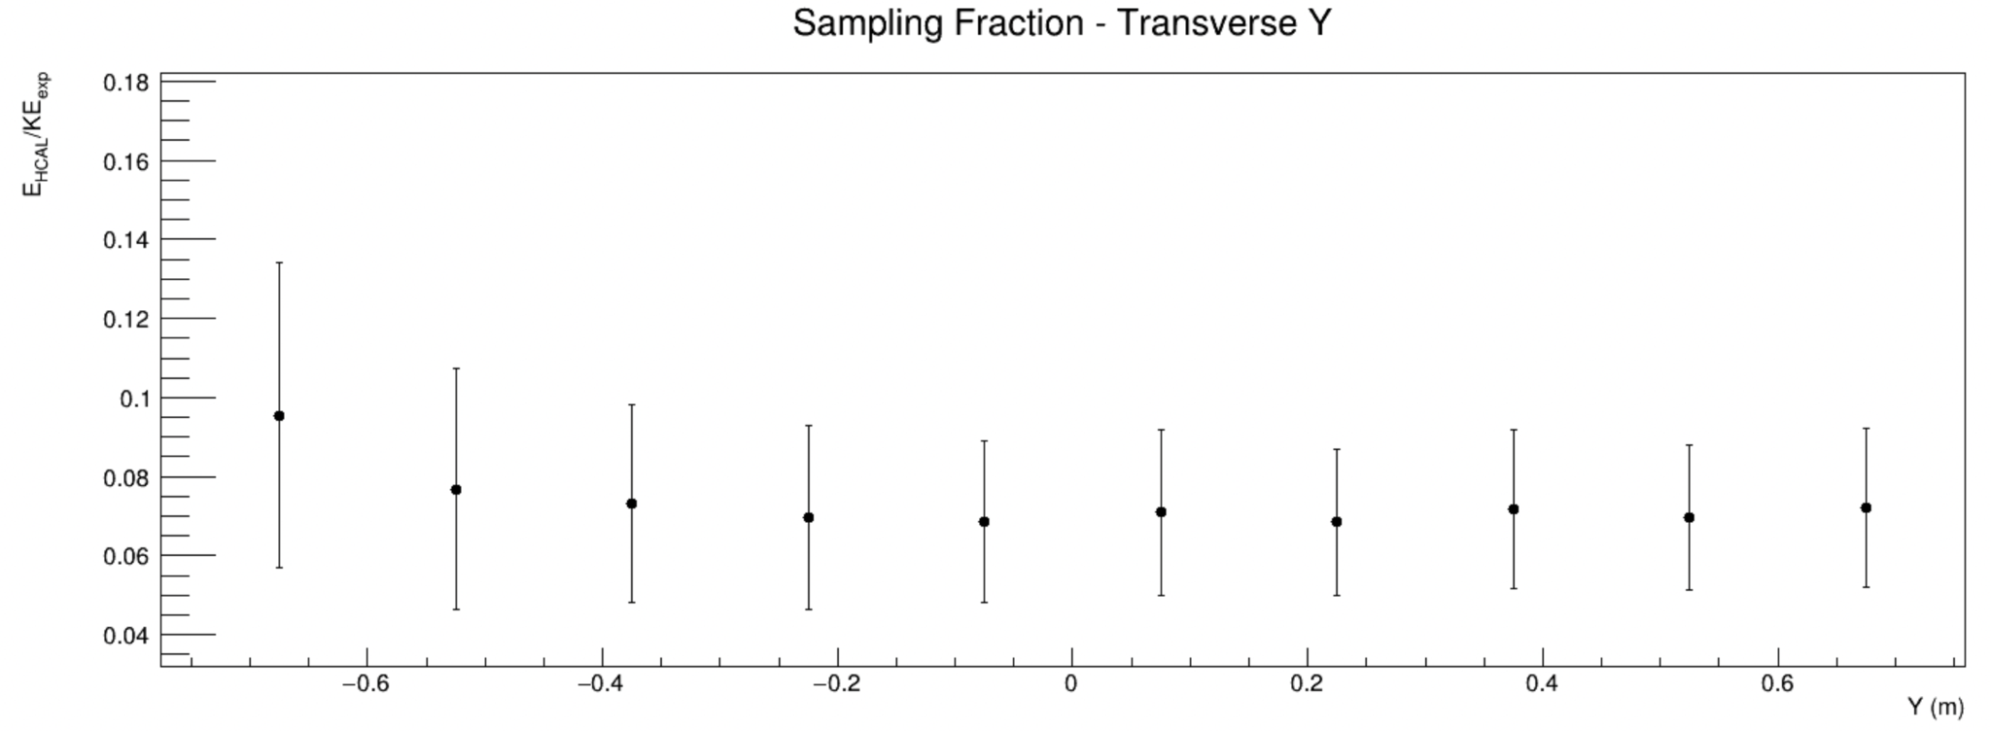
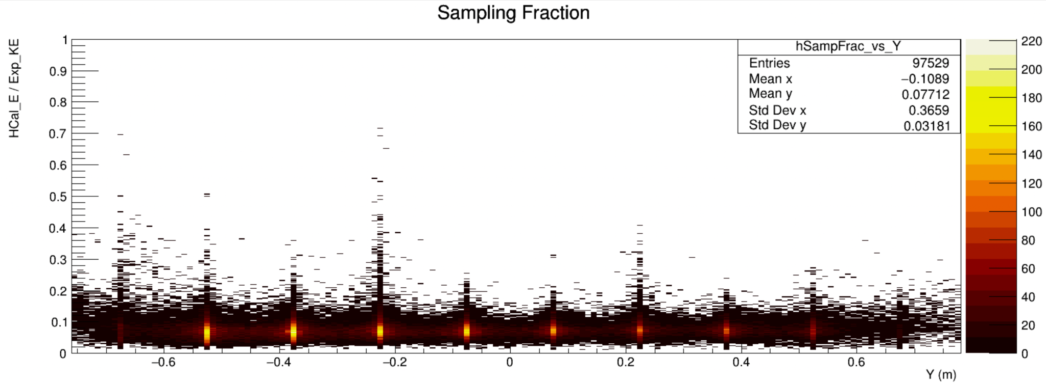
G_{M}^{n} Performance - Detection Efficiency Preliminary
E_{beam} ≈ 5.965 GeV, Q² ≈ 4.5 GeV² (SBS8)
Mean sampling fraction ≈ 6.9%
Uniformity by row (top, dispersive)
Uniformity by column (bottom, transverse)
Better uniformity expected after first pass data cooking and recalibration

Slide 14
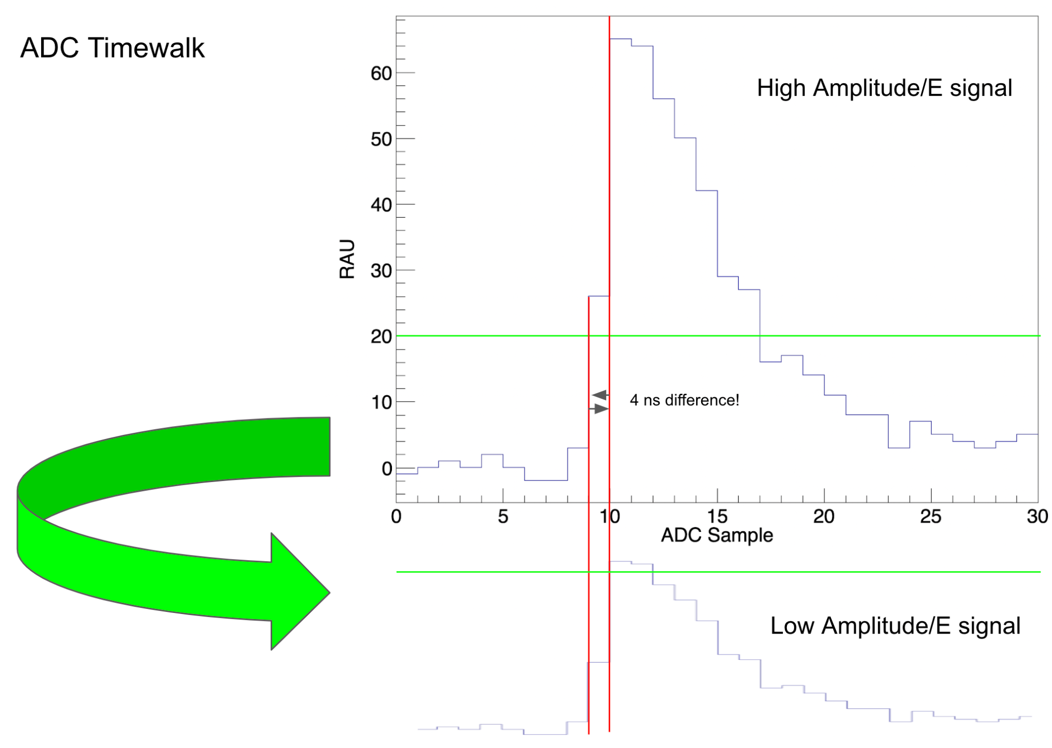
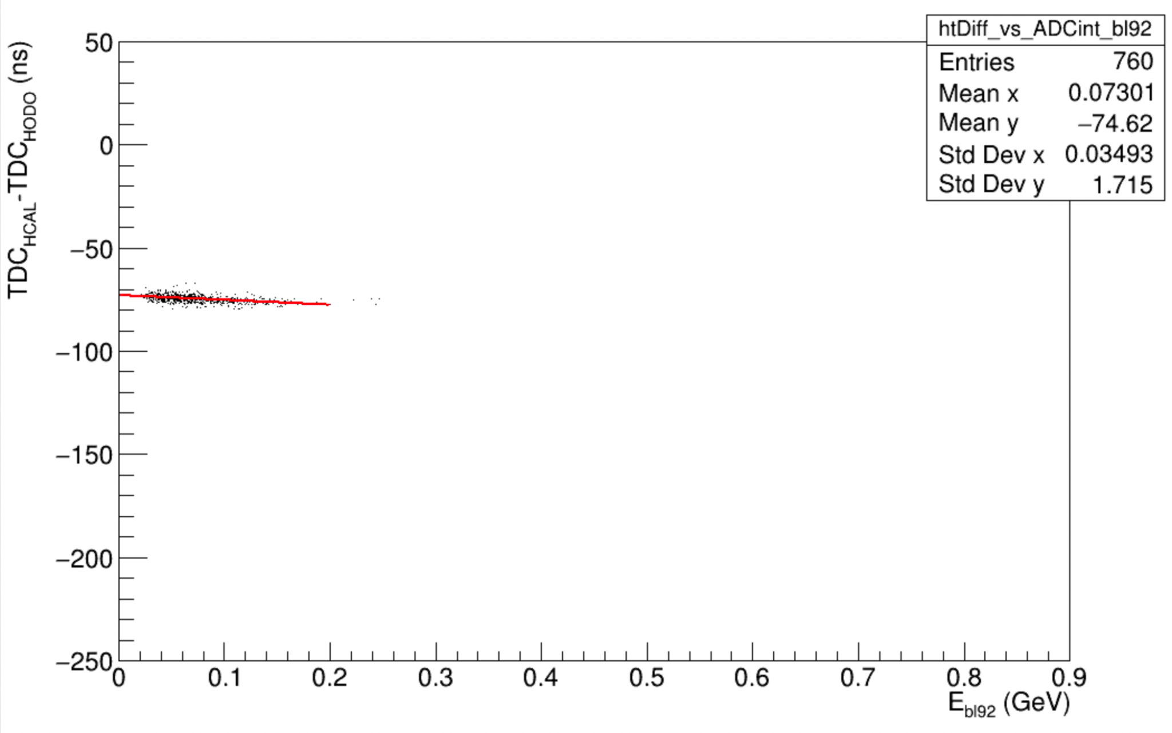
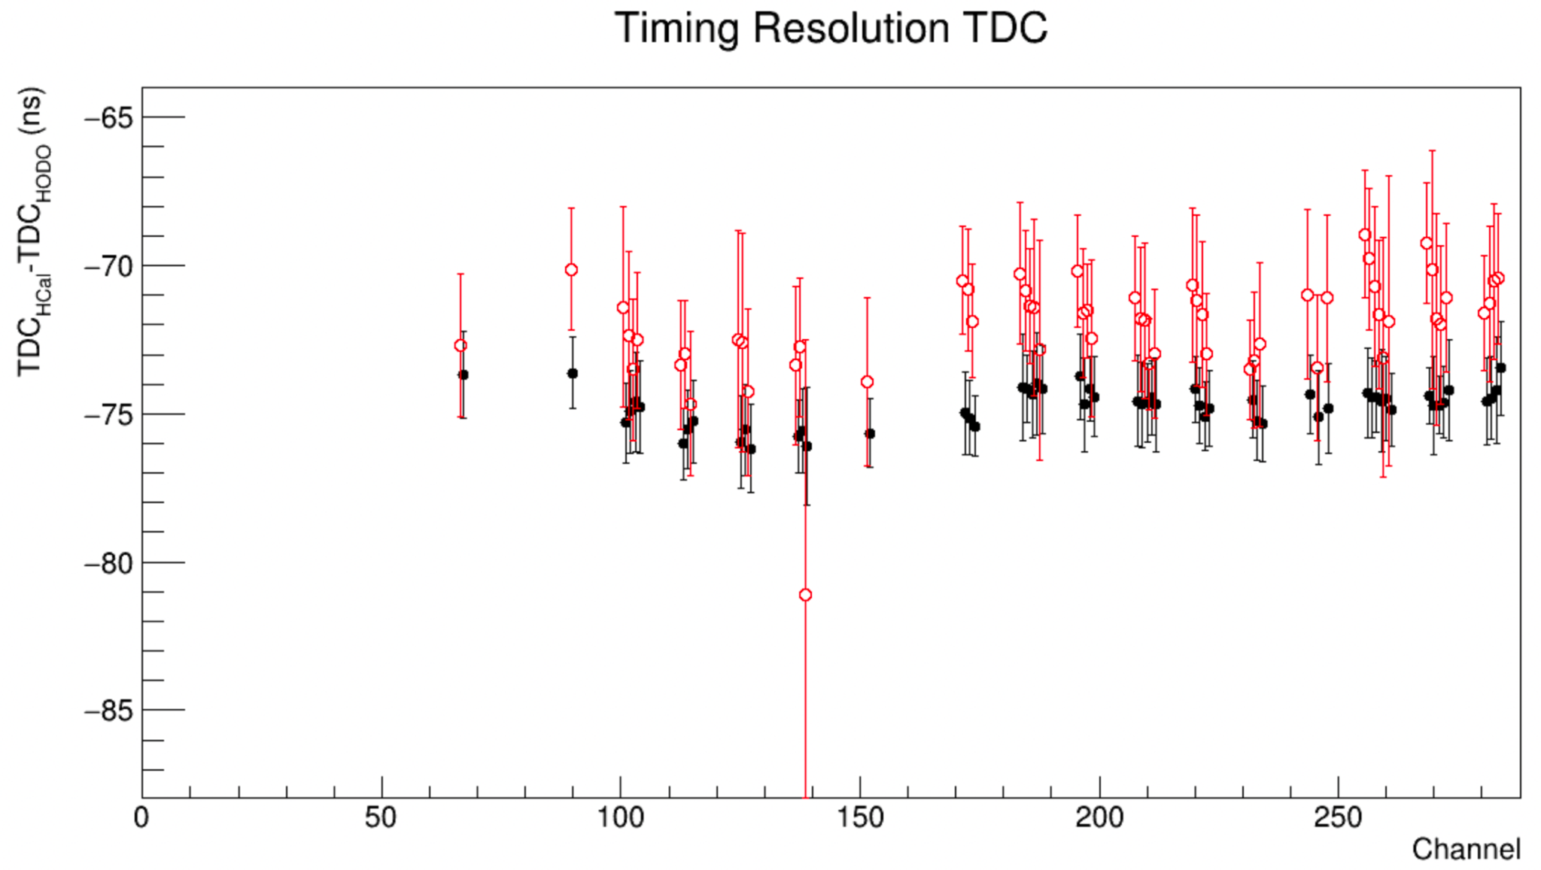
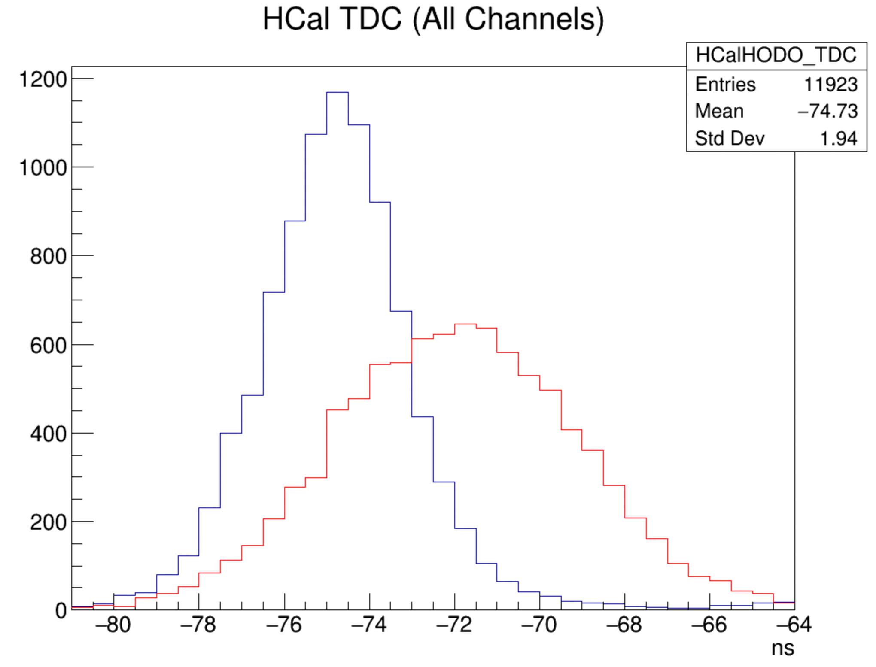
G_{M}^{n} Performance - Timing Resolution
Expected TDC timing efficiency by design ≈ 0.5 ns
Both ADC and TDC have timing resolution
TDC better, but both are investigated
Significant jitter exists on HCal TDC signals from several sources
Timewalk: Rising edge of raw signal impacted by amplitude
Time of flight (TOF): Scattered nucleons have different momenta and take different paths to HCal
Trigger: Electronics jitter from BigBite trigger impacts reference time for all signals
Each can be addressed
Timewalk: Apply exponential energy-dependent correction to timing per event
TOF: Reconstruct momenta and energy using BigBite electron track and apply corrections to timing per event
Trigger: Use RF-corrected hodoscope timing as reference
Fit to time difference vs energy deposited
Apply correction from fit to shift timewalk back to nominal
Uncorrected, elastic cuts
Trigger and Timewalk
corrected, elastic cuts

Slide 15
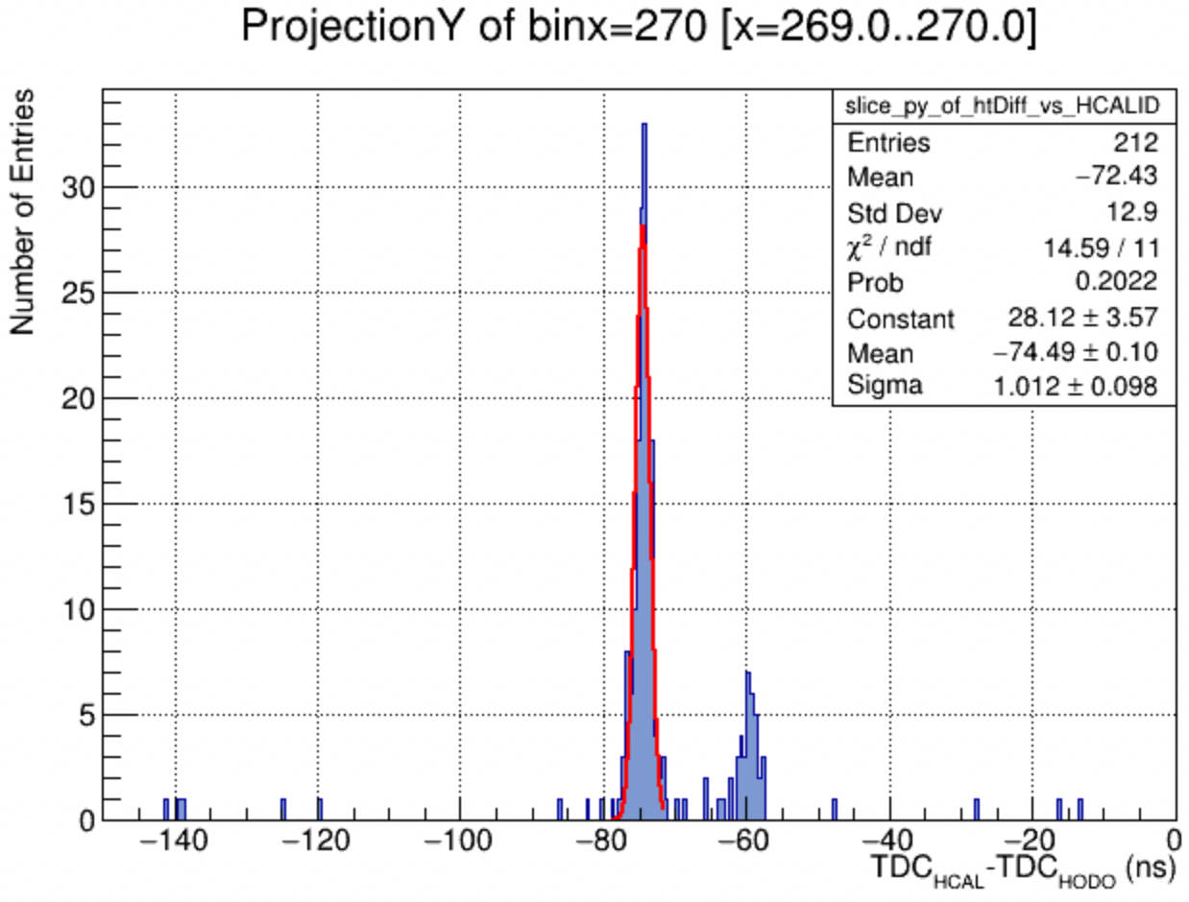
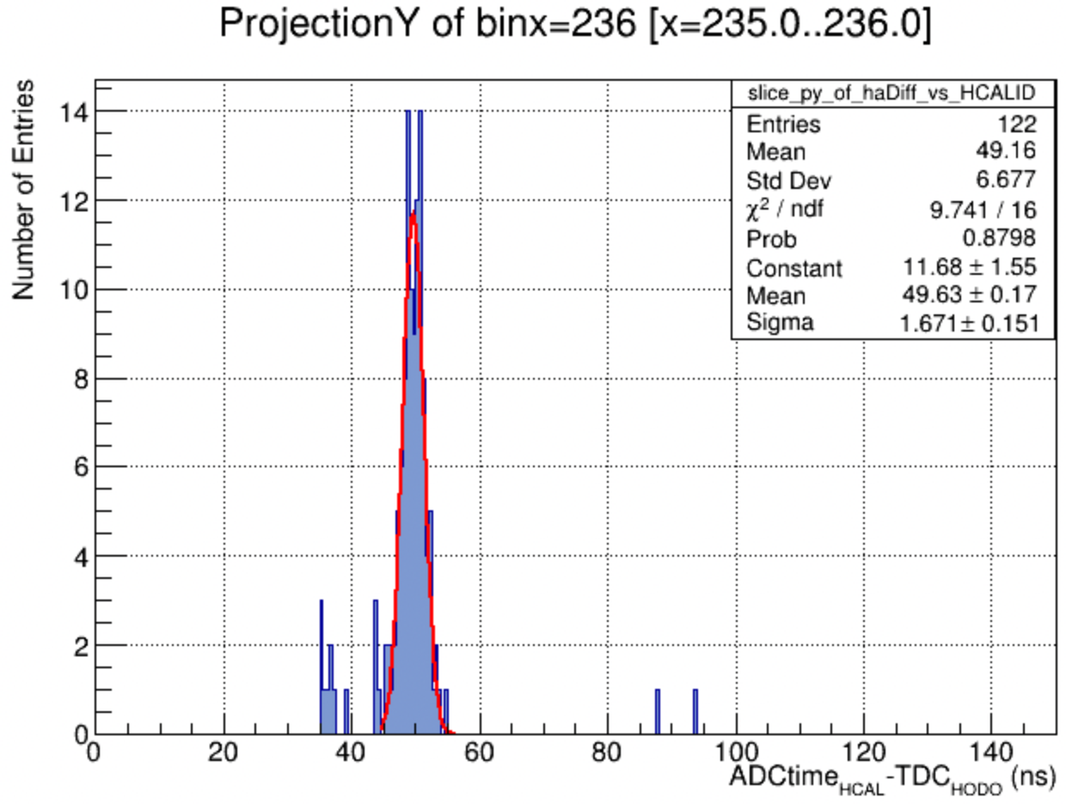
G_{M}^{n} Performance - Timing Resolution Preliminary
Strict elastic cuts and expected position cuts on scattered quasielastic protons
Mean TDC resolution over all channels ≈ 1.4 ns (as good as 1.0 ns)
Mean ADC time resolution ≈ 2.4 ns (as good as 1.7 ns)
Improvements expected
Prior to first pass, data are sparse
TOF, timewalk corrections pending first pass cooking
Example Slices
TDC
ADC time

Slide 16
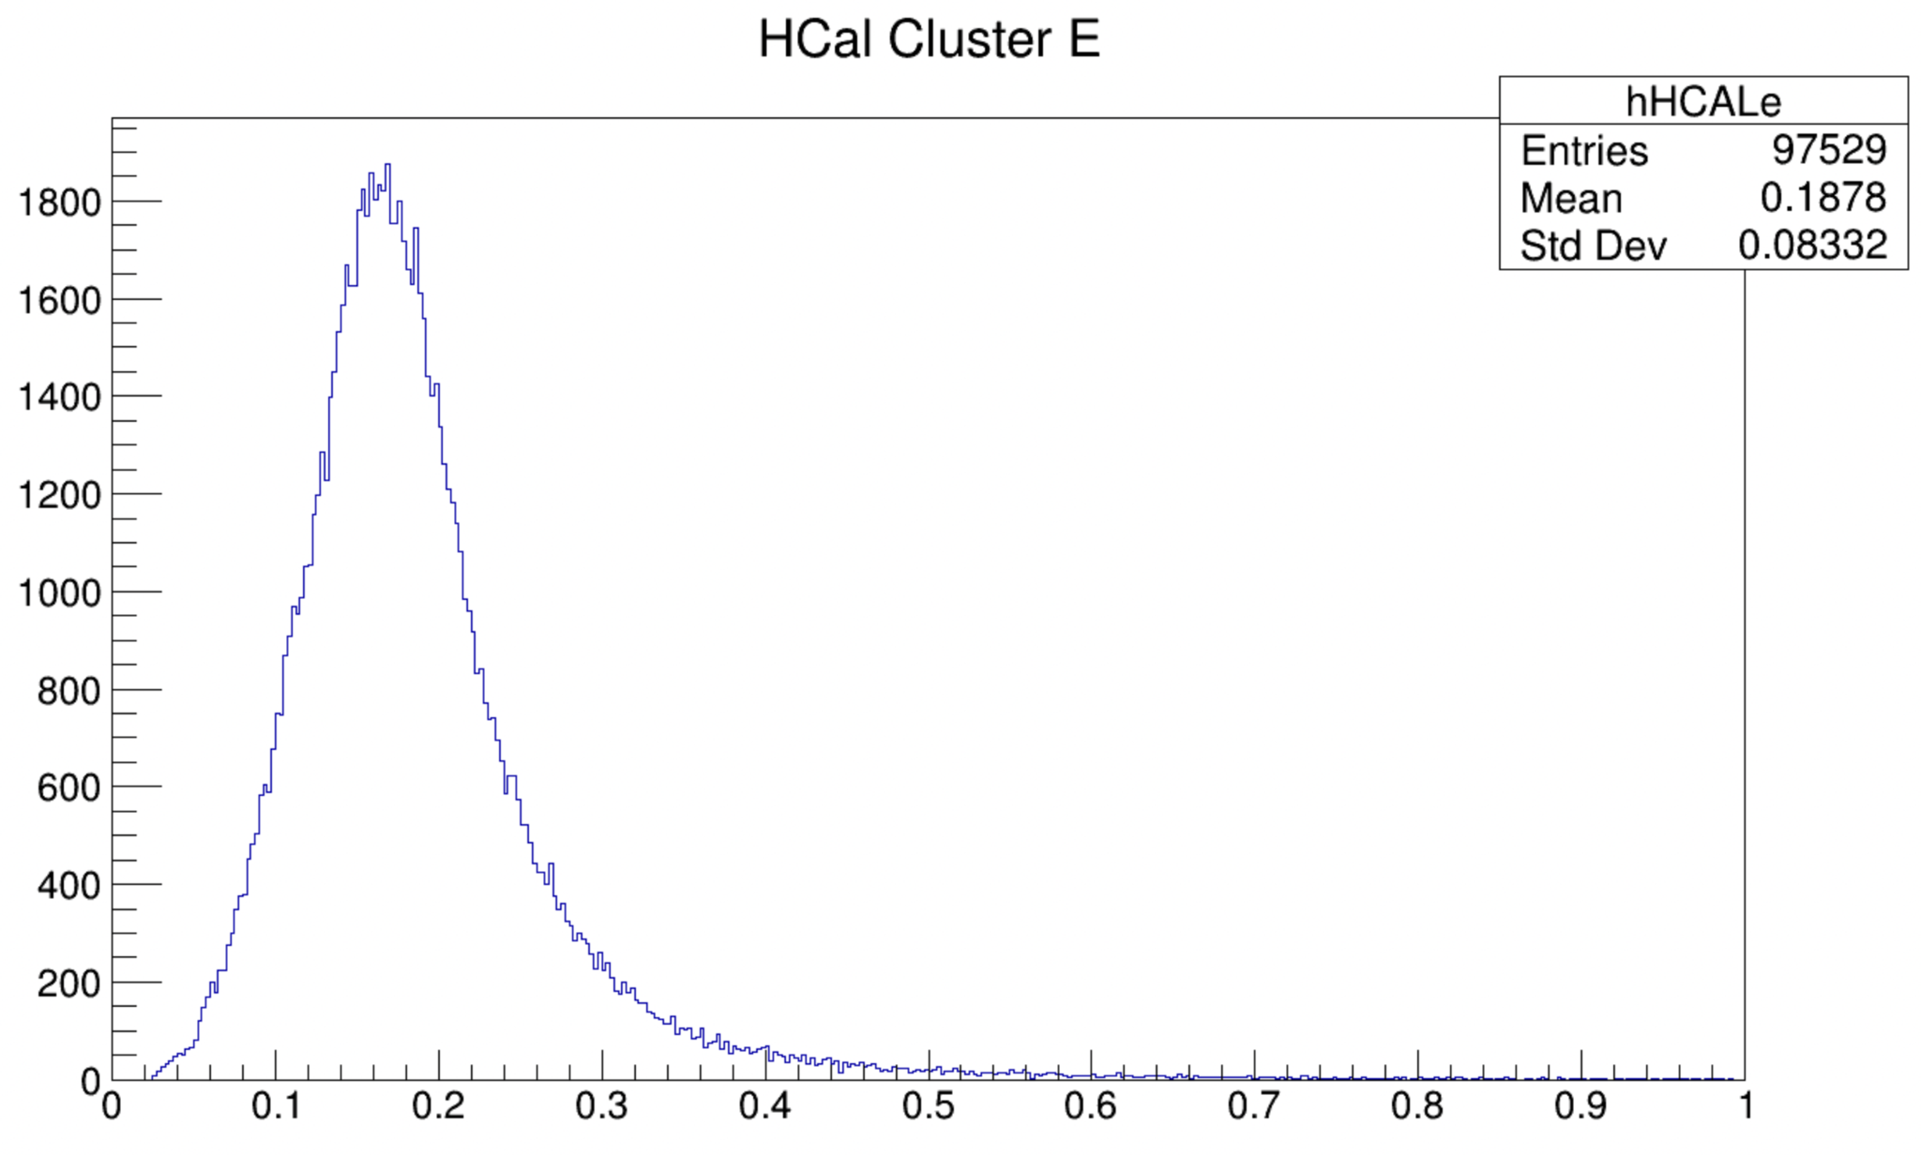
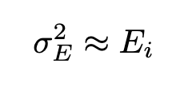
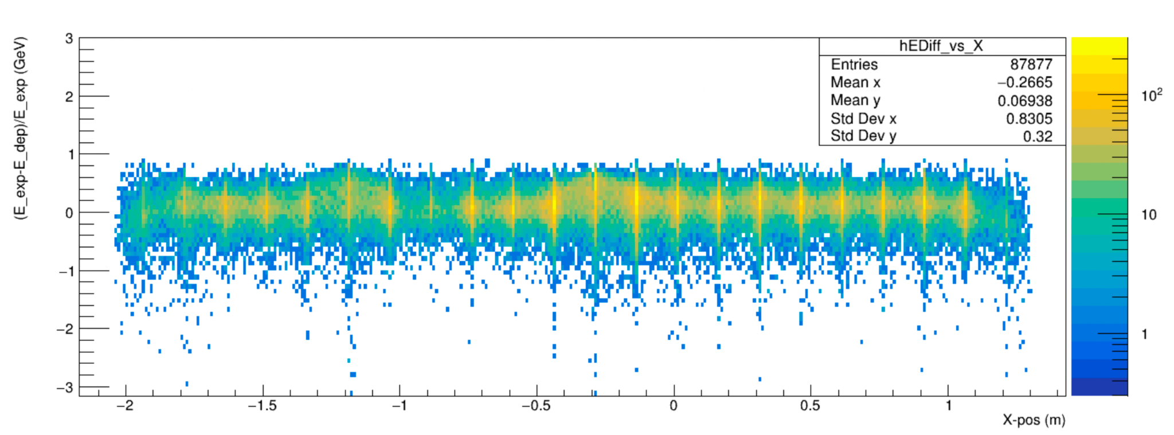
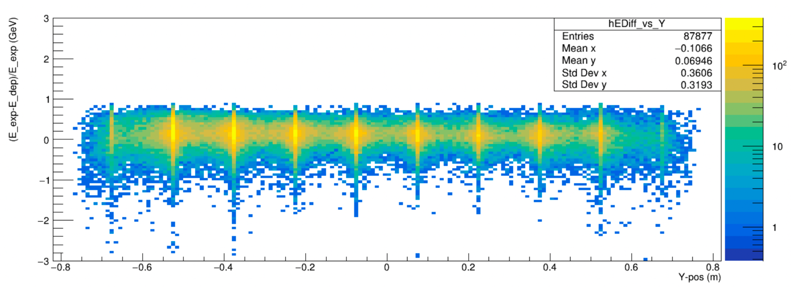
Calibrations - Energy
Energy Calibrations by channel from scattered protons at Q² = 4.5 GeV²
Relate ADC values (pC) to deposited energy (GeV)
c_{j} in GeV/pC
pC for integrated ADC waveforms
Indices i, j over hits within cluster
Energy E_{i}
Kinetic energy of hadron incident to HCal
Calculated assuming elastic scattering from BigBite track momentum and beam
Apply sampling fraction of 7.95% for HCal
Obtained from monte-carlo simulations
Chi squared minimization with linear system of equations relating energy deposited on single channel to total deposited energy of elastically scattered hadron in cluster per event.
Populate matrix with measured integrated ADC values (pC)
Reject cells with insufficient statistics
Set diag element for cell to 1, all coupled set to 0
Solve for coefficients via inversion of matrix
Apply coefficients by channel to convert ADC values to energy deposited in HCal!
Minimize

Slide 17
TDC vs Module
Calibrations - Timing
Align ADC time and TDC signals from coincidence target events using elastically scattered protons at Q² = 3 GeV²
Elastic hadrons expected to arrive at HCal in time relative to the BigBite single arm trigger (reference time)
Cut on elastic events using q-vector from BigBite arm and build distributions of ADC time and TDC time by channel
Make by-channel corrections to raw ADC time and TDC
Use hodoscope mean TDC to clean up jitter in reference time
Address energy-dependent timewalk corrections (not shown)
Apply time-of-flight corrections exploiting q-vector (not shown)
Select target time within ADC(TDC) window: 55ns(-75ns)
Extract mean ADC time and mean TDC and calculate offset to target times
Pass offsets by channel to achieve relative timing alignment between them!
ADC Time vs Module
Before
After
TDC vs Module
ADC Time vs Module

Slide 18
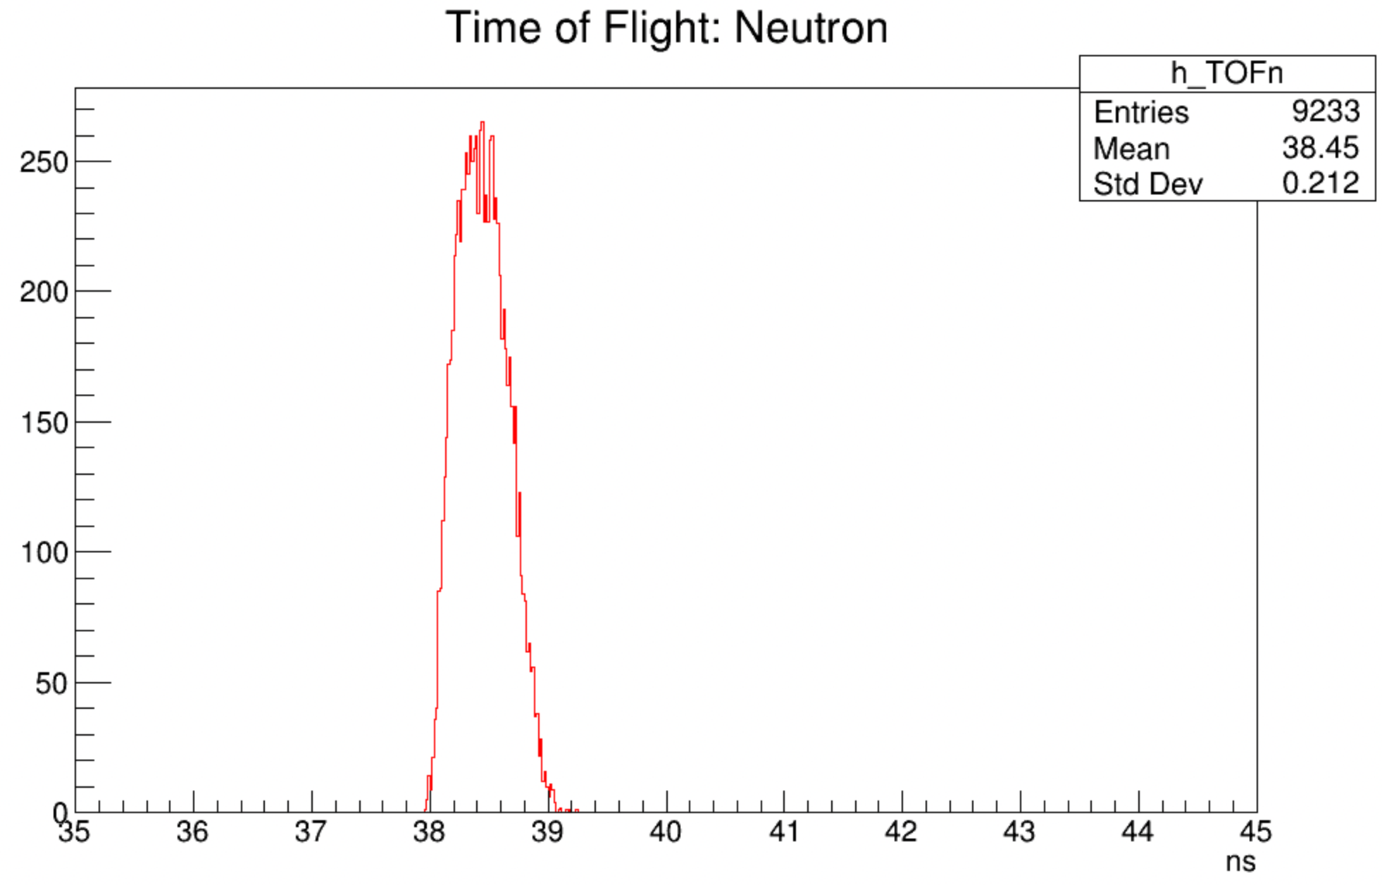
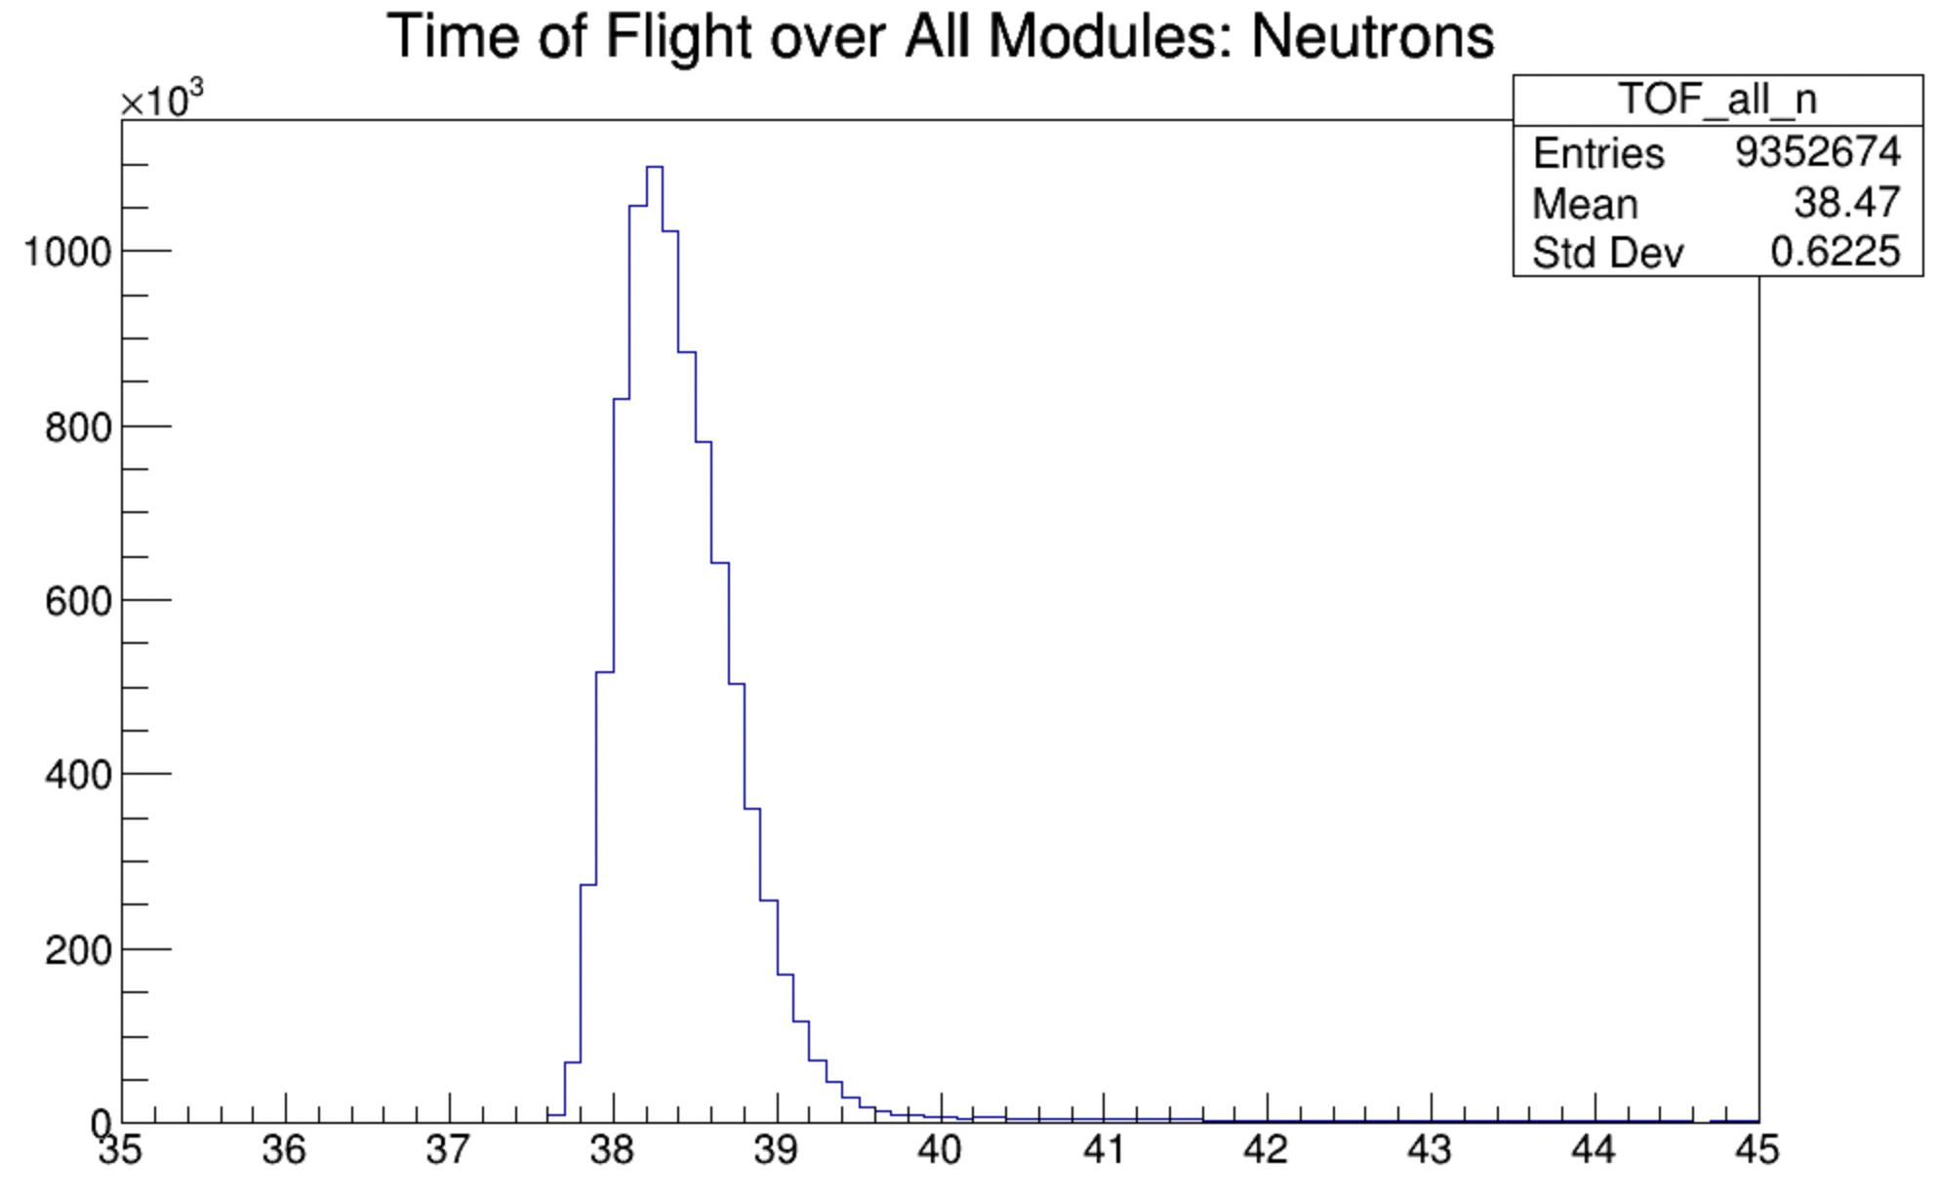
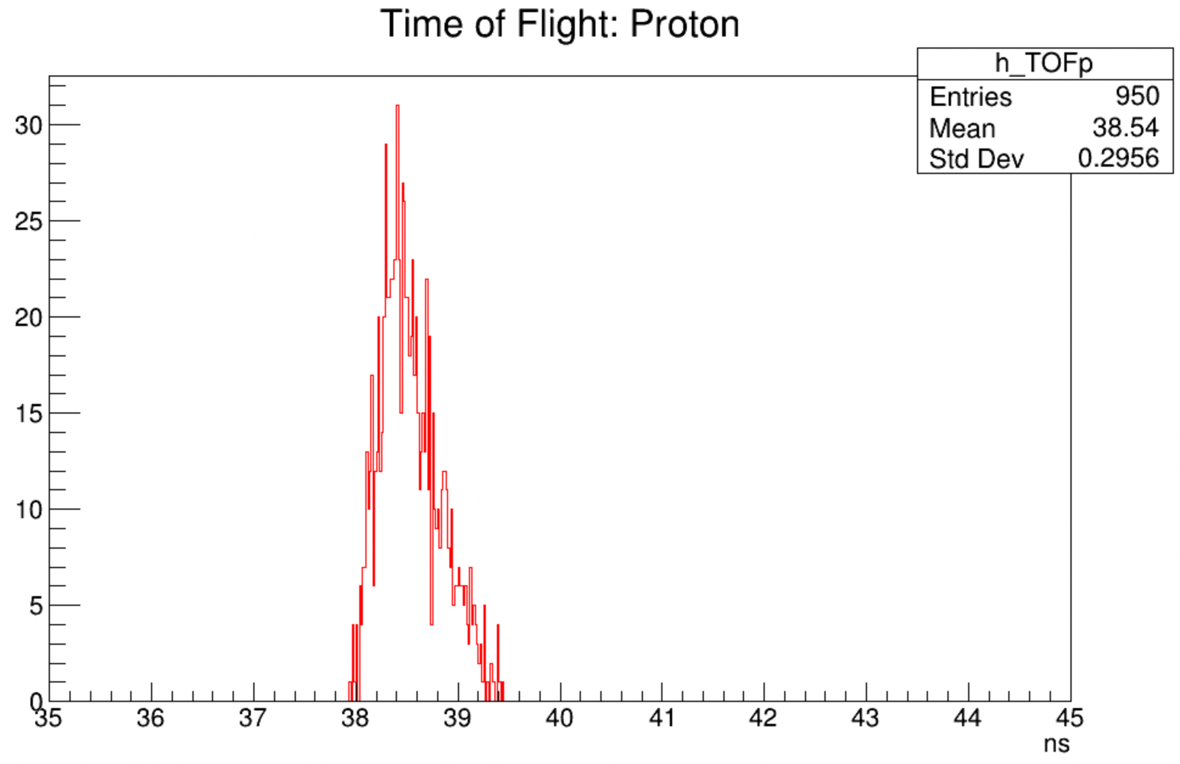
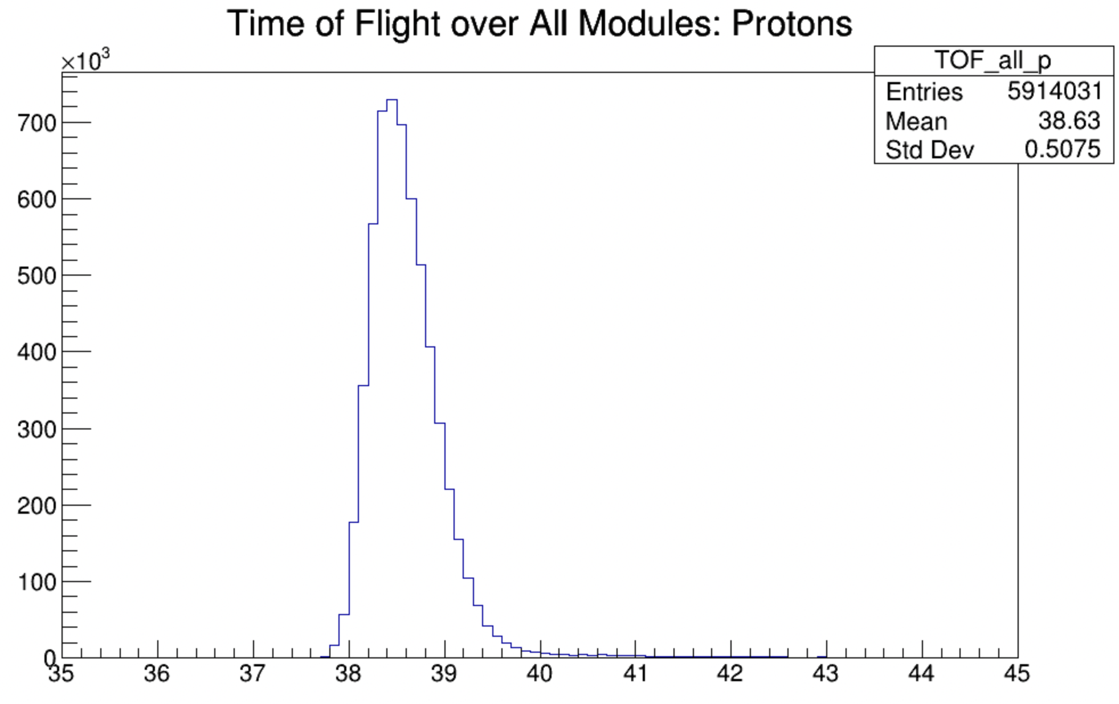
Corrections - Time of Flight
Calculate expected time of flight using e’ tracks and beta for SBS8
Find corresponding cluster TDC times in HCal (Red)
Build TDC distributions per channel, fit, and get mean TOF
Run simulations of SBS8 with magnetic field tuned to 30% field
Write script to take boundary crossing (BC) time from sensitive detectors (SD), the modules/channels in HCal (Blue)
Get simulated difference between event time and BC time
Use these times to improve timing cuts on elastics and to improve elastic cluster finding
Current clustering assumes highest energy cluster corresponds to elastic nucleon, which is not always the case
Judicious cuts on timing can eliminate high energy clusters which do not correspond to elastic nucleons, improving efficiency
Neutron (GMn vs Simulation)
Proton (GMn vs Simulation)

Slide 19
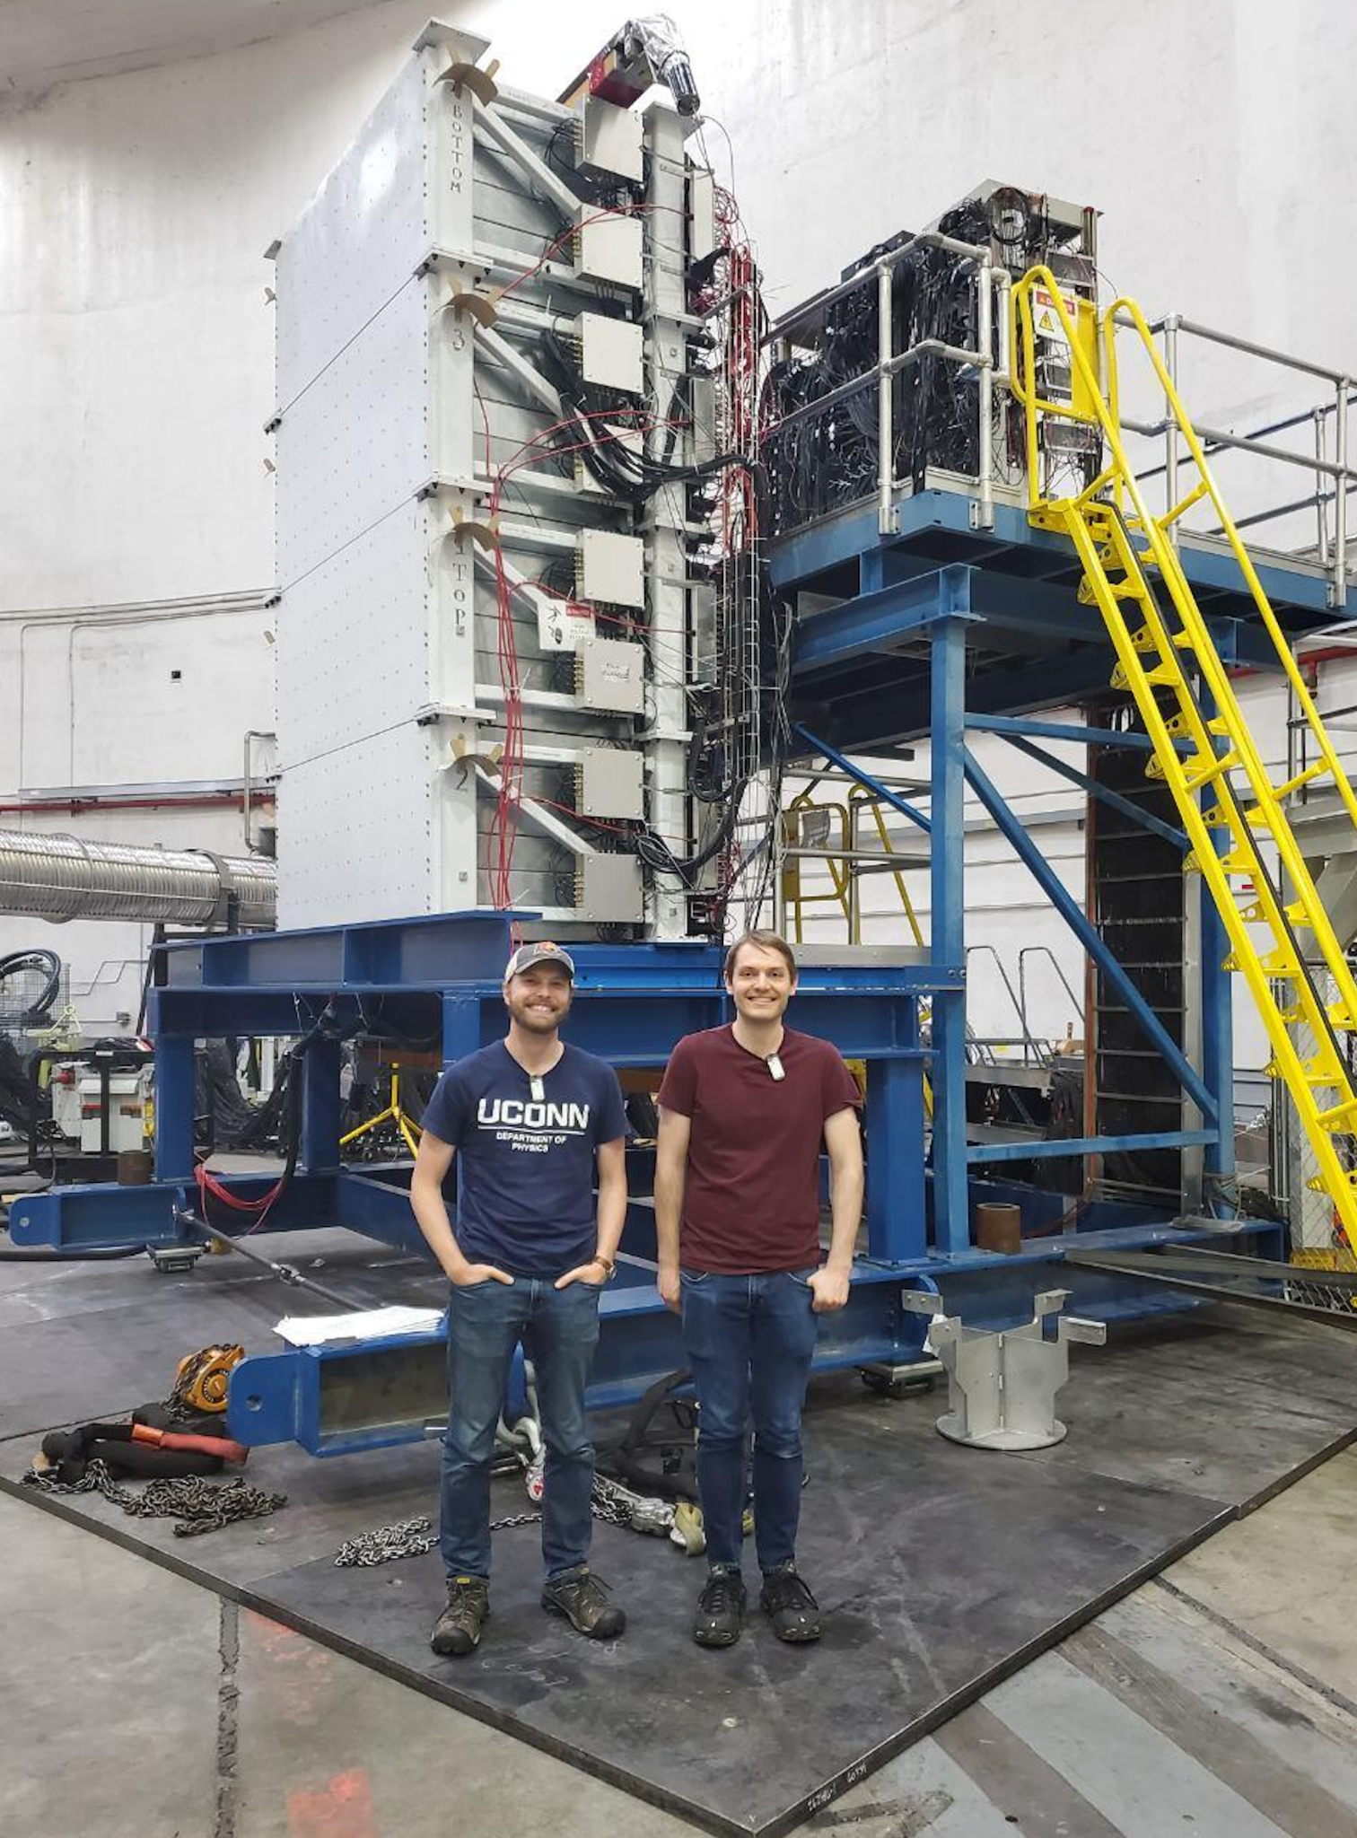
Acknowledgements
The design and construction of HCal was primarily overseen by Gregg Franklin and Brian Quinn, whose efforts primarily made HCal a reality. Many others have been involved the project including, but not limited to:
Chuck Long, Juan Carlos Cornejo, Alex Camsonne, Jessie Butler (and his team), Bryan Moffit, Bogdan Wojtsekhowski, Mark Jones, Andrew Puckett, Eric Fuchey, Arun Tadepalli, Vanessa Brio, and Provakar Datta.
And thanks to Scott Barcus who has successfully managed preliminary testing, the move, reassembly, and commissioning of HCal for the SBS program!

Slide 20
Backup

Slide 21
HCal F1TDC Double Peaking and Rollover
Double Peaking
Double peaking occurs from GMn data when looking at TDC time with a difference of roughly 15ns. This phenomenon exists after elastic cuts.
SBS-offline defines replayed F1 data as the difference between the raw TDC data and the trigger time. Double peaking is the result of a resolution difference between the two values.
Rollover Peaks
Rollover occurs when the trigger time is greater than the raw tdc signal or when the raw signal has counted beyond the 16 bit register of the F1, but the trigger time reference has not. A correction to the raw tdc time is necessary to account for this.
Rollover peaks occur when the correction is incorrect (+=2^16-1 tdc units)

Slide 22
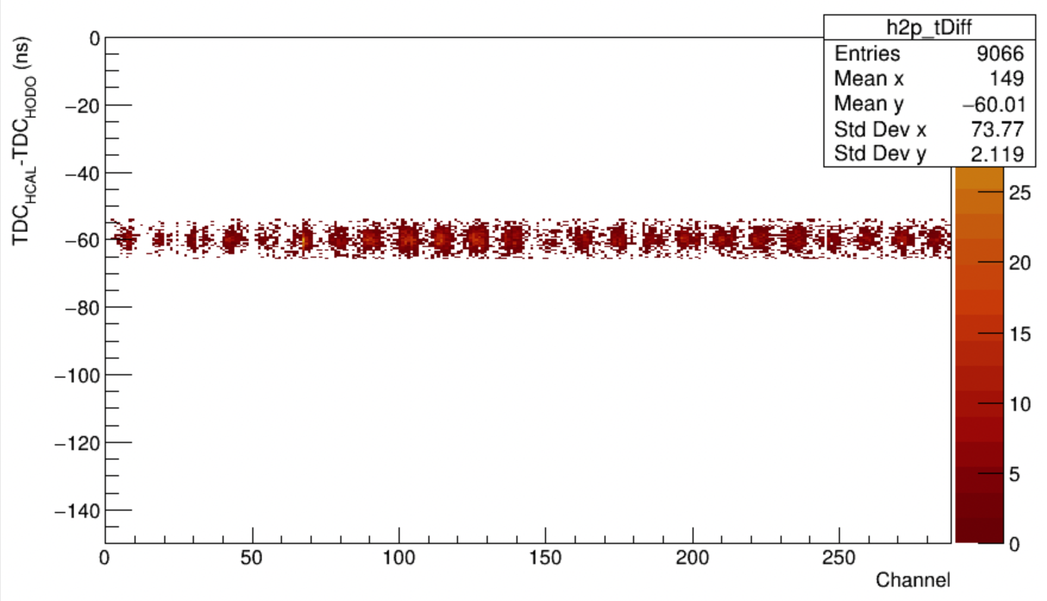
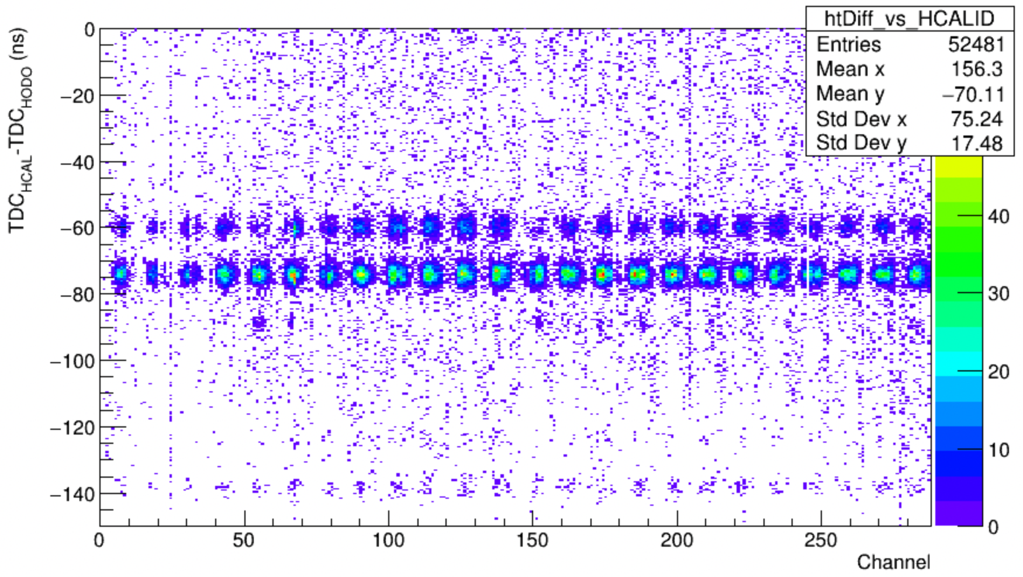
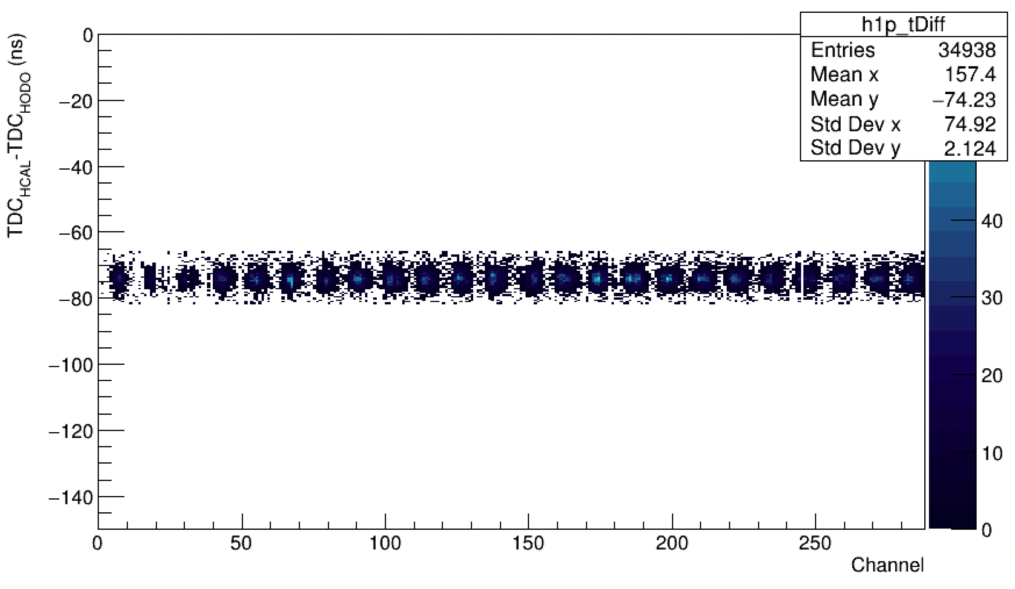
Double Peaking Reminder
Signal 2 cut
Two “peaks” appear in HCal TDC beam-on data after cuts
Settings and Cuts
LH2, SBS4
Elastics (W, E_{min} BB/HCal, trigger coin BB/HCal, proton spot)
Signal 1 (first, blue), Signal 2 (second, red)
Peak Δt ~ 15 ns (fit to all channels, Δt = 14.4 ns)
A smaller third peak (green) exists at -14.4 ns from first peak
Signal 1 cut
Cut at -66 ns

Slide 23
Rollover Correction Peaks
Two “peaks” appear in HCal TDC beam-on data after cuts around -130 ns
Settings and Cuts
LH2, SBS4
Elastics (W, E_{min} BB/HCal, trigger coin BB/HCal, proton spot)
Peak Δt ~ 15 ns (fit to all channels, Δt = 14.4 ns)
Matches primary double peaks

Slide 24
HCal - Hodo TDC diff (old align). Before correction (blue), after correction (red)
Jiwan suggested solutions to both issues. Mark implemented them in SBS-offline.
Fix resolution of trigger time reference
Add accurate rollover correction (+=64964 tdc units)
Plotting from SBS8 over all channels after elastic cuts
Faint third peak (at -14.4 ns from first peak) disappears
Second peak (at +14.4 ns from first peak) gets smaller, but still exists

Slide 25
HCal - Hodo TDC diff vs channel
Before Correction, Larger Statistics
Plots by channel from SBS4, after elastic cuts.
Additional peak in aggregate plots arise from poor TDC offsets in database which will need corrected
With smaller statistics, double peaking and rollover correction peaks have vanished.
Changes have been implemented and pulled into git repo
JeffersonLab/SBS-offline
TDC times realigned and both issues resolved.
After Correction, Smaller Statistics

Slide 26
Backup
Proton Spot SBS4, LH2
SBS4, timing comparison

Slide 27
Elastic Cuts
Elastics (Can accurately predict hadron energy)
W cut on elastic peak
W calculated from k’, p_{beam}, and p_{targ} (LH2, at rest)
BBCal/HCal Trigger Coincidence Time
510ns +/- 40ns wide cut from TOF calculation
E/p electron cut
Unity for electrons, cut 1.0 +/- 0.3
BBCal preshower energy deposition (150 MeV, SBS8)
Pion rejection
Vertex Position
From BigBite track
Confirms electron originates within bulk of 15 cm target
-8cm < BigBite track vertex position < 8cm

Slide 28
GMn

Slide 29
GEn Beamline
HCal
SBS Dipole (48D48)

