Slide 1
G4SBS Beamline and HCal Calibration
Sebastian Seeds - SBS Collaboration Meeting Feb. 2021
Notes:
Introduction
This is about two fairly disparate topics which I’ve tried to keep coherent, but, just by way of a warning, there’s a rather sudden switch in the middle.

Slide 2
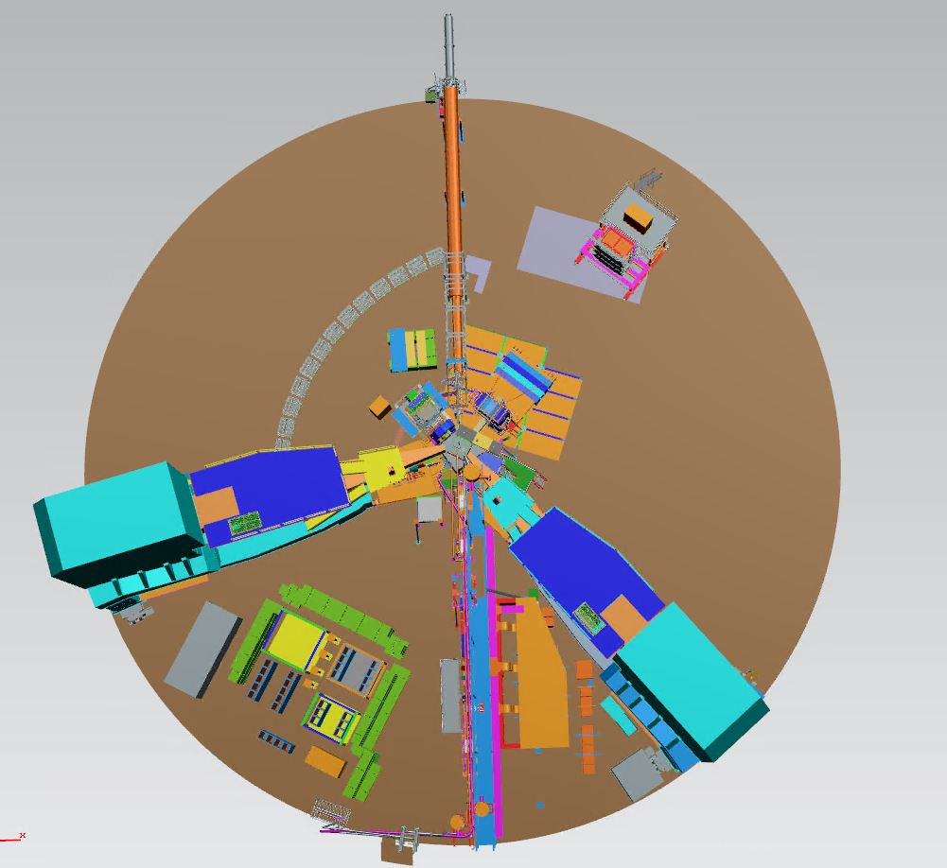
G4SBS Beamline Overview
G4SBS is an interactive simulation software that uses Geant4 to simulate beam conditions for various SBS hardware configurations in Hall A. It can:
Track the kinematics and interactions of simulated particles
Simulate/calculate event rates for processes of interest in sbs program
Calculate detector performance/acceptance/resolution
Estimate background rates and detector occupancies
G4SBS requires simulated geometry. The beamline, in particular, consists of:
Upstream beampipe and components
Target-Proximal downstream beampipe
Target-to-midpipe section
Beam dump section
All builds hosted on git
github.com/JeffersonLab/g4sbs
JT model of GEn Hall Configuration (for Reference)
HCal
BigBite Spectrometer
Super BigBite
Notes:
Utility: Estimate background rates / calibrate optics / optimize detector acceptance
I’ve been working on GMn run group beamline with David Flay
Upstream: pipe and components like collimators and raster; TargProx: conical pipe, components later; targTo: beampipe; beamDump: beampipe and components like beam diffuser
The beamline in particular is critical for estimation of background counting rates and occupancies in detectors because these quantities are sensitive beamline details. Related to this, shielding requirements by experiment require accurate beamline geometry in G4SBS.

Slide 3
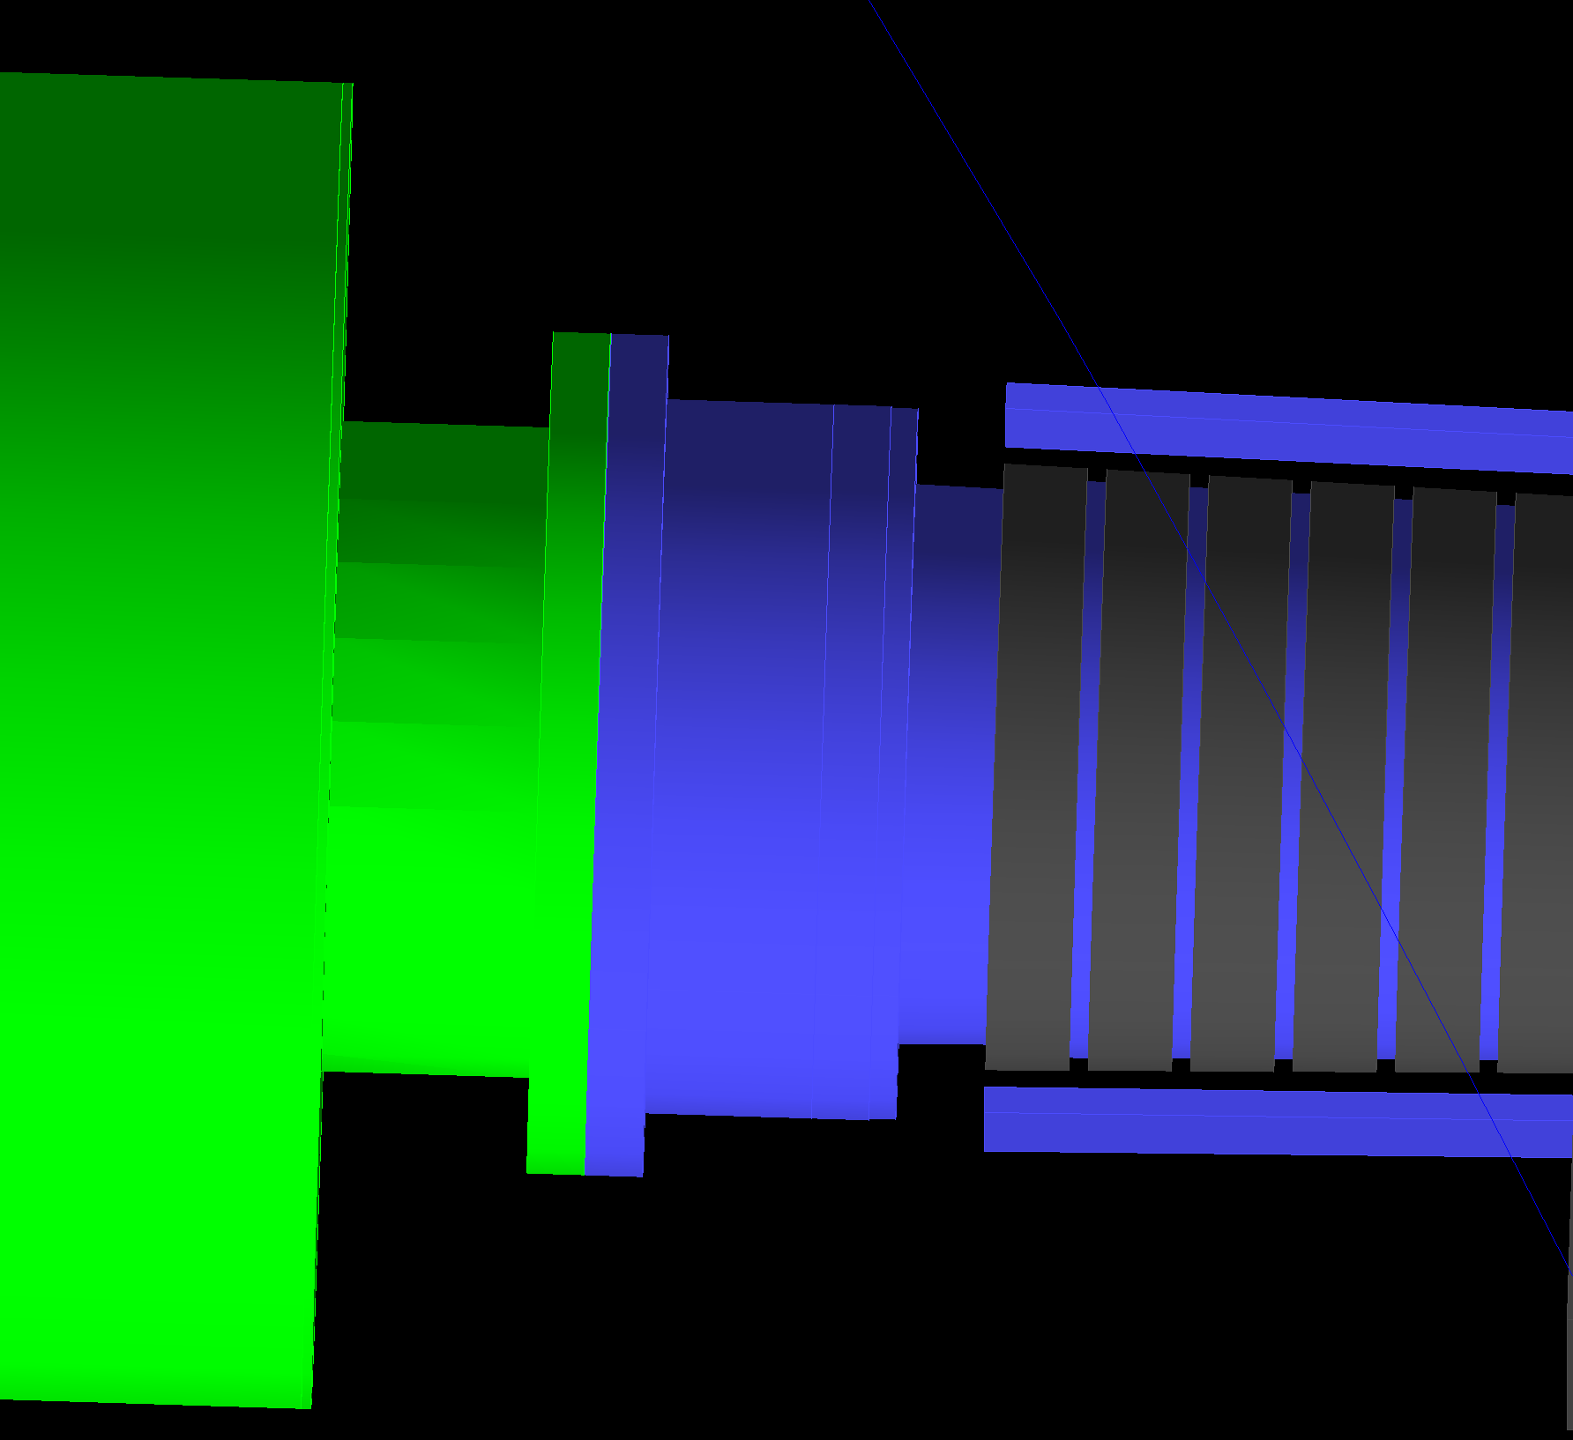
G4SBS GEn Beamline
Interface between target-proximal beamline and common target-to-midpipe sections.
All sections constructed to match engineering plans (primary JT file)
Geometry and materials
Insignificant elements ignored
Brackets, screws, rivets, etc.
Target to midpipe, beam dump, and active upstream components implemented by David Flay
Interface to experiment-common target-to-midpipe section accurate
GEn JT Geometry
Corrector magnets removed for perspective
Current G4SBS geometry
Shielding Mounts
Shielding Rings
Upstream Beampipe
Target Chamber
Downstream Beampipe
Corrector Magnets
BigBite Spectrometer
Common target-to-midpipe section in green, large O/D
48D48 magnet moved for perspective
Notes:
Step by step process: Receive hall configuration from engineering team via JT file -take measurements of component geometry, materials, and placements from JT, break into sections defined by target offset parameters, and code Geant4 geometry into beamline builder class g4sbs. Ignore smaller components.
I’ve done all targProx and worked on upstream (both currently experiment-specific) . David Flay’s contributions include the DS common geometry (targToMid and beamDump) and experiment-specific US geometry
Rough run-down of major components in targProx geometry: steel conical beampipe, corrector magnets, iron magnetic shielding, additional aluminum shielding mounts, steel bellows and flanges.

Slide 4
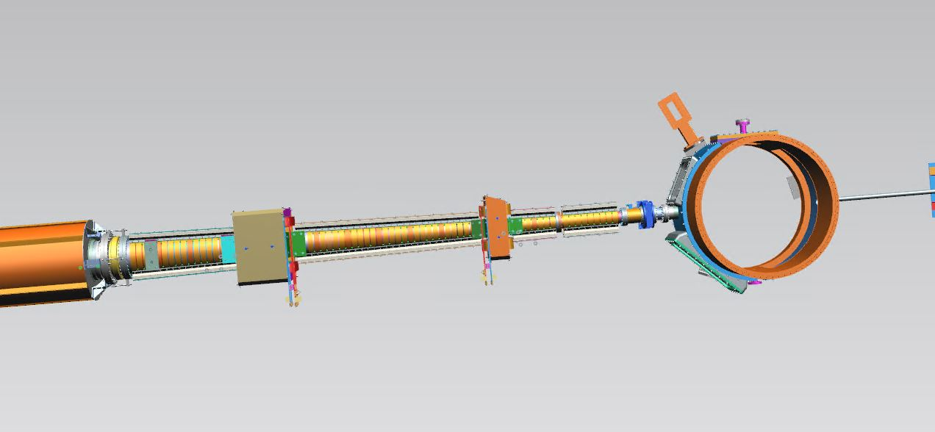
G4SBS GMn Beamline
Beamline geometry now constrained to previous BL03 configuration
No others expected for GMn
Conical beamline section (including corrector magnets and shielding) shifted and checked.
Additional components can be added as needed including lead shielding.
All experiment common downstream beamline elements are consistent with GEn.
GMn BL03 JT Geometry
z
x
Similar sectioned offset procedure used to verify component placement
Current G4SBS geometry
Current g4sbs geometry: config 3
Shielding Mounts
Shielding Rings
Upstream Beampipe
Target Chamber
Downstream Beampipe
Corrector Magnets
BigBite Spectrometer
Common target-to-midpipe section in green, large O/D
48D48 magnet moved for perspective
Notes:
The number of beamline configurations for GMn has been reduced to 1 - BL03
Process similar. Obtain JT file, take measurements, build in G4SBS beamline builder class
To accommodate the placement of the SBS Magnet (48D48) for GMn, targProx comp. have been shifted and augmented. New magnetic shielding section, bellows reconfigured, additional shielding mounts (as shown).
Additional components can quickly and easily be implemented as needed.

Slide 5
G4SBS GEp Temporary Beamline Status
Similar G4SBS geometry retooled as stand-in
Pending determination of final GEp configuration
All overlaps and air gaps eliminated with simple assumptions about configuration of shielding and target-proximal bellows.
Similar magnetic shielding structure
SBS side lead shielding
Bellows and flange extensions interface with common elements at similar radial dimensions
Target to midpipe section in green, large O/D
48D48 magnet wireframe (in purple) located between corrector magnets
Notes:
GEp is a work in progress.
Placement of the SBS magnet is known, so placement of the corrector magnets can be confirmed. Naive assumptions consider only shielding and continuous vacuum between target chamber and common DS beamline elements.
Run down of assumptions: Magnetic shielding: two sections of iron shielding rings. Lead shielding exists between beamline and H arm and between target chamber and H arm. Steel beampipe/bellows connects elements.

Slide 6
G4SBS Beamline Status and Further Work
SBS experiments with complete beamlines in simulation software:
GEn/SIDIS
GEn-rp
GMn
WAPP
nTPE
Experiments with incomplete beamlines in simulation software pending work:
GEp (in progress, pending final configuration)
..and any other configurations which require changes to the beamline.
Along with all detectors (hadron arm and electron arm), the beamline in g4sbs is ready for simulation in support of the Fall 2021 run and up to date with all GMn run group hall configurations.
Notes:
By way of a short recap… (read slide)

Slide 7
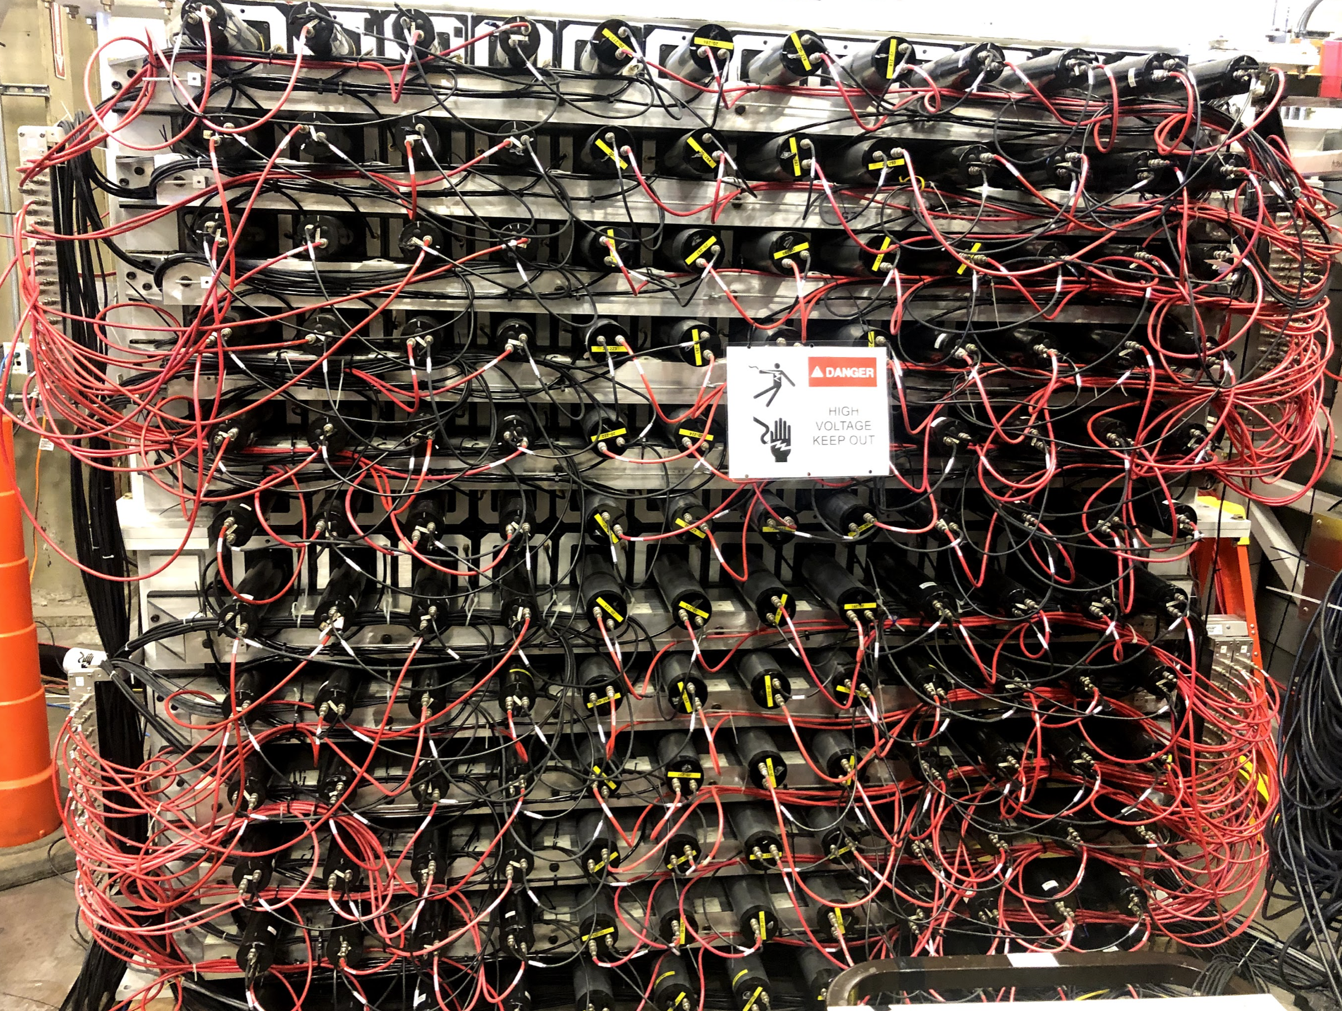
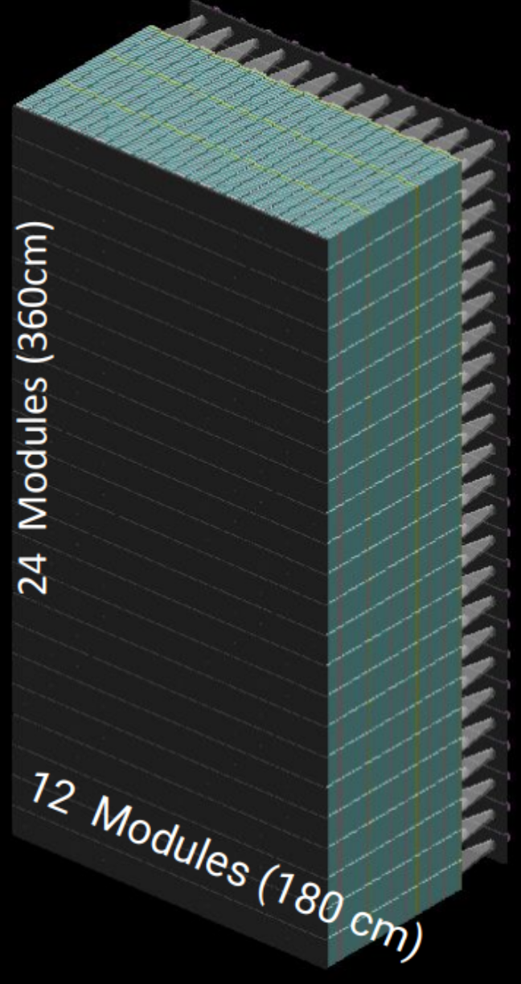
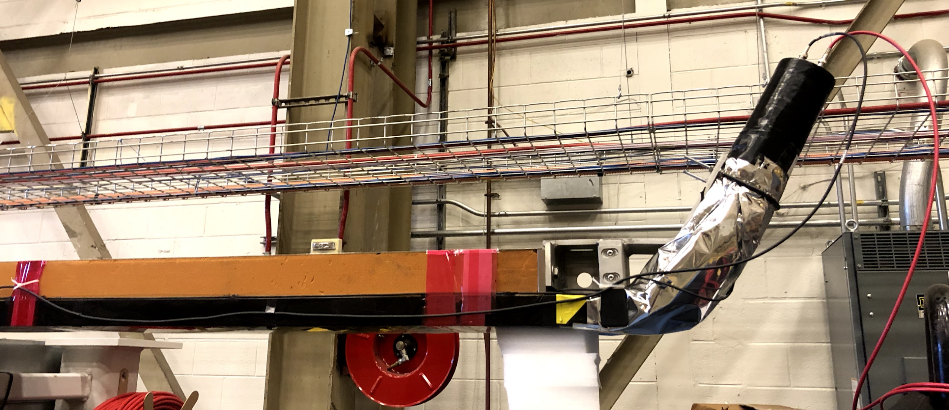
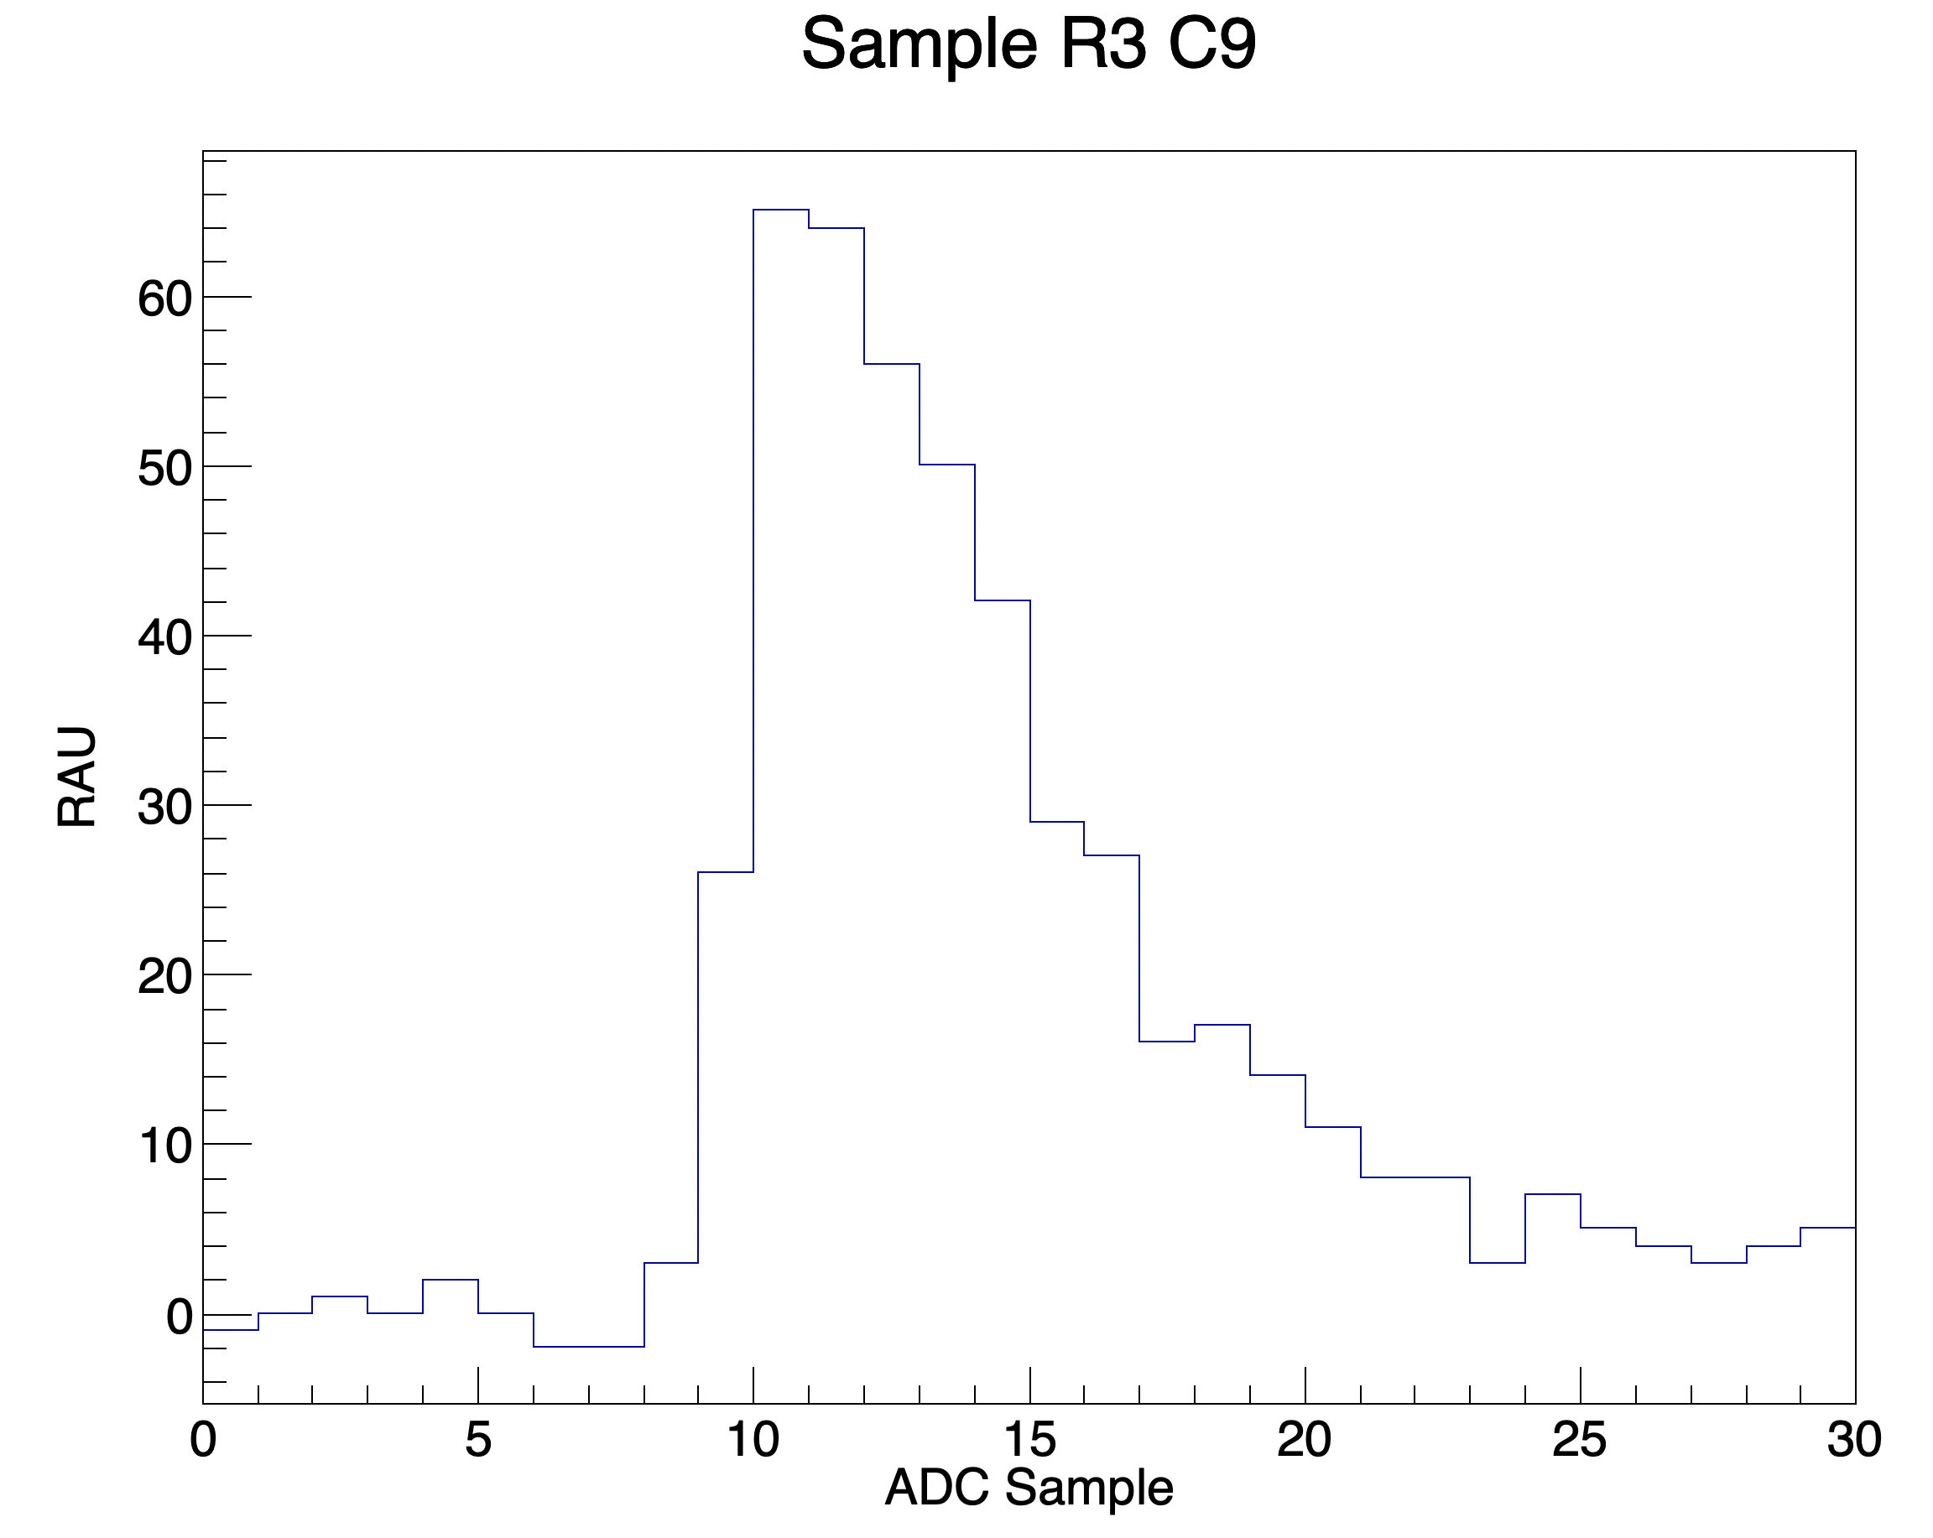
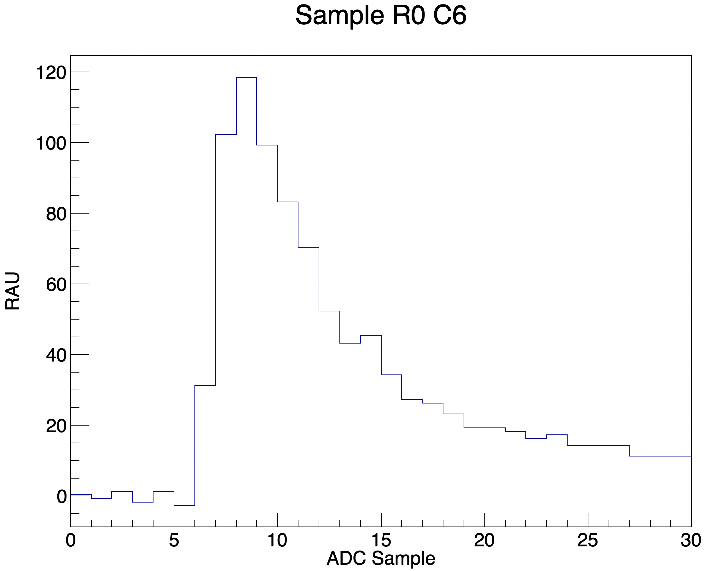
HCal Cosmic Configuration Fast Overview
Hadron Calorimeter will measure hadron (p/n) energy for all SBS experiments
288 (12 x 24) channels
One pmt per module/channel
Cosmic paddle trigger
Typical signal pulses by channel
4 ns bins on x-axis
fADC converts PMT analog signal to Raw ADC Units (RAU) (~0.5 mV = 1 RAU)
Summed RAU (sRAU)
Bottom half of HCal in Test Lab. 144 modules (channels) showing.
Max ADC ~65 RAU
Int ADC ~600 sRAU
Cosmic scintillator over top half of HCal. One cosmic paddle for each 12 x 12 set of modules.
Notes:
For those not familiar with the hardware, I quickly go through the cosmic setup for HCal. In general, the hadronic calorimeter will measure energies of scattered protons and neutrons in all SBS experiments. Harm position.
HCal is divided up into 288 modules, each a stack of alternating steel and scintillator with a single pmt at the end. Each of these modules forms a single channel which I’ve indexed by row and col here. Layout shown.
For cosmic tests, one cosmic paddle, or scintillator, is positioned over each of two halves of 12 x 12 modules - the bottom and top halves of HCal.
The analog output from the pmts across all channels are converted to digital via flash analog to digital converters (fADCs) and signal pulses can be reconstructed like these. Run down on characteristics of pulses.

Slide 8
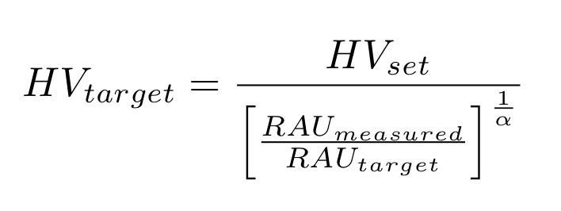
HCal Calibration Targets
Target RAU by channel set to within electronics saturation
Average energy deposition by cosmic per pmt -> 14 MeV
Max energy deposited per pmt for highest Q^2 point in GMn -> 700 MeV
Saturation -> 4095 RAU (ADC limit) * 1.5 (dynamic range of amplifier/fADC) * 0.5 (cable attenuation)
Target signal maximum RAU per channel -> (4095 RAU * 0.75) * (14 MeV / 700 MeV) = 61 RAU
Gain and Target HV by pmt
Gain from data sheet
Alpha est. by pmt type
Cosmic Calibration Plan
Set HV by channel using initial estimate from data sheet range. Take cosmic run with 500k to 1500k events.
Calculate target HV from measured RAU per channel.
Set HV for next iteration. Repeat calculation.
HV setting convergence (61 RAU) is reached and final HV setting by channel can be extracted for cosmic rays.
At these final HV settings the highest expected energy deposition during running will not saturate the amplifiers, but the signal gain is at the highest possible level.
Notes:
The bias voltage supplied to each pmt determines its gain, but must be chosen with care such that the amplifiers aren’t saturated and such that signal isn’t lost. To do this, we obtain a target signal, measured in RAU, corresponding to the highest expected energy deposition in GMn. Read from slide. Using the gain equation for our pmts and estimates of the associated alpha parameter, we can calculate a target HV setting from a previous HV setting by measuring the signal from cosmic events. Initially, we estimate the HV setting from the data sheet for each pmt, then take a 0.5M to 1.5M event run, obtain an average maximum signal per channel, calculated the target HV, change the HV settings per pmt accordingly and repeat until all channels average maximum signals converge to the target - 61 RAU.

Slide 9
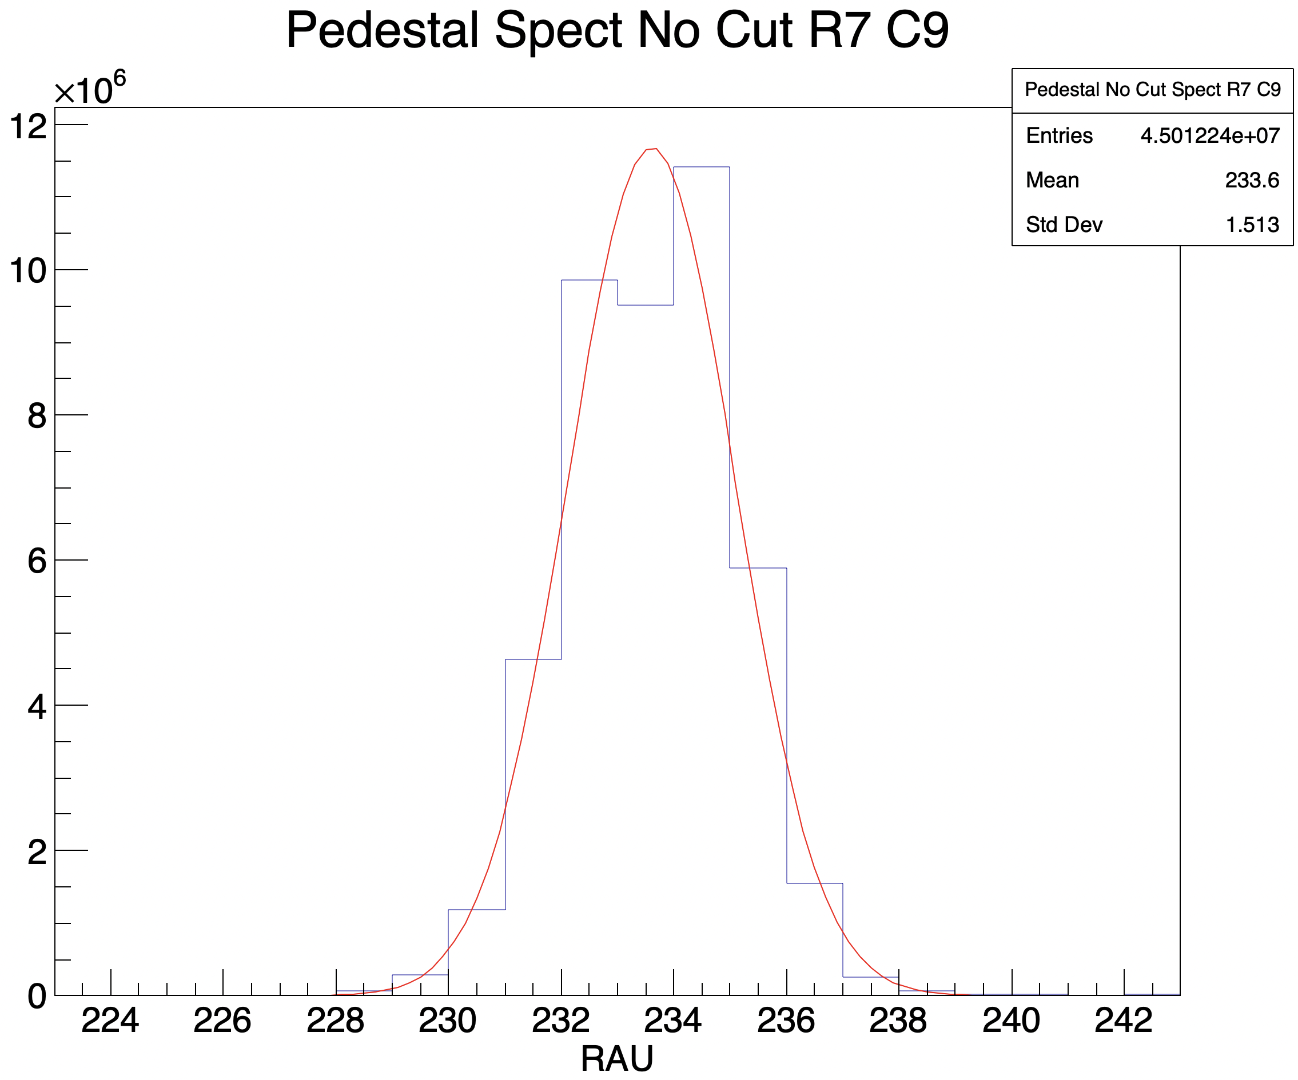
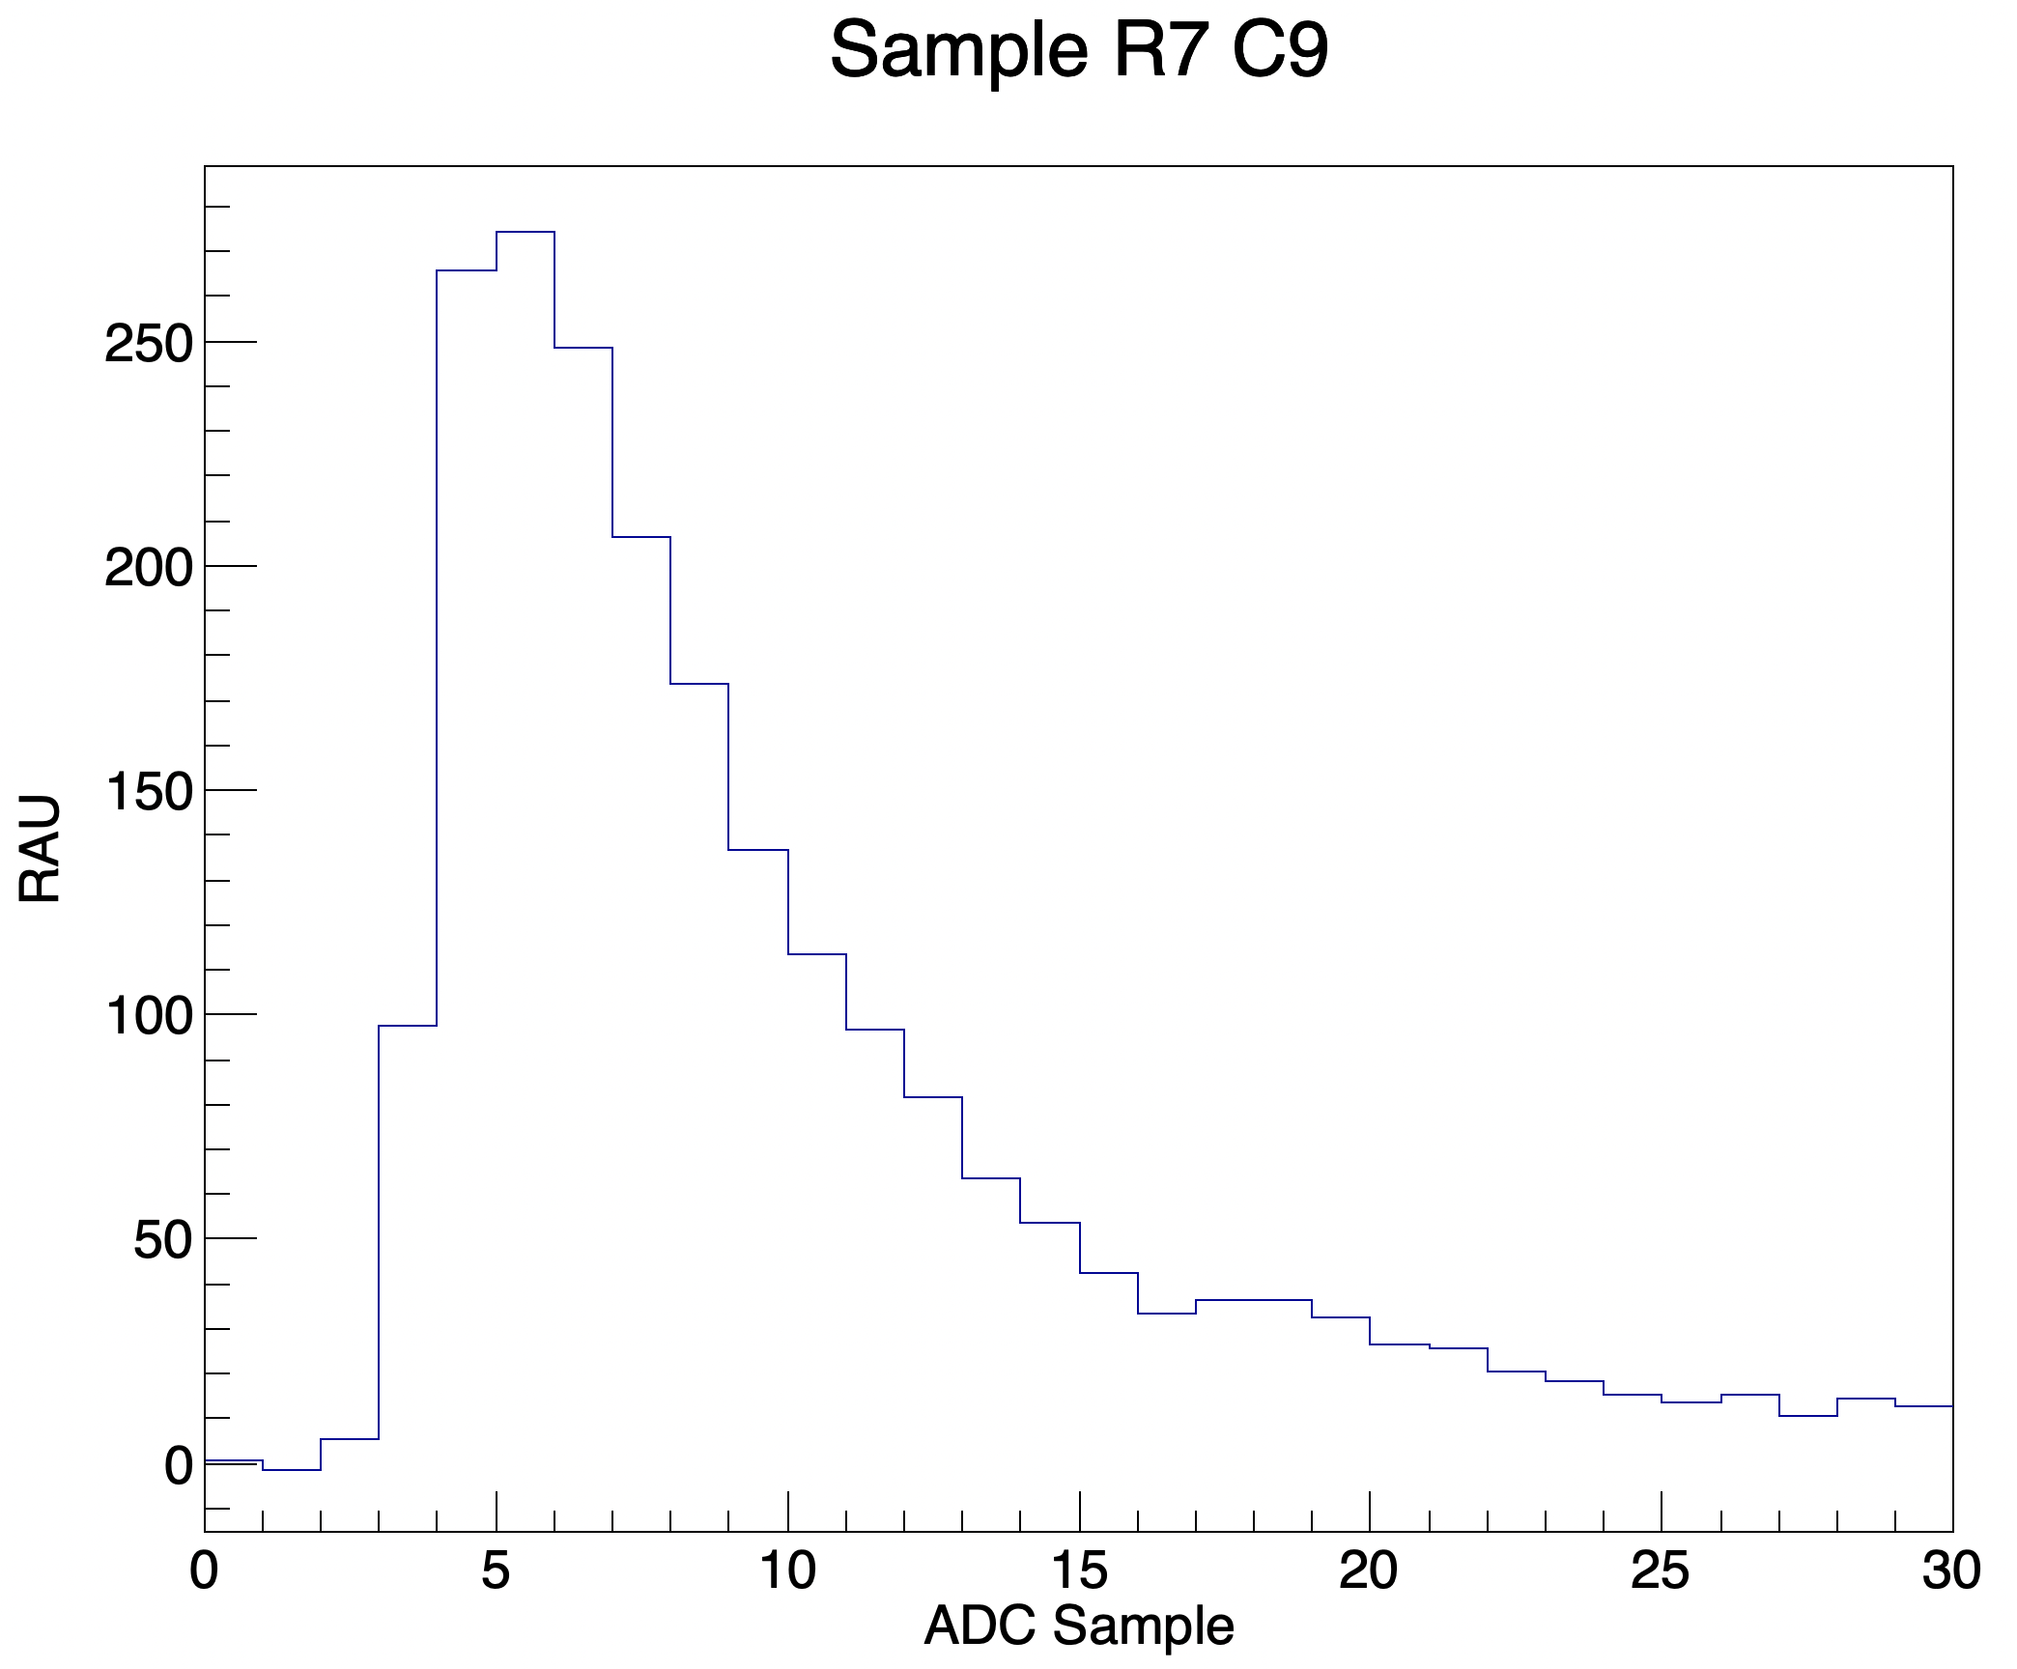
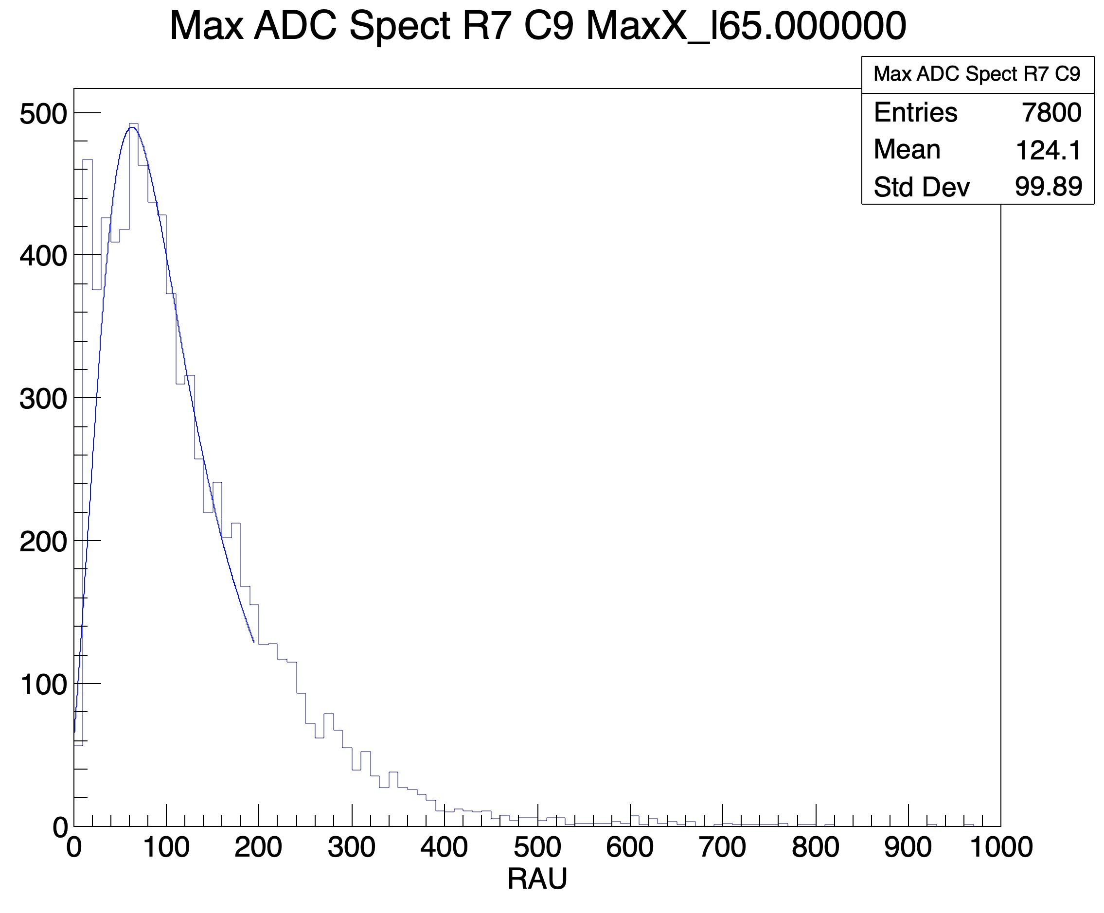
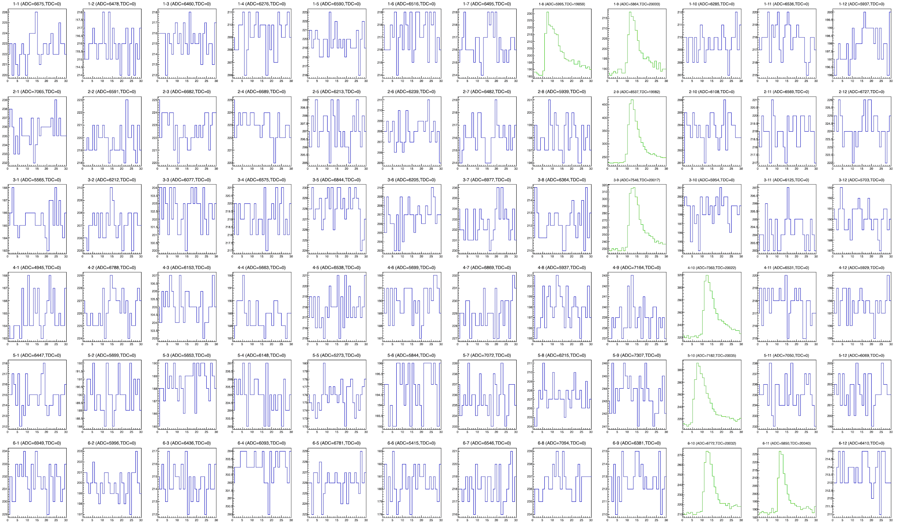
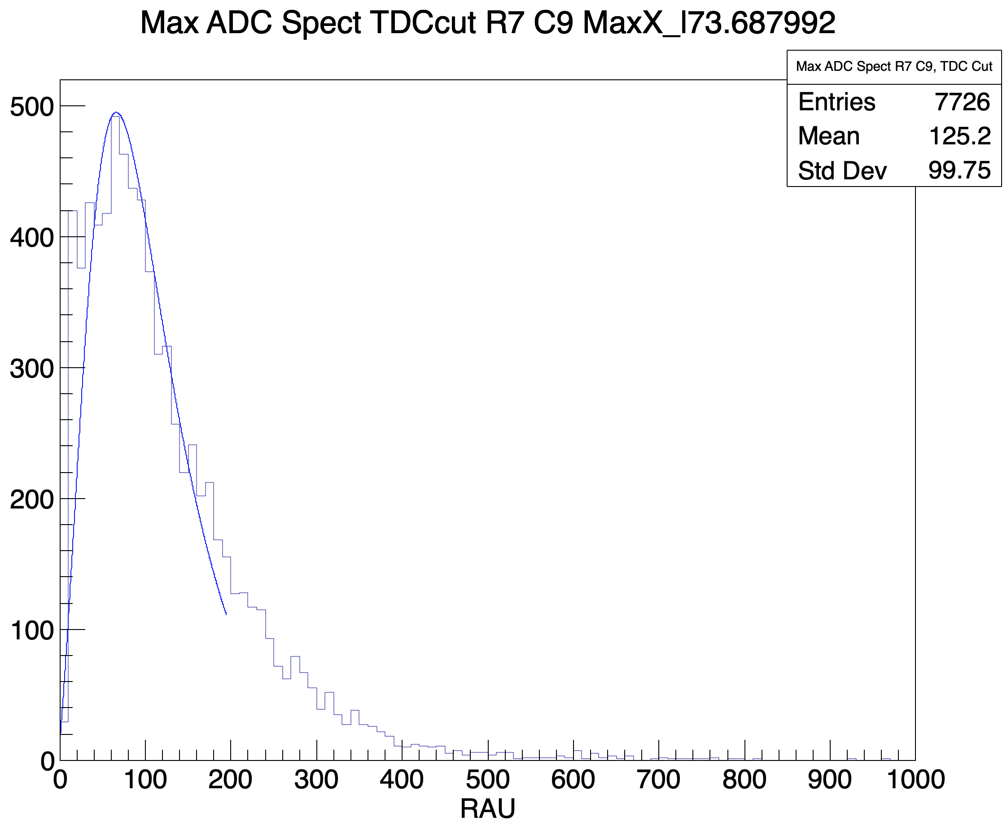
Cosmic Calibrations
Trigger
Scintillation in cosmic paddle over threshold
Event cuts
Pedestal from aggregate events by channel
ADC threshold set in software to 6 sigma pedestal
Pedestals subtracted from signal
Track cuts
Three in line, else rejected
TDC cut and final comparison with ADC signal without TDC cut
Cosmic Track
Single event display - third quadrant of HCal
Similar results, some low amplitude noise rejected by TDC
Notes:
Each event begins when the cosmic paddle registers a signal over threshold. The display here is an example of such an event. In blue, noise on channels which saw no cosmic scintillation. In green - signal pulses tracing the path of the cosmic ray. We obtain the noise pedestal as an average over all channels for all runs since the majority of events see no signal. This average is subtracted from each pulse by channel and the maximum, in RAU, fills a histogram. To determine which events correspond to event pulses, we set the pedestal-subtracted ADC threshold to 6 sigma pedestal noise and require that three channels pass this cut in line (boxed in green). While one can use a TDC coincidence to determine pulses, we apply this cut at the end to compare the results. The result is that the TDC eliminates some low amp noise, but doesn’t change the shape of our MAdc hists.

Slide 10
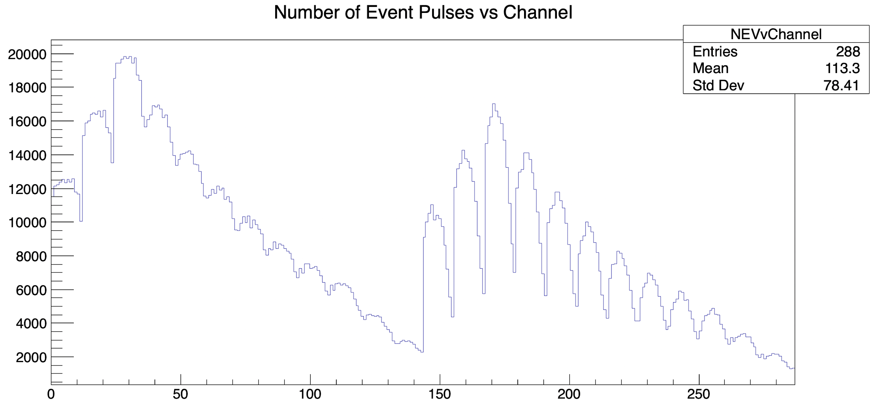
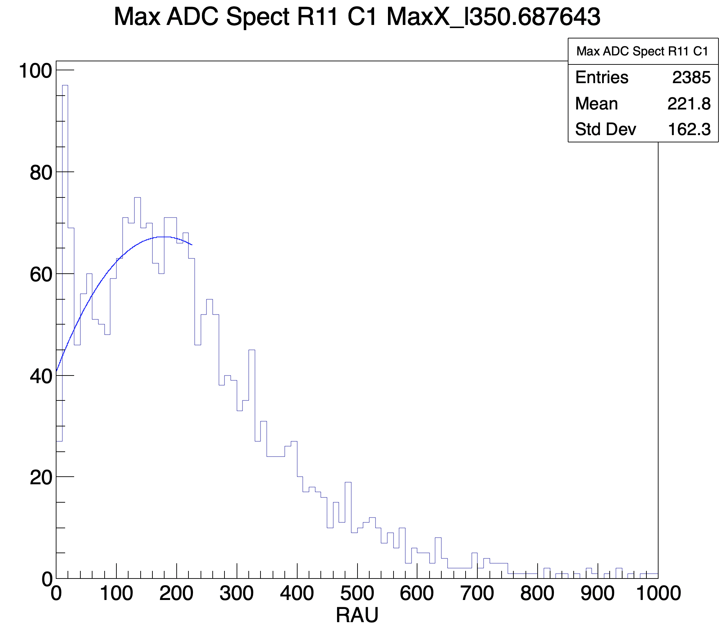
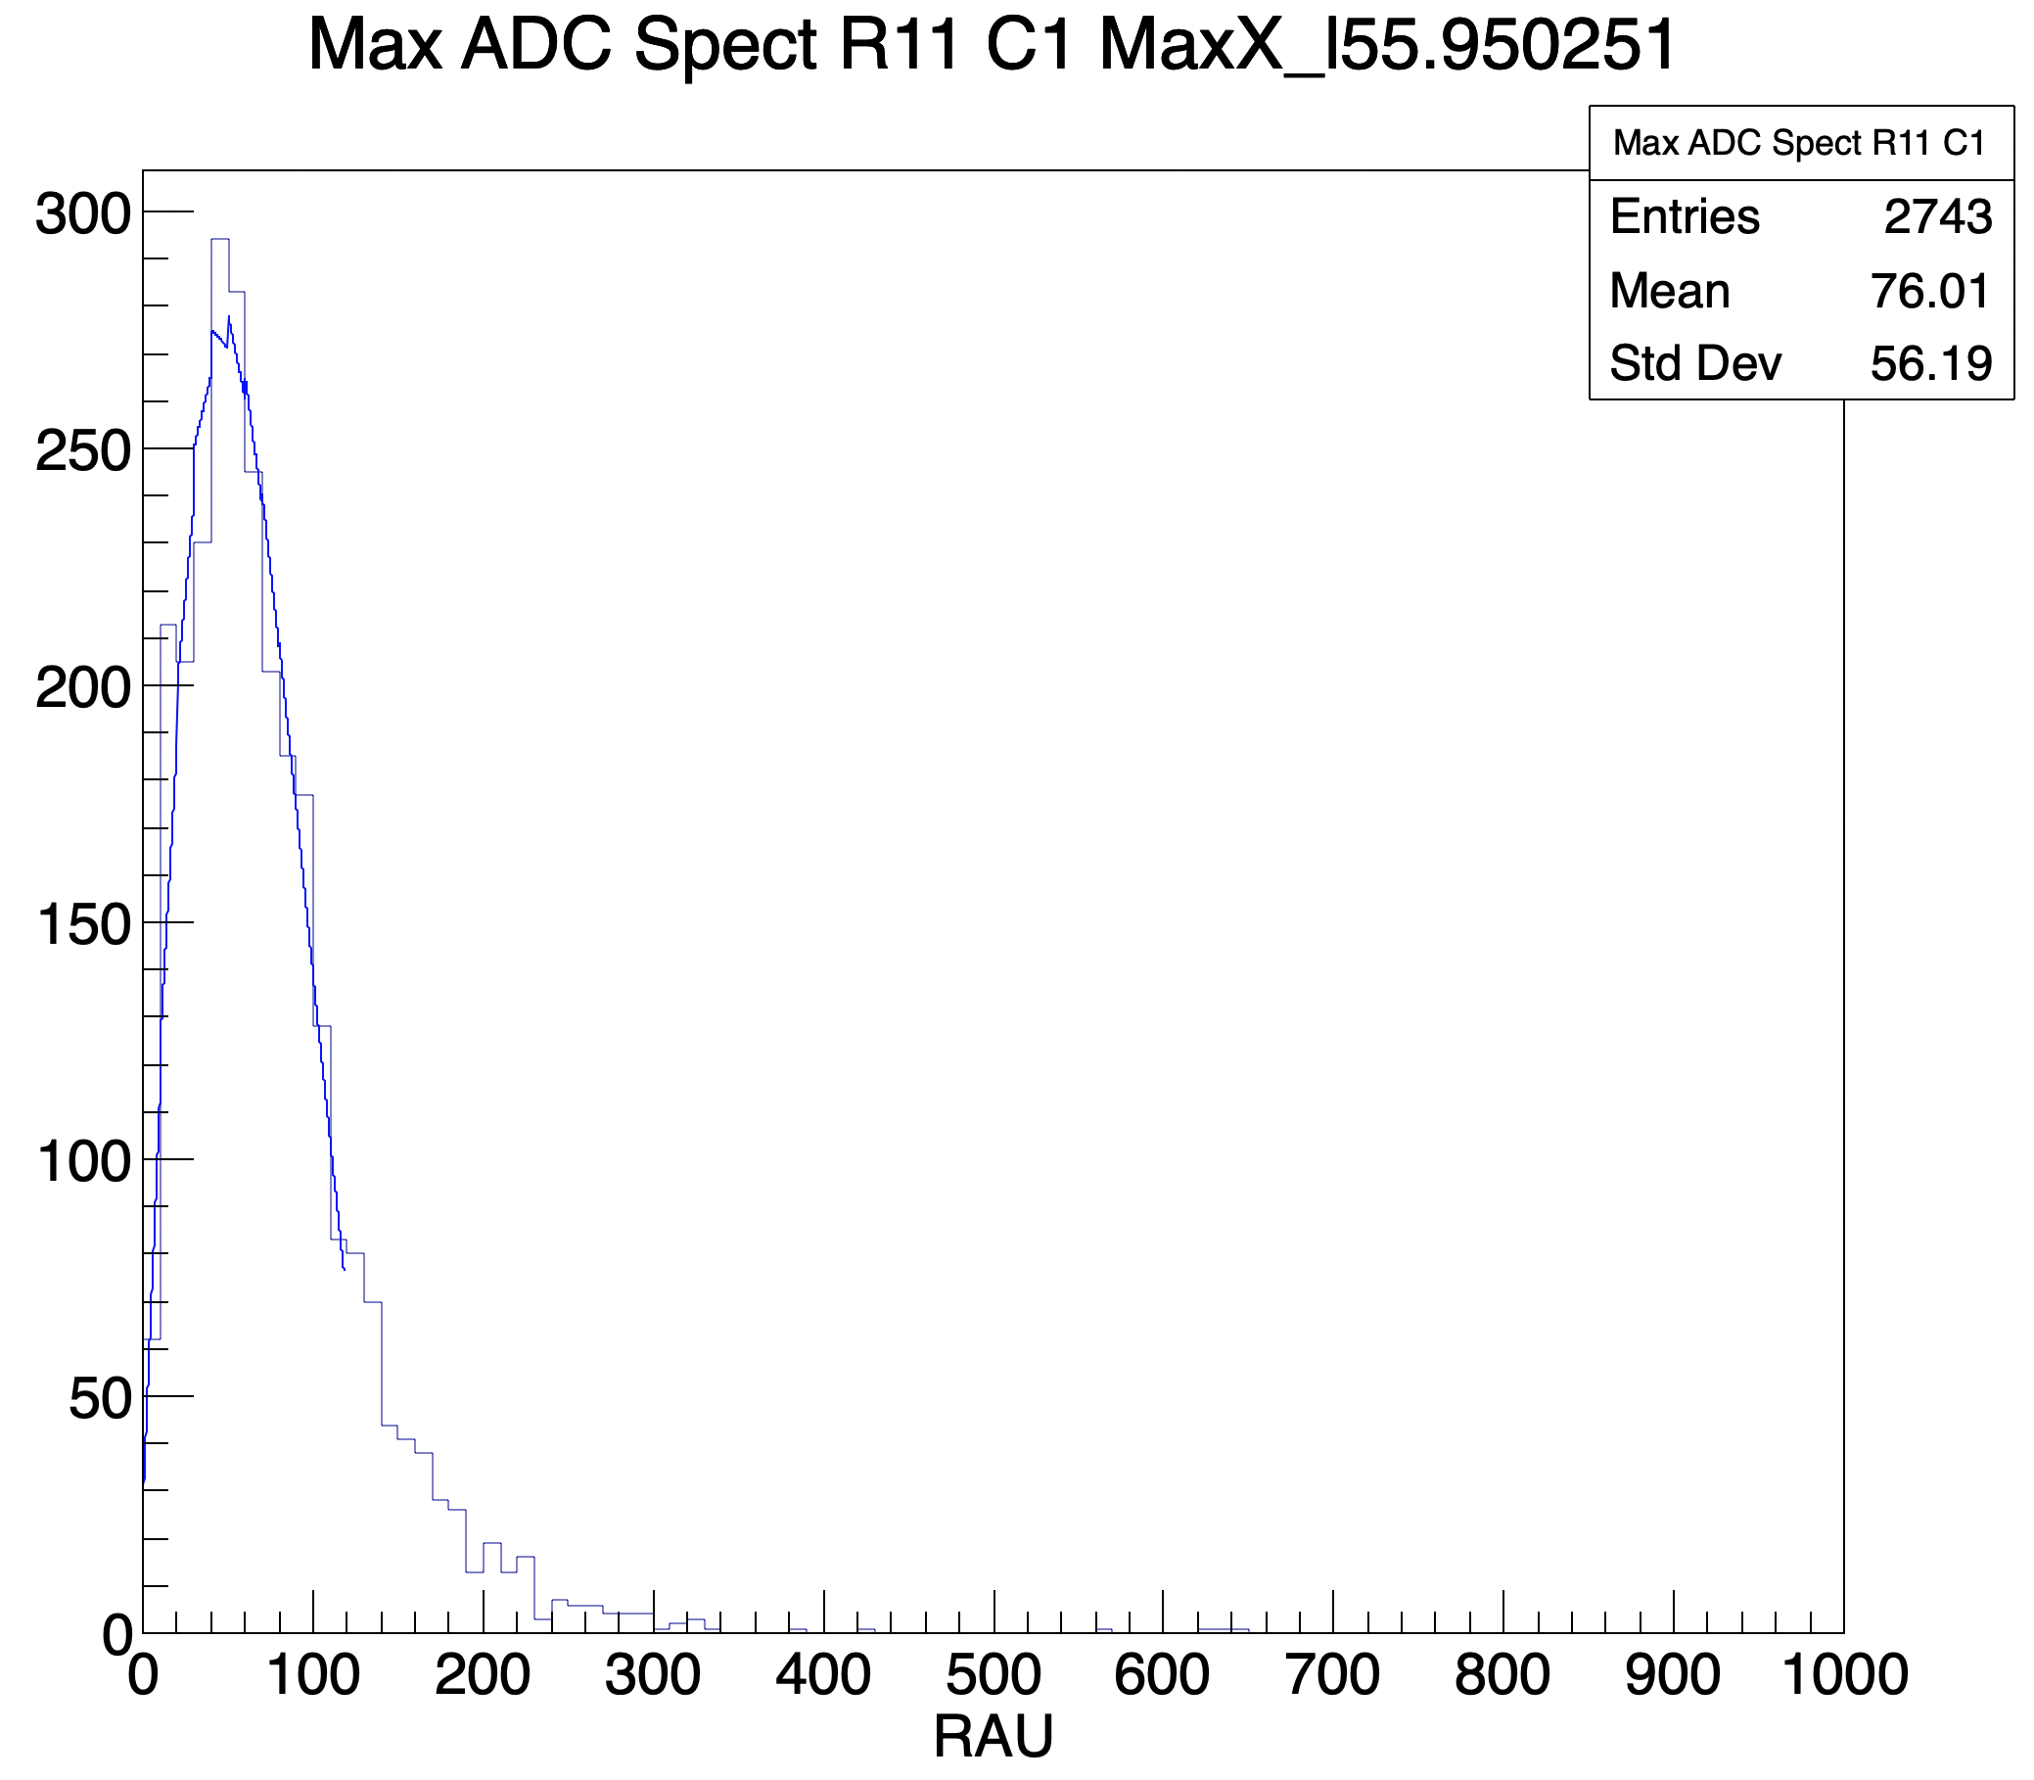
Cosmic Calibration Results
Max ADC and Max TDC by channel
1.5M events to obtain average value for measured RAU
~2500 cosmic events that pass cuts per channel
Fits
Landau distribution for cosmics - when fit fails default to mean in histogram
Effective for iterative calibration approach
Some manual fitting required
Average Max value (in RAU) extracted.
Recall: Target is 61 RAU from simulated neutron events at highest Q^2 in GMn run group and associated energy deposition
Bottom Half of HCal
Top Half of HCal
Several Iterations
Notes:
As a basic check, we resolve the geometry of the detector by plotting the number of events vs channel. Describe plot. More importantly, we have sufficient statistics to estimate max adc values per channel; roughly 2500 signal pulses per run. Each of the max-ADC histograms can be fit with a landau distribution appropriate for cosmic energy deposition, albeit with some checks and manual fitting required. Most probable values for each landau fit are the measured RAU used to calculate our next HV setting. Over several iterations of this process, we see these max ADC histograms go from this to this. Describe plot.

Slide 11
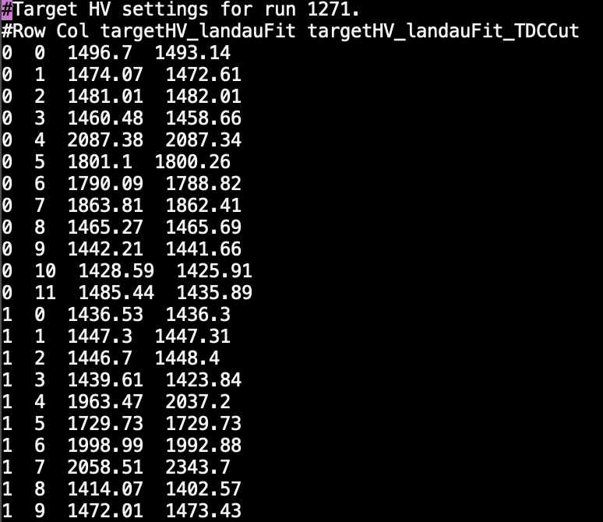
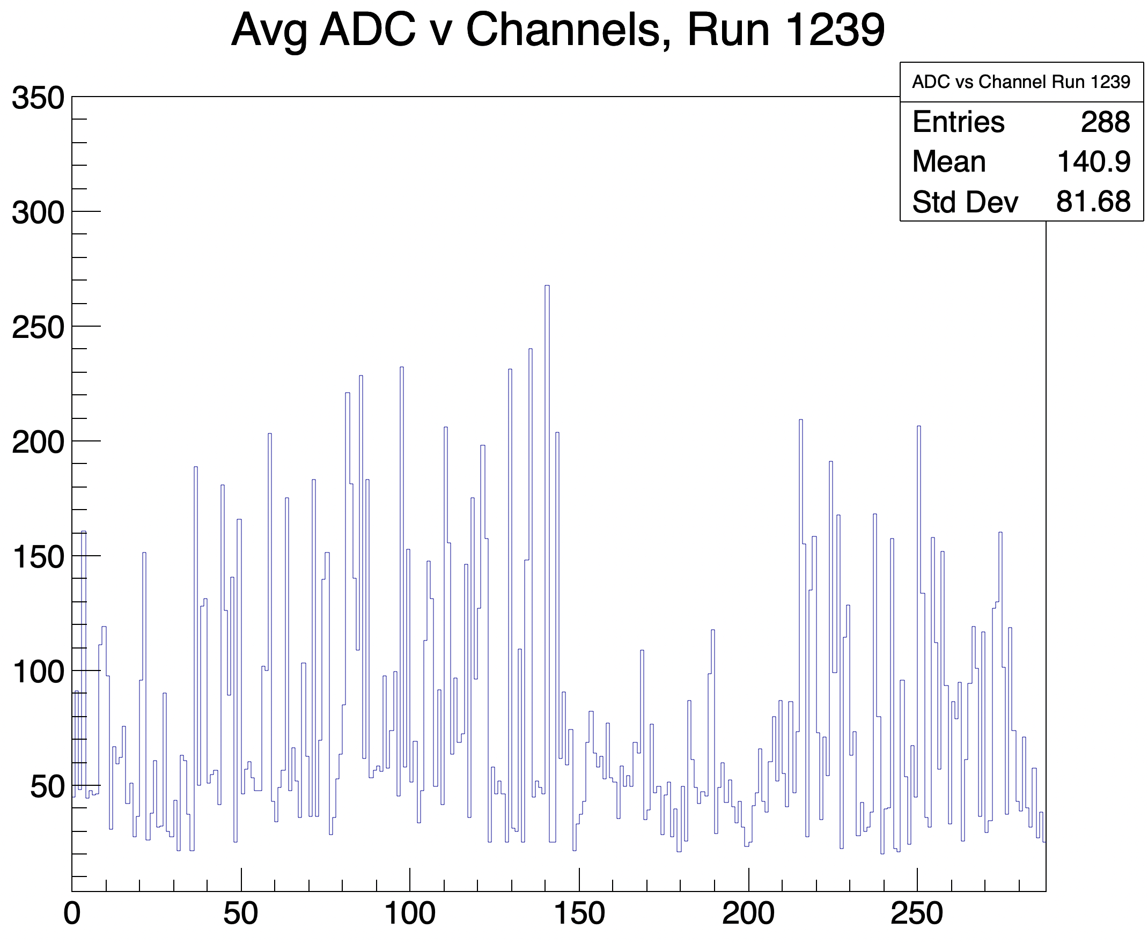
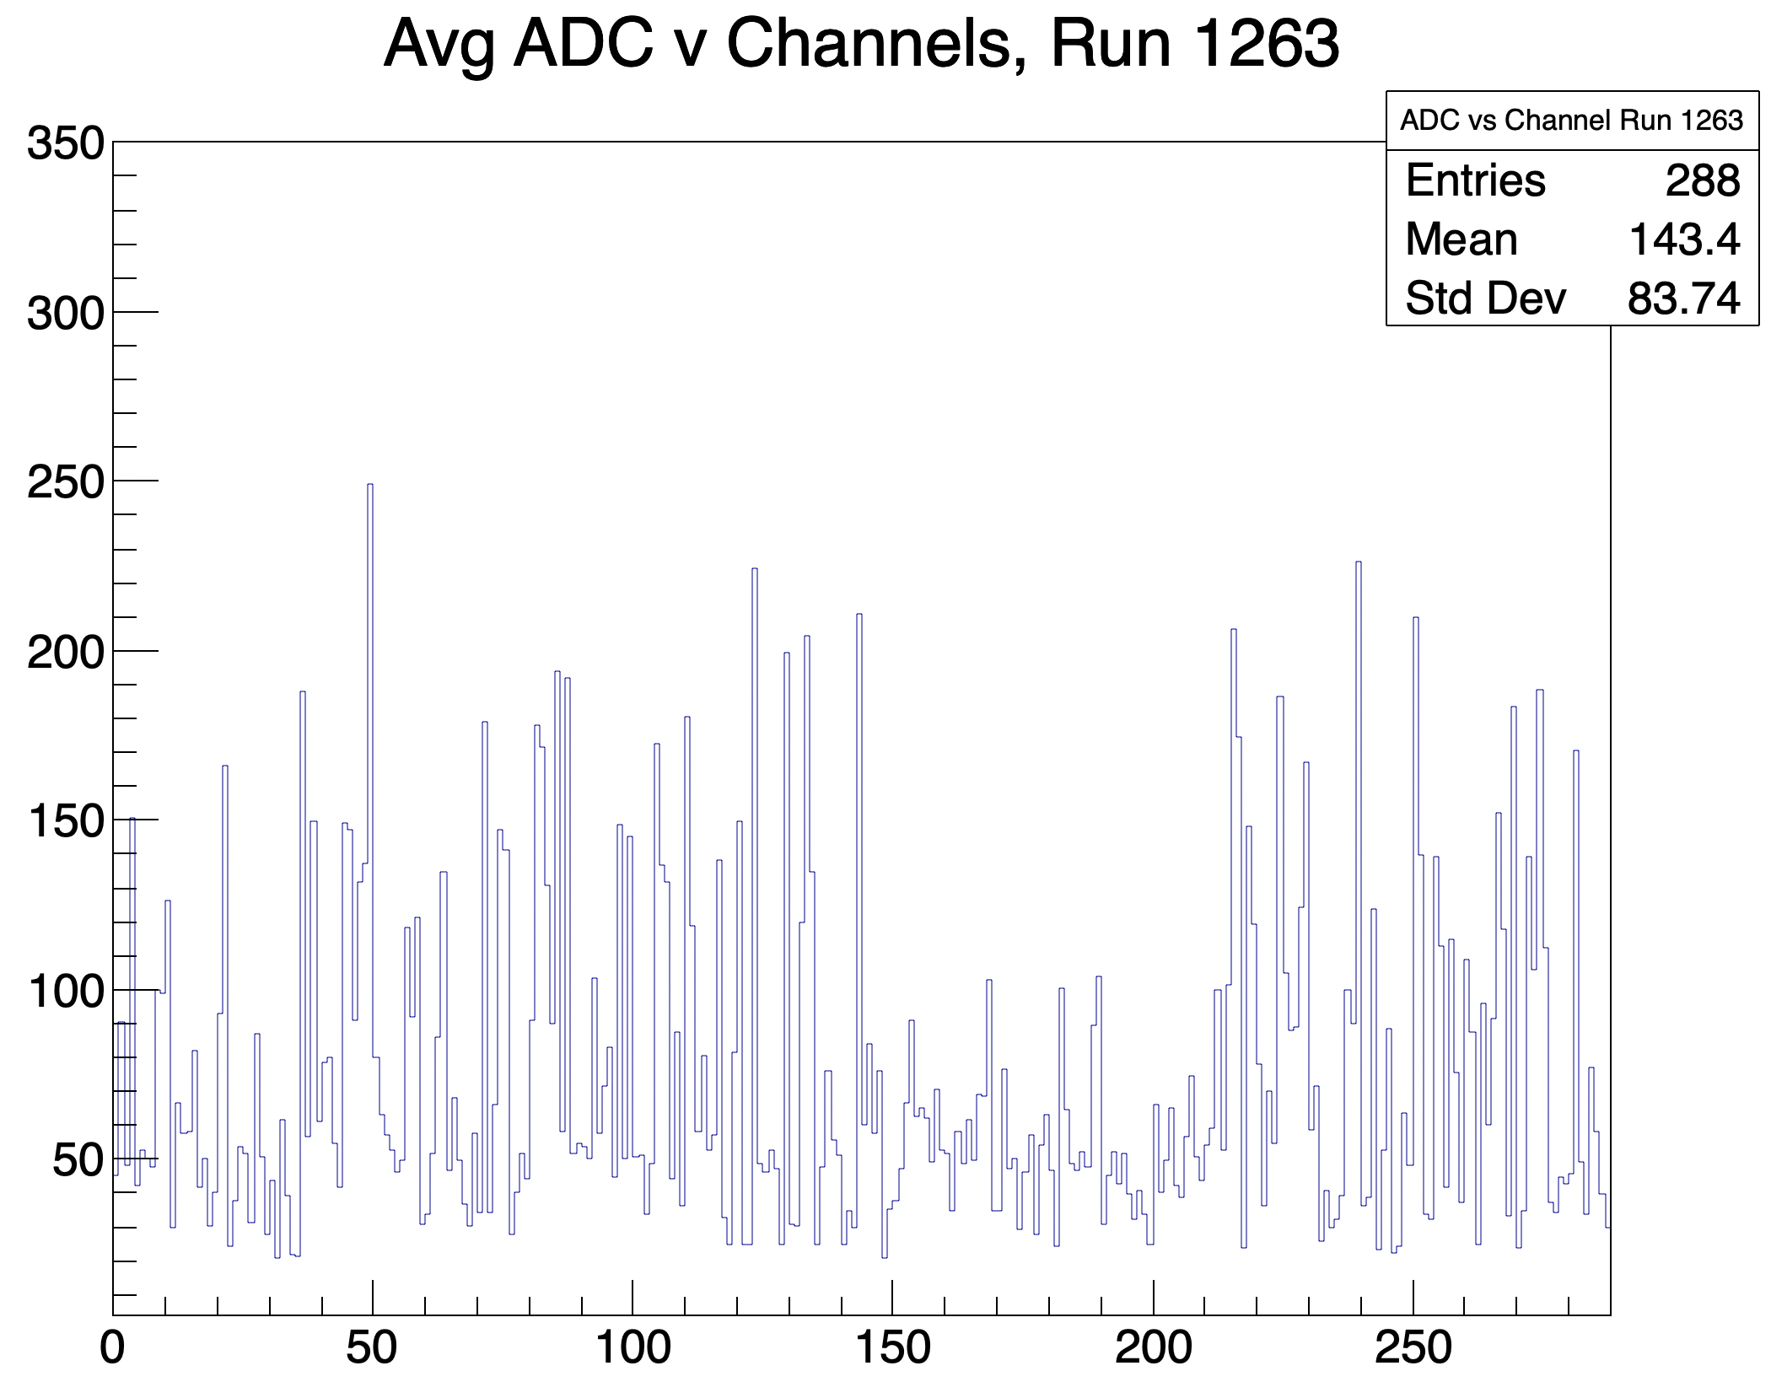
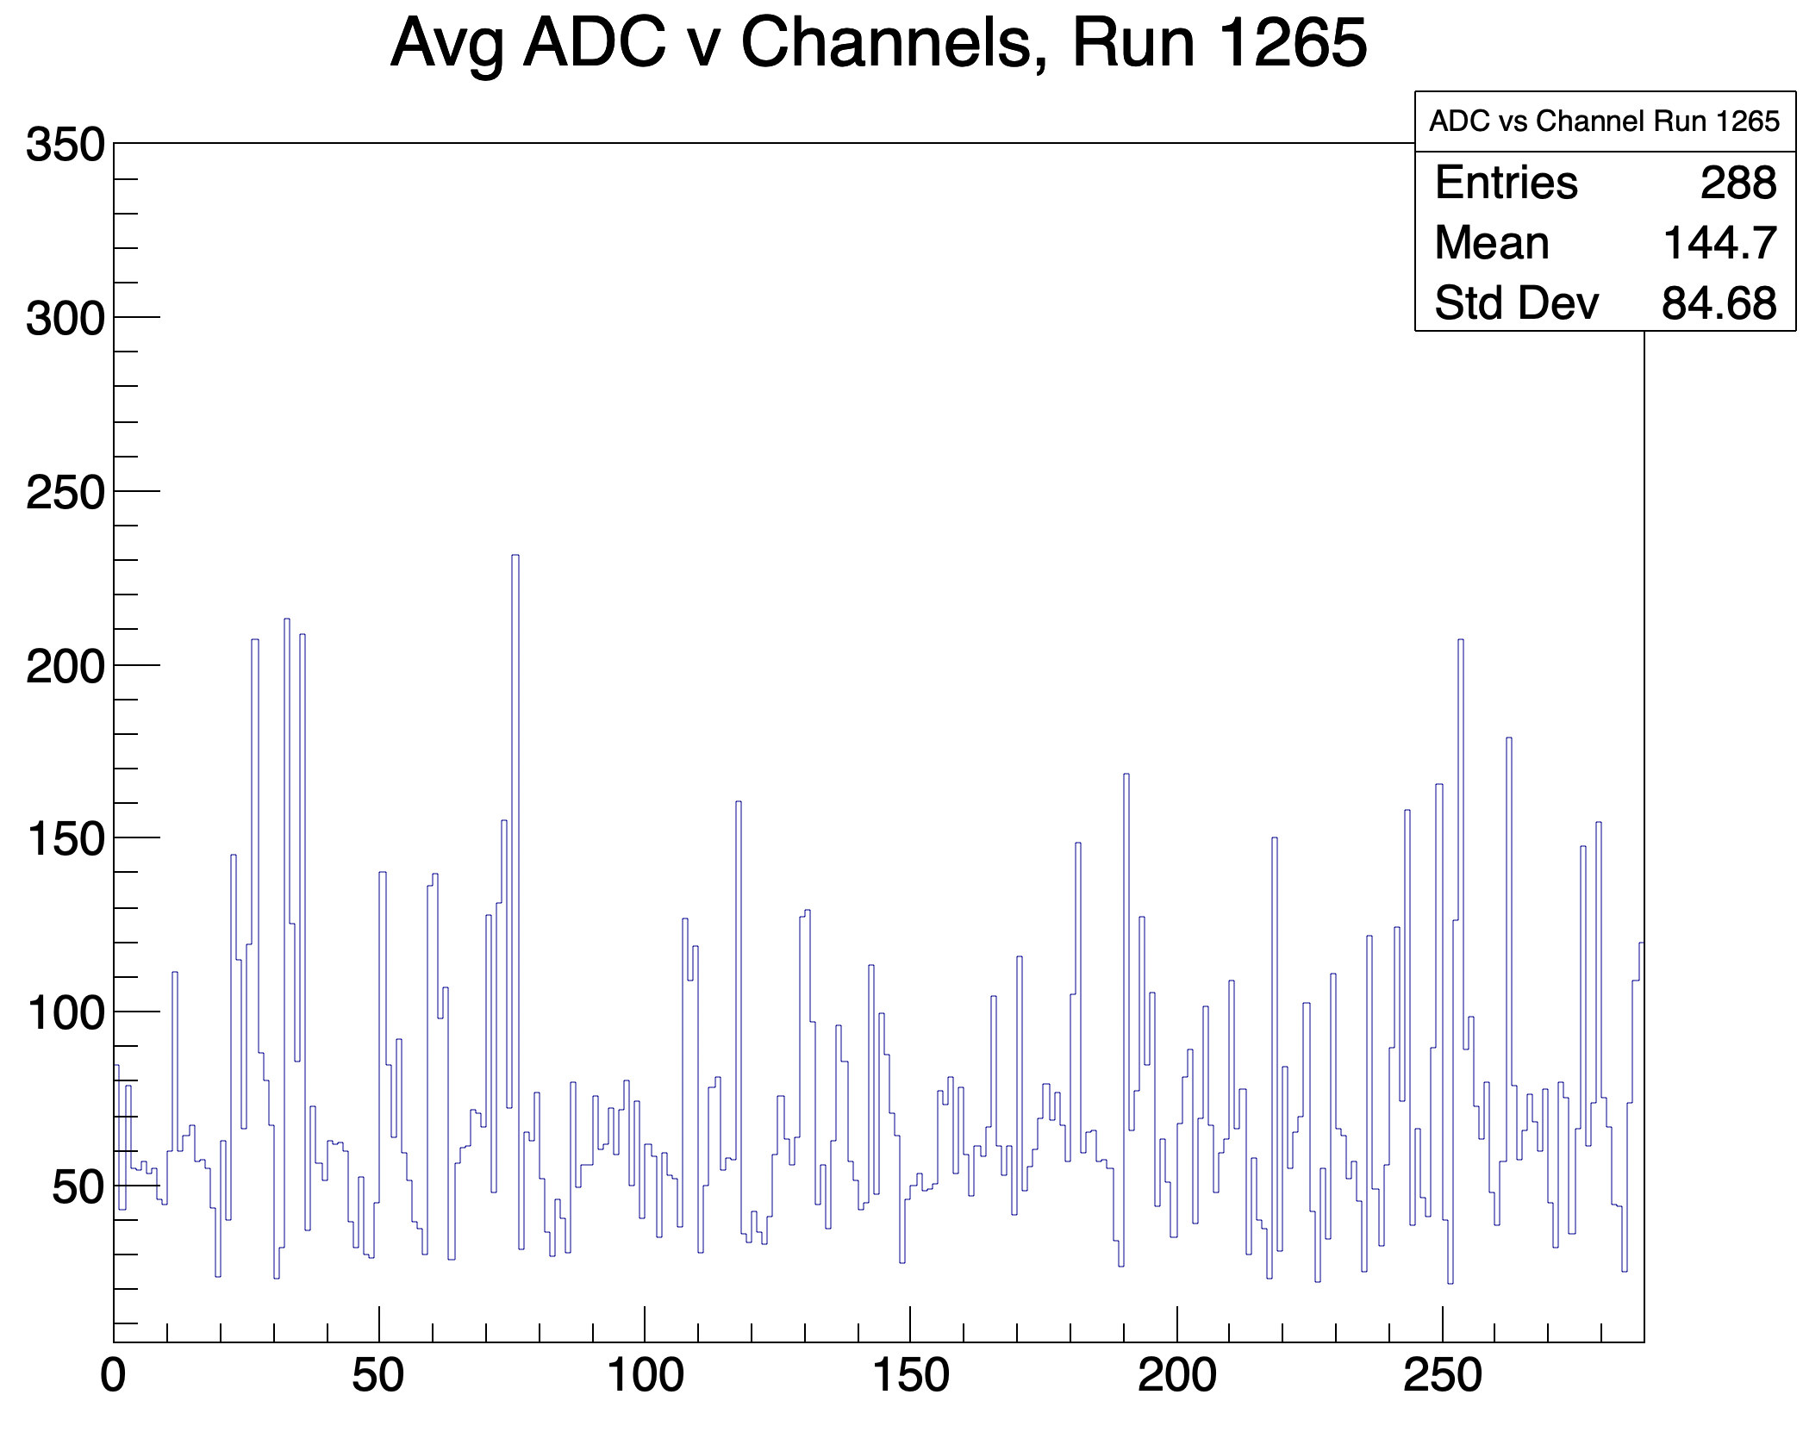
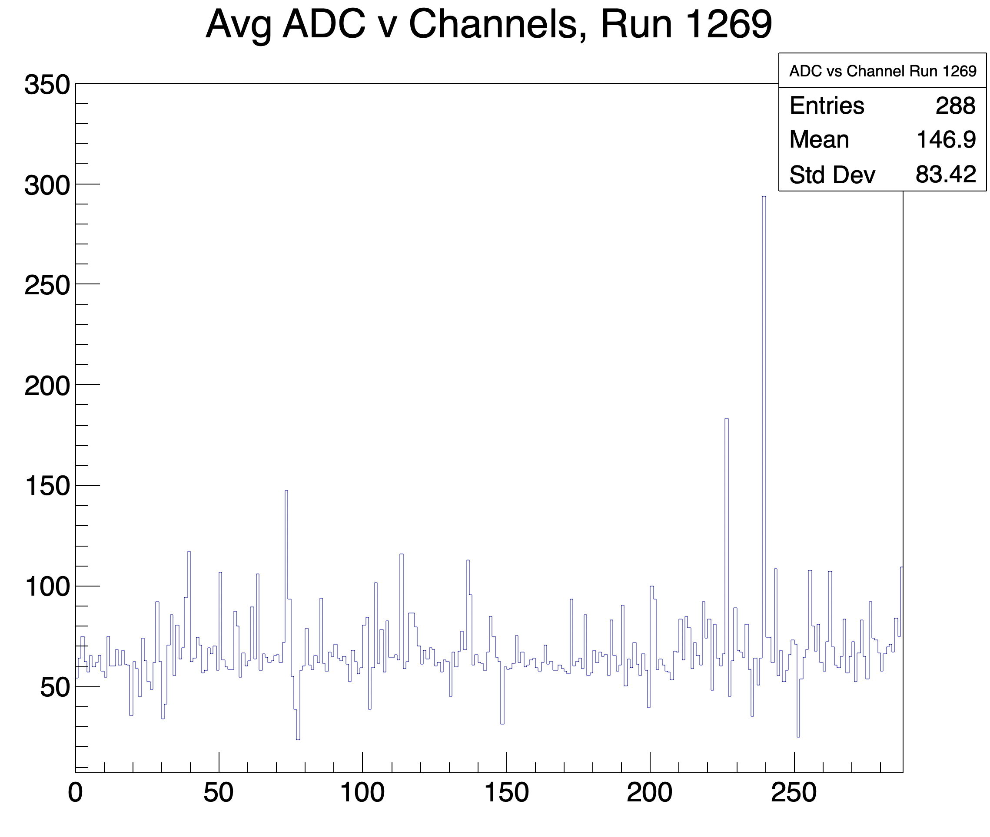
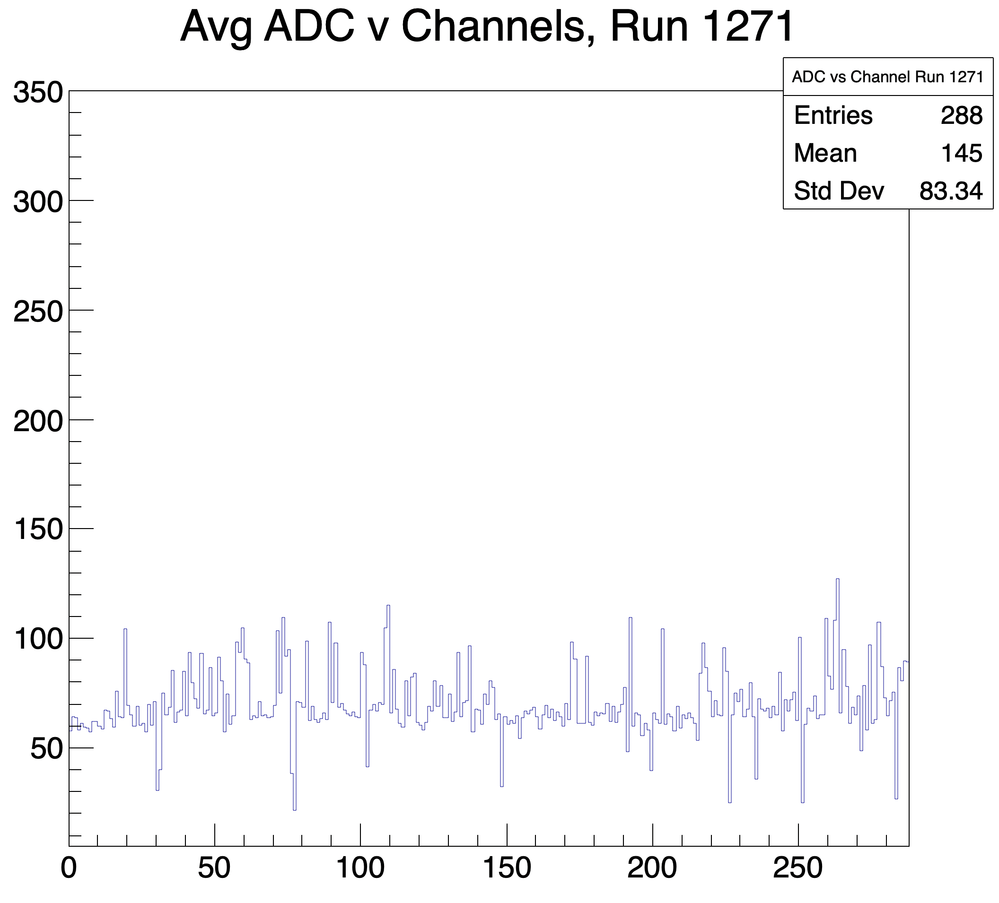
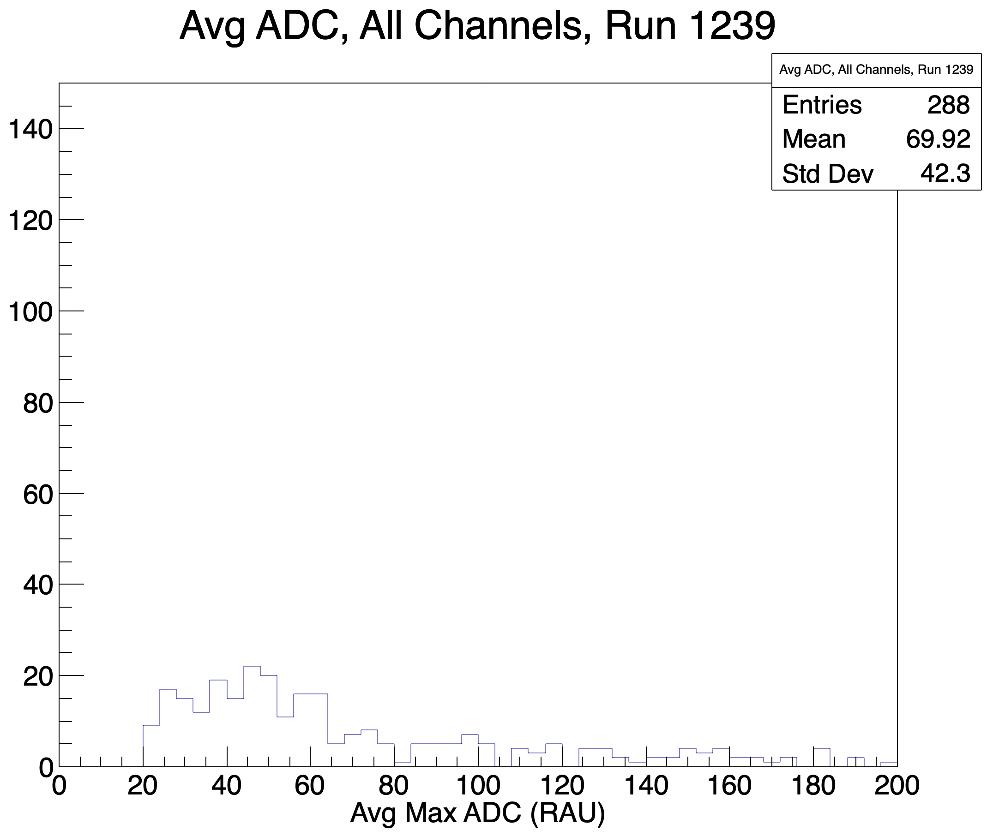
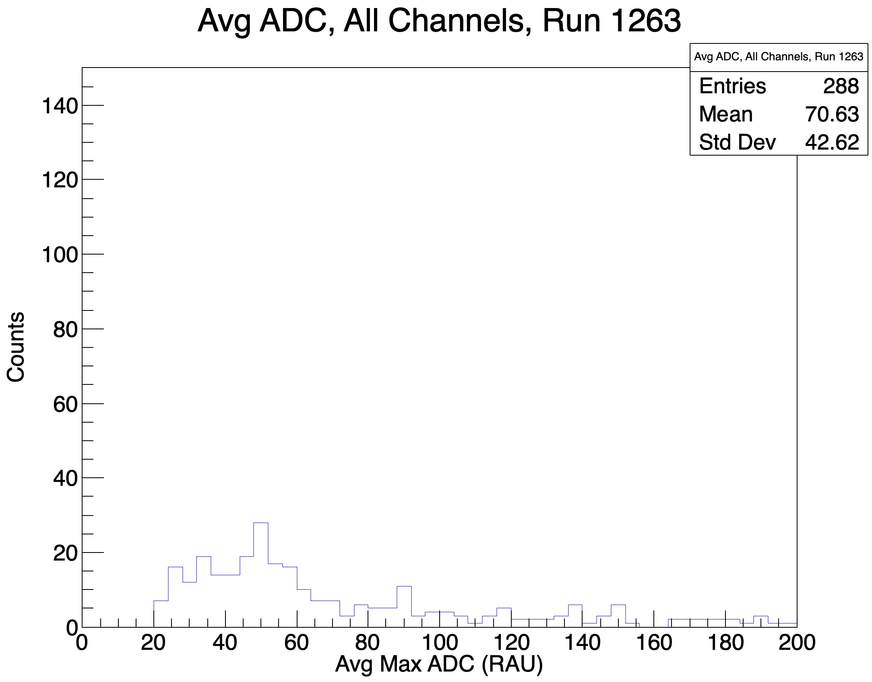
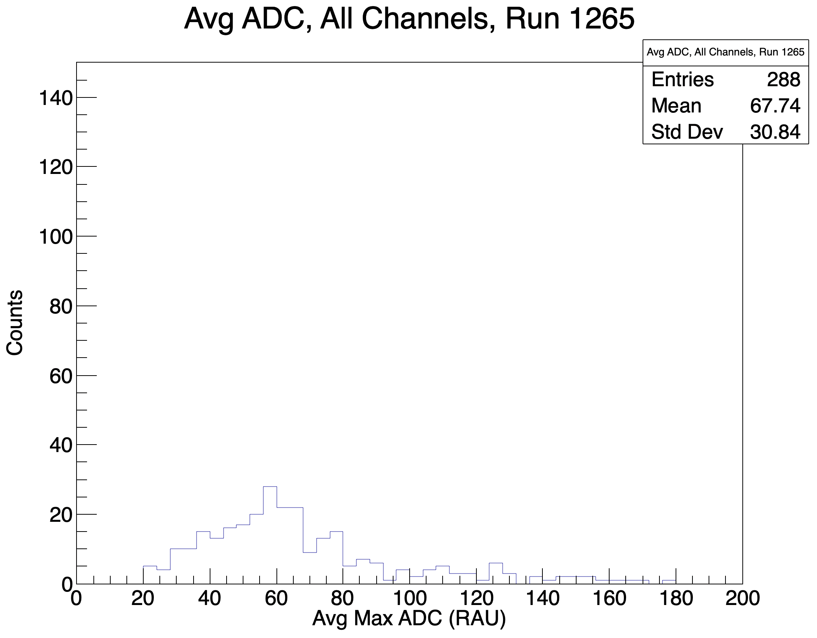
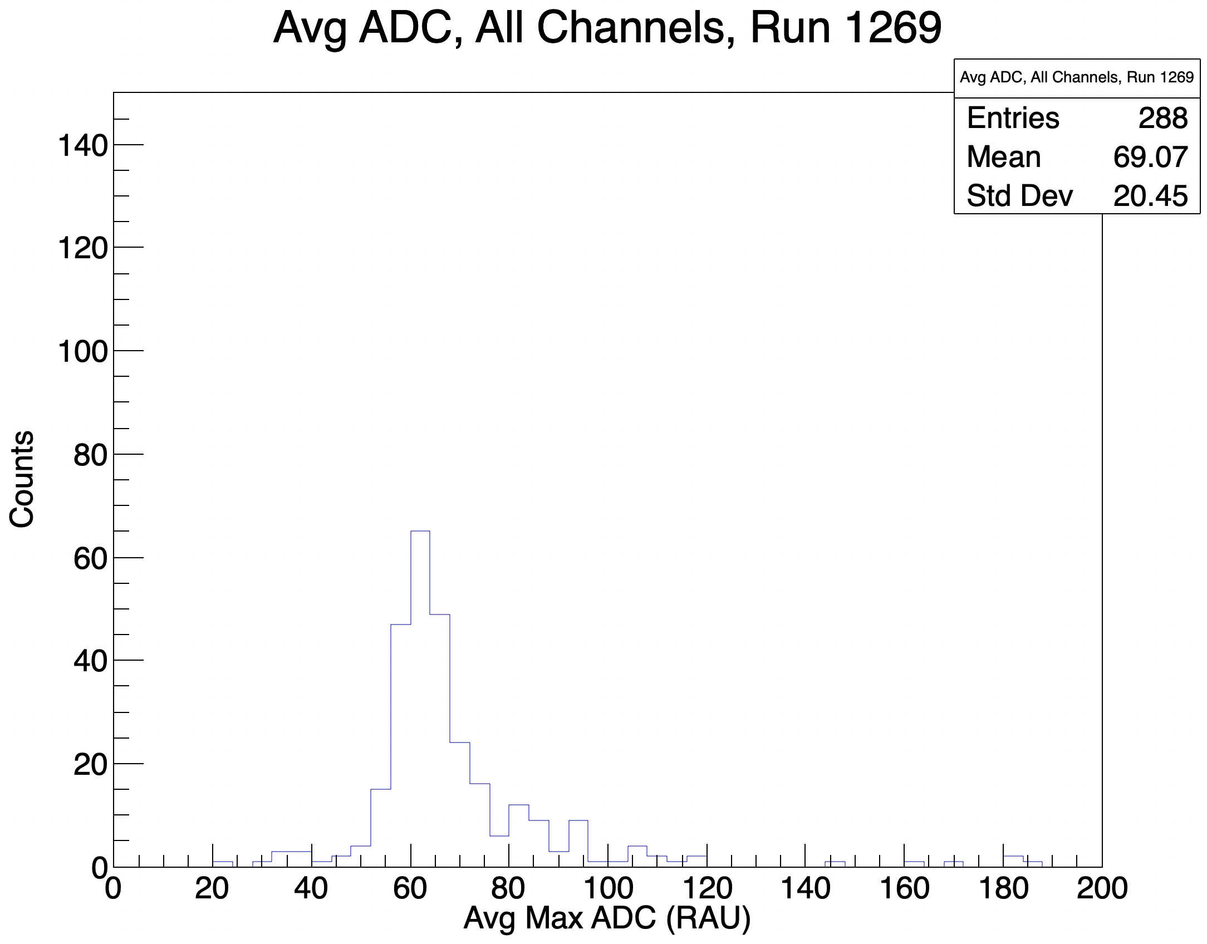
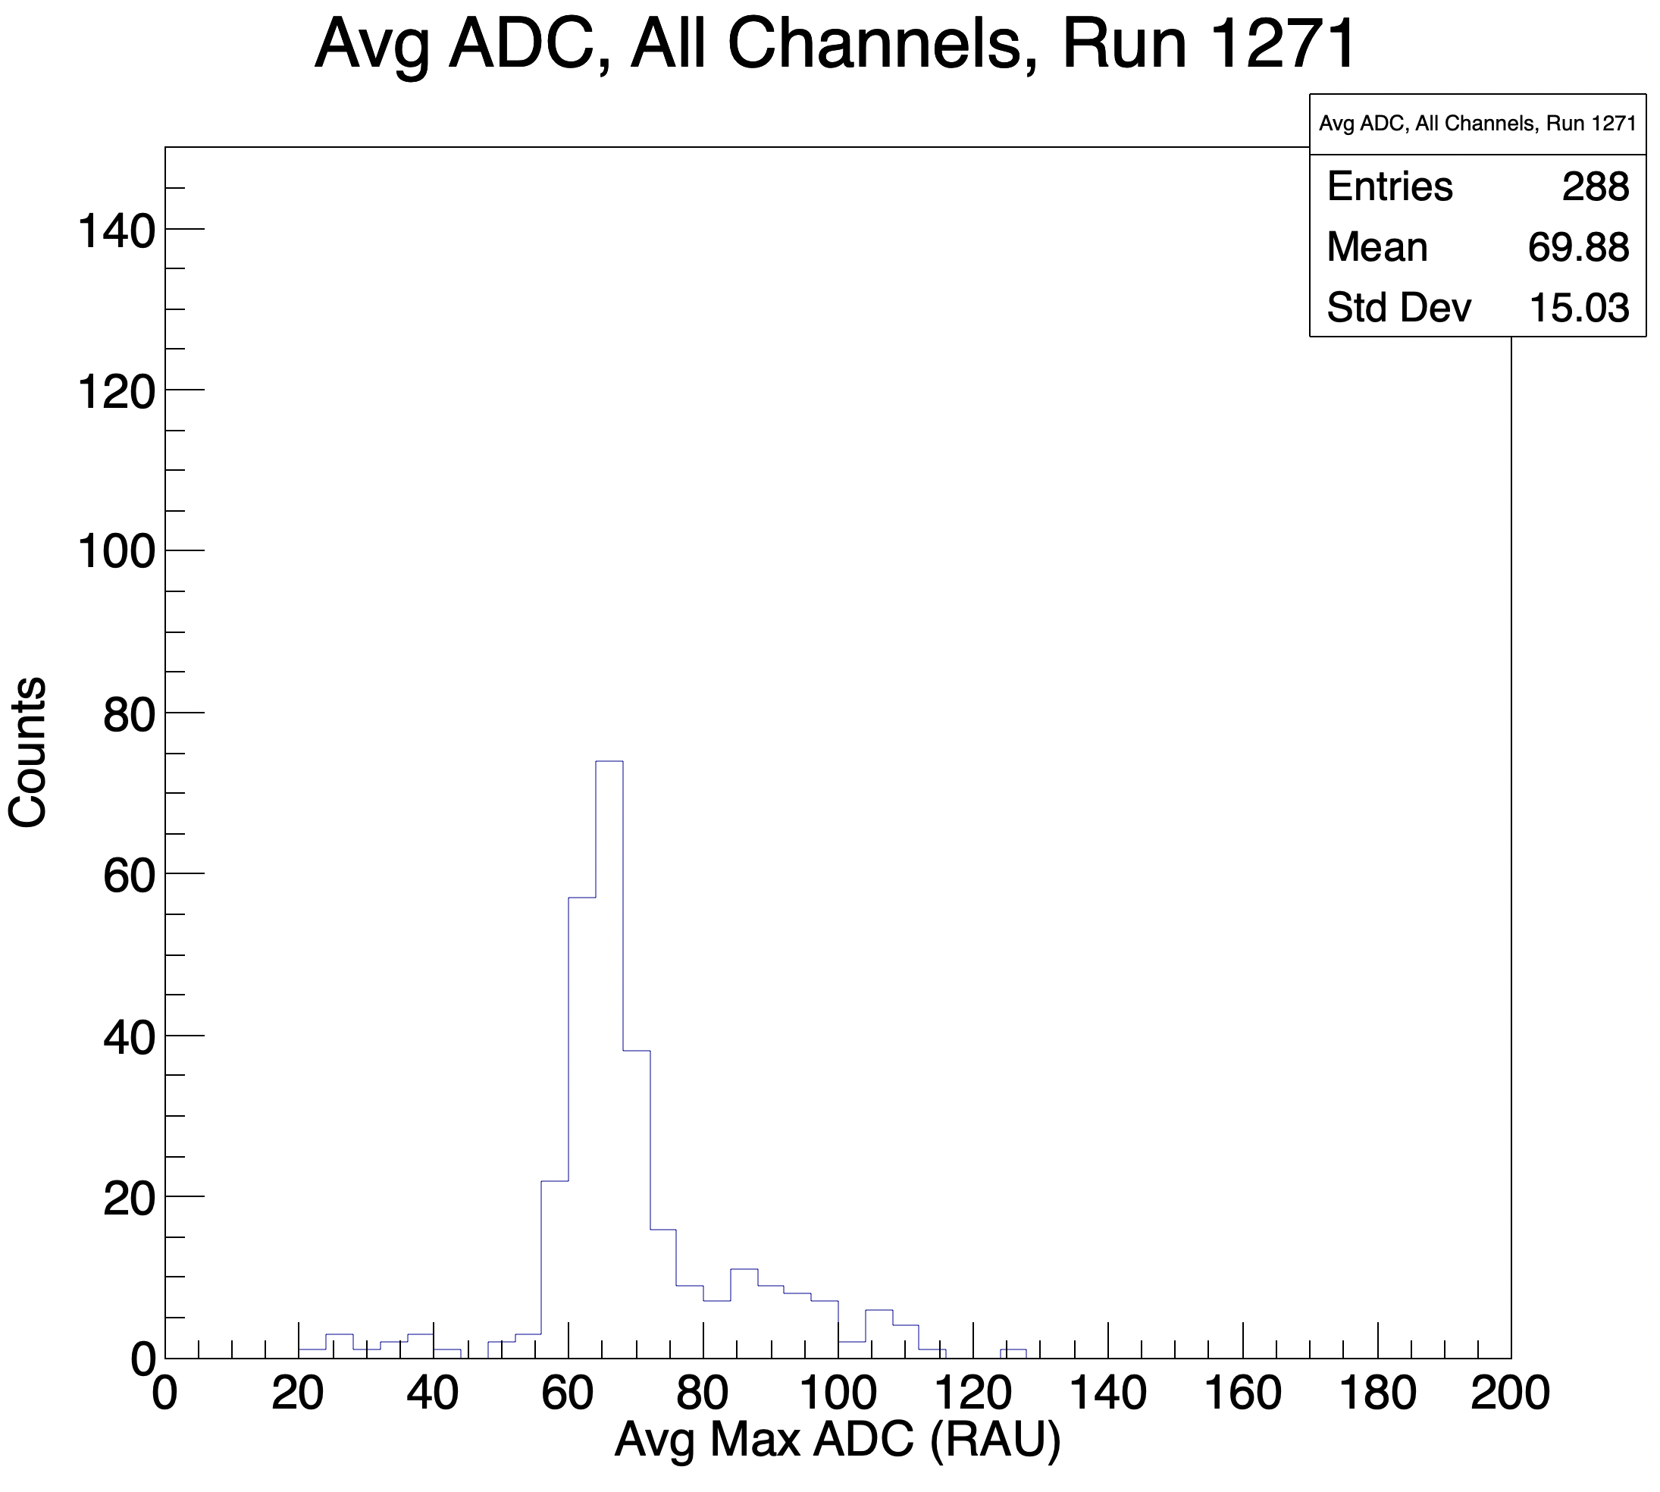
Cosmic Calibration Results - continued
Analysis Histograms
Over several iterations, all channels converging to 61 RAU Max ADC
Output target HV settings per channel
Over several Iterations
Notes:
Additionally, we can easily output a text file with all target HV settings as necessary.
SPEAK SLOWLY The results of our analysis thus far are shown here: The x axis on the top plots are channels, here indexed from 0-287. The y axis is the average max ADC value for that run. The bottom plots are aggregate histograms of average max adc over all channels per run. As we pass over several iterations, we can see the variance decrease and the mean value approach 61 RAU, as expected.

Slide 12
Future HCal work
Hardware
Can extract gain curves by pmt across various HV settings and compare with parallel LED analysis (see Vanessa Brio’s talk).
This will provide a means to calibrate by various kinematics in the hall via better estimation of alpha parameter.
Hardware checks
General calibration constants are being checked by channel to account for front end electronics and cable attenuation. These analyses consider an electronics attenuation factor of 0.75, but recent measurements will update this factor (closer to 0.6).
Software
Implement script to run when we have beam that sets HV by channel from signal via gain curve.
Notes:
There’s still much to do. Read slide

Slide 13
Acknowledgments
David Flay and Eric Fuchey - beamline and geant4
Juan Carlos Cornejo and Scott Barcus - HCal, g4sbs, hardware
Andrew Puckett
Lots to do! Thank you for your time and attention!

Slide 14
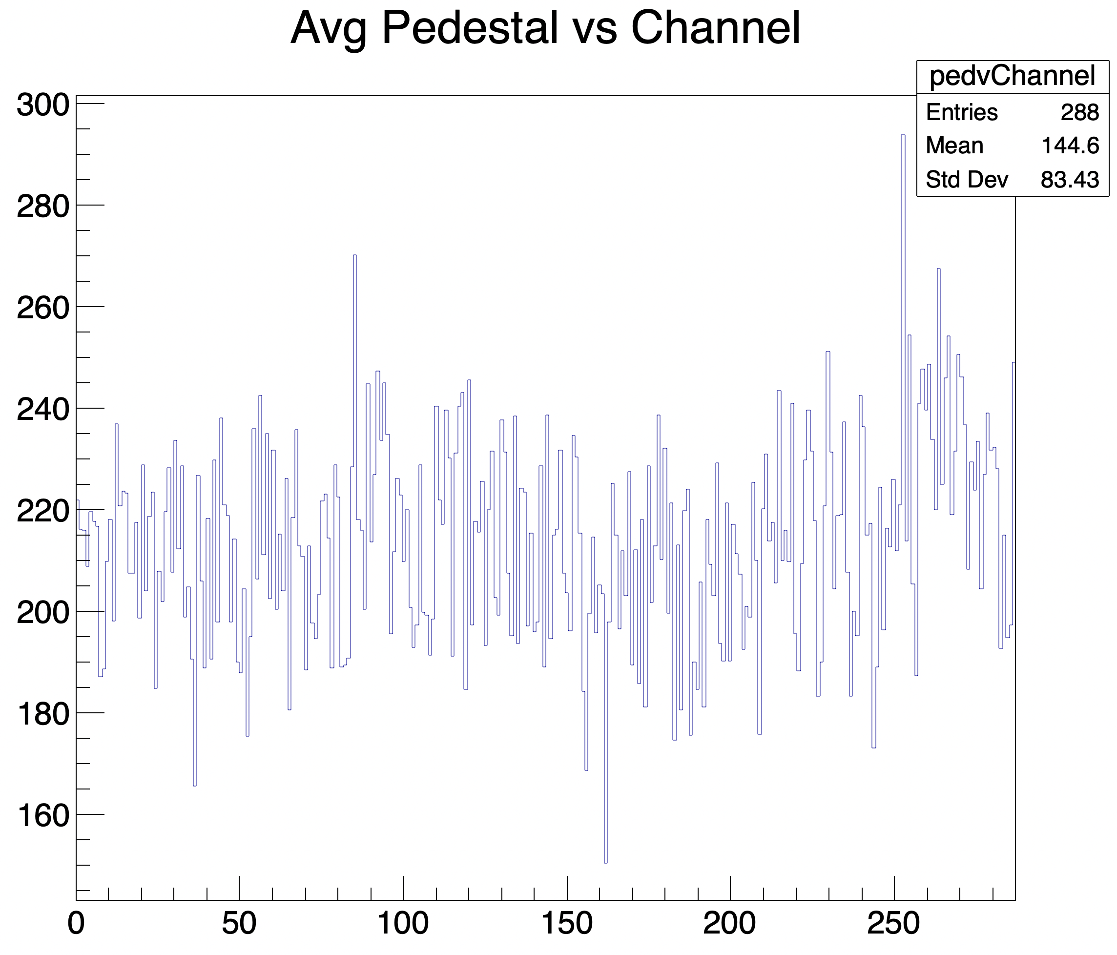
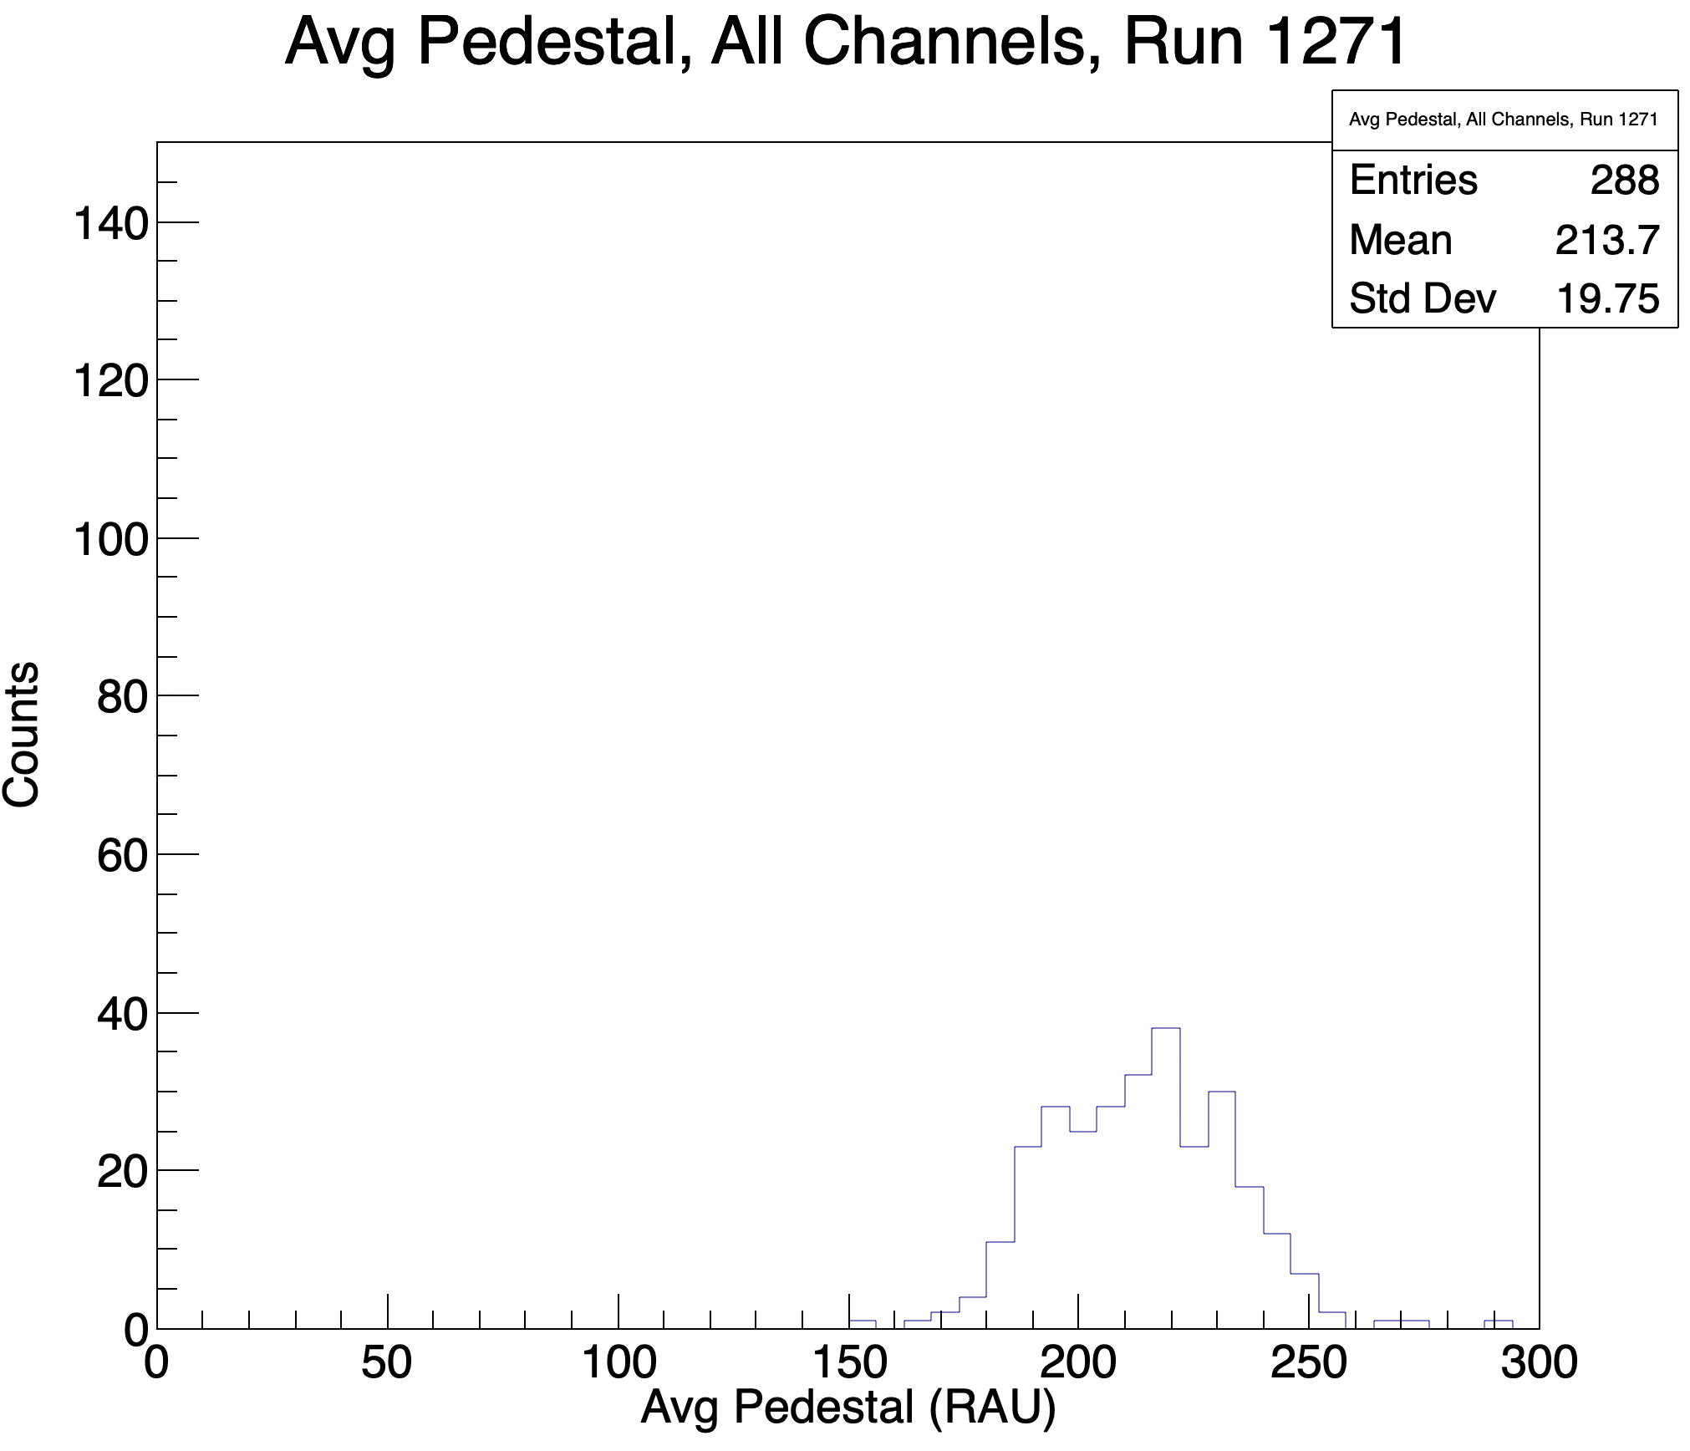
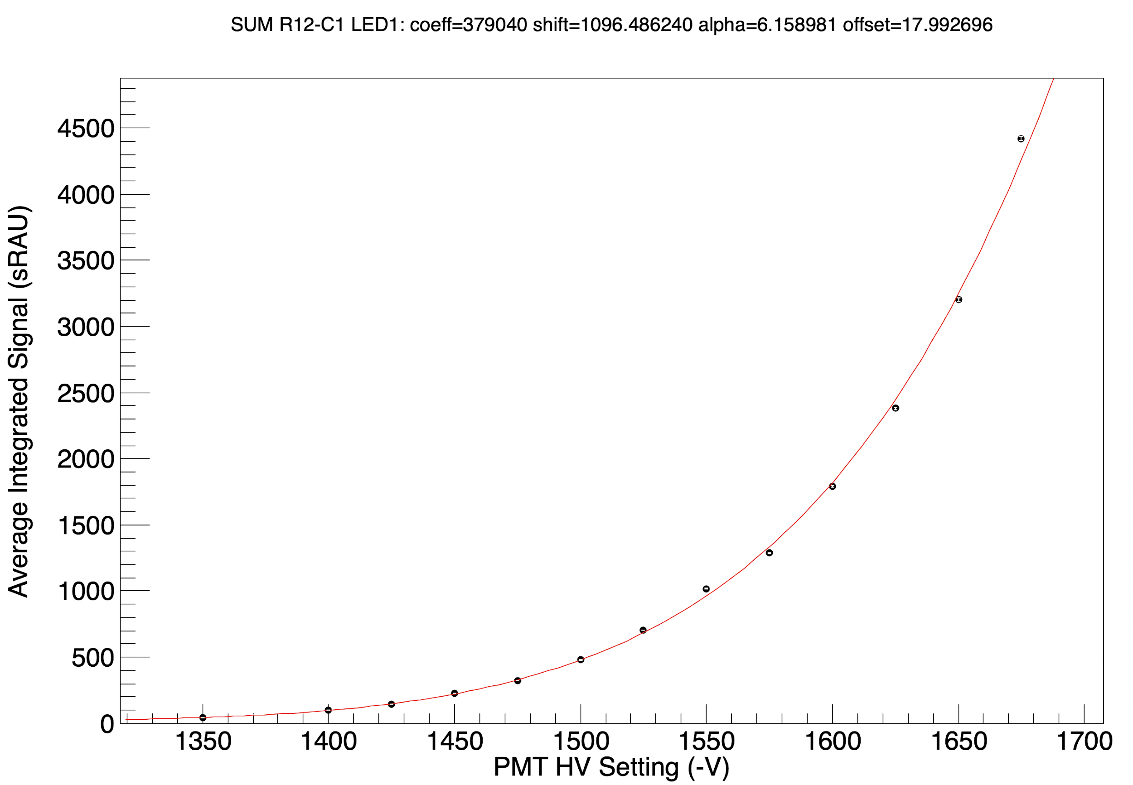
Backup
Pedestals
Gain Curves

Slide 15
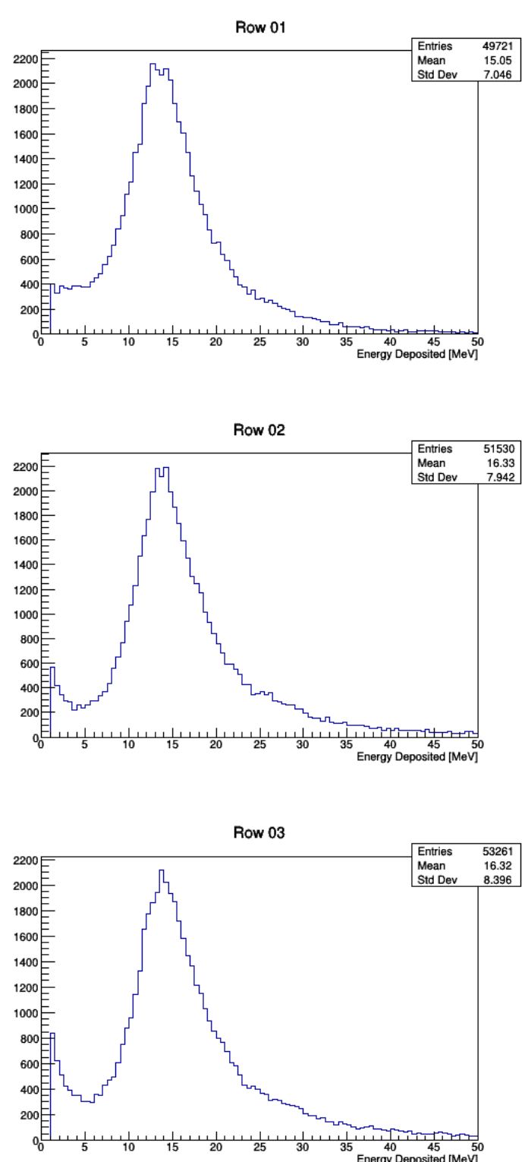
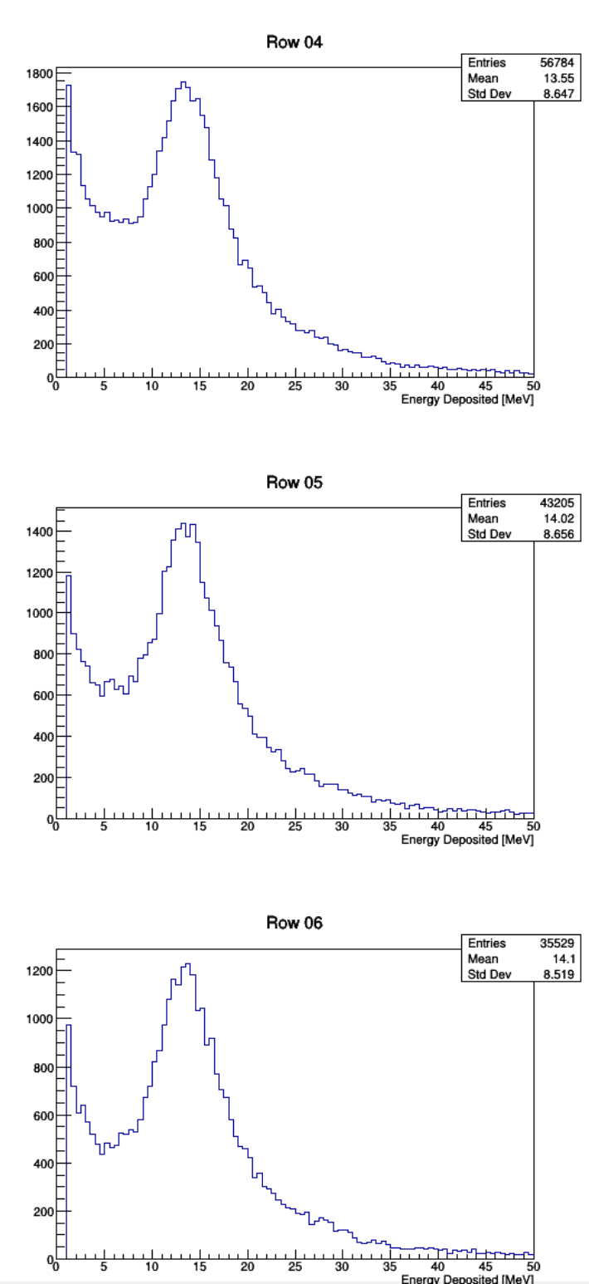
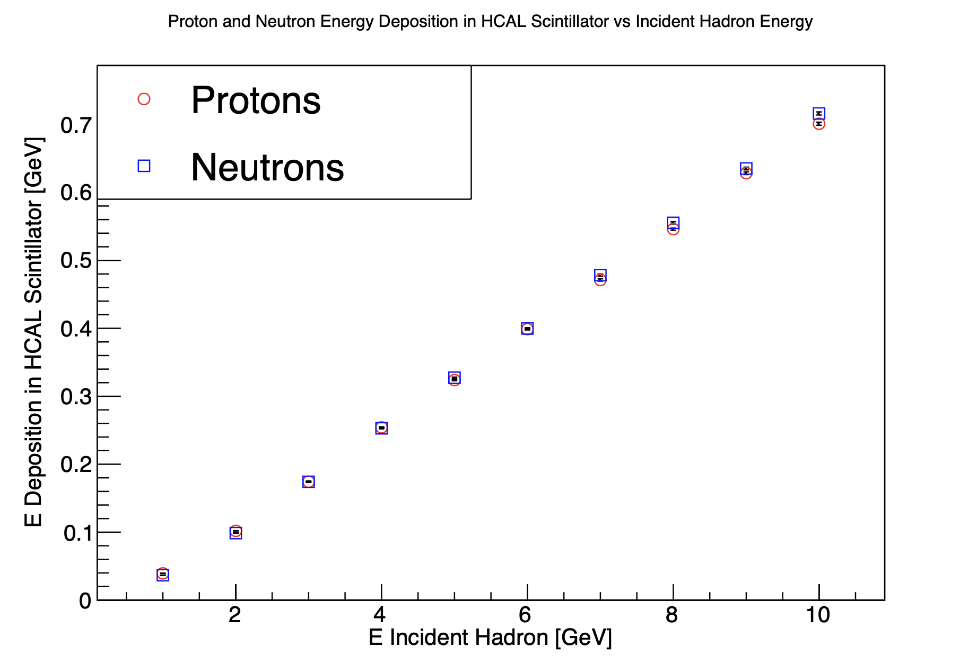
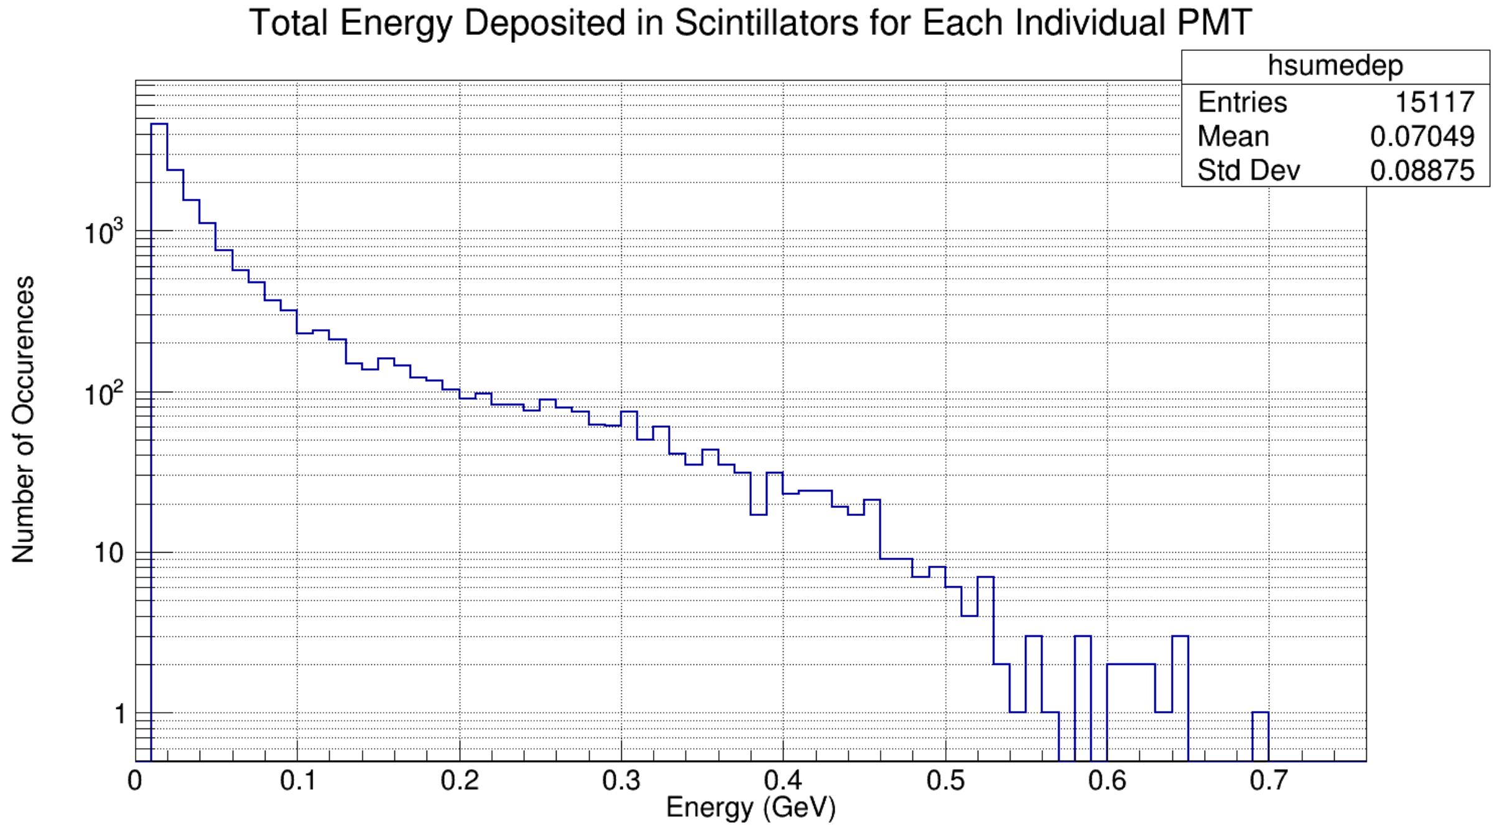
Backup
Average cosmic E
Simulation plots via Juan Carlos Cornejo
Total E dep per pmt
Simulation plots Sebastian Seeds and Scott Barcus

Slide 16
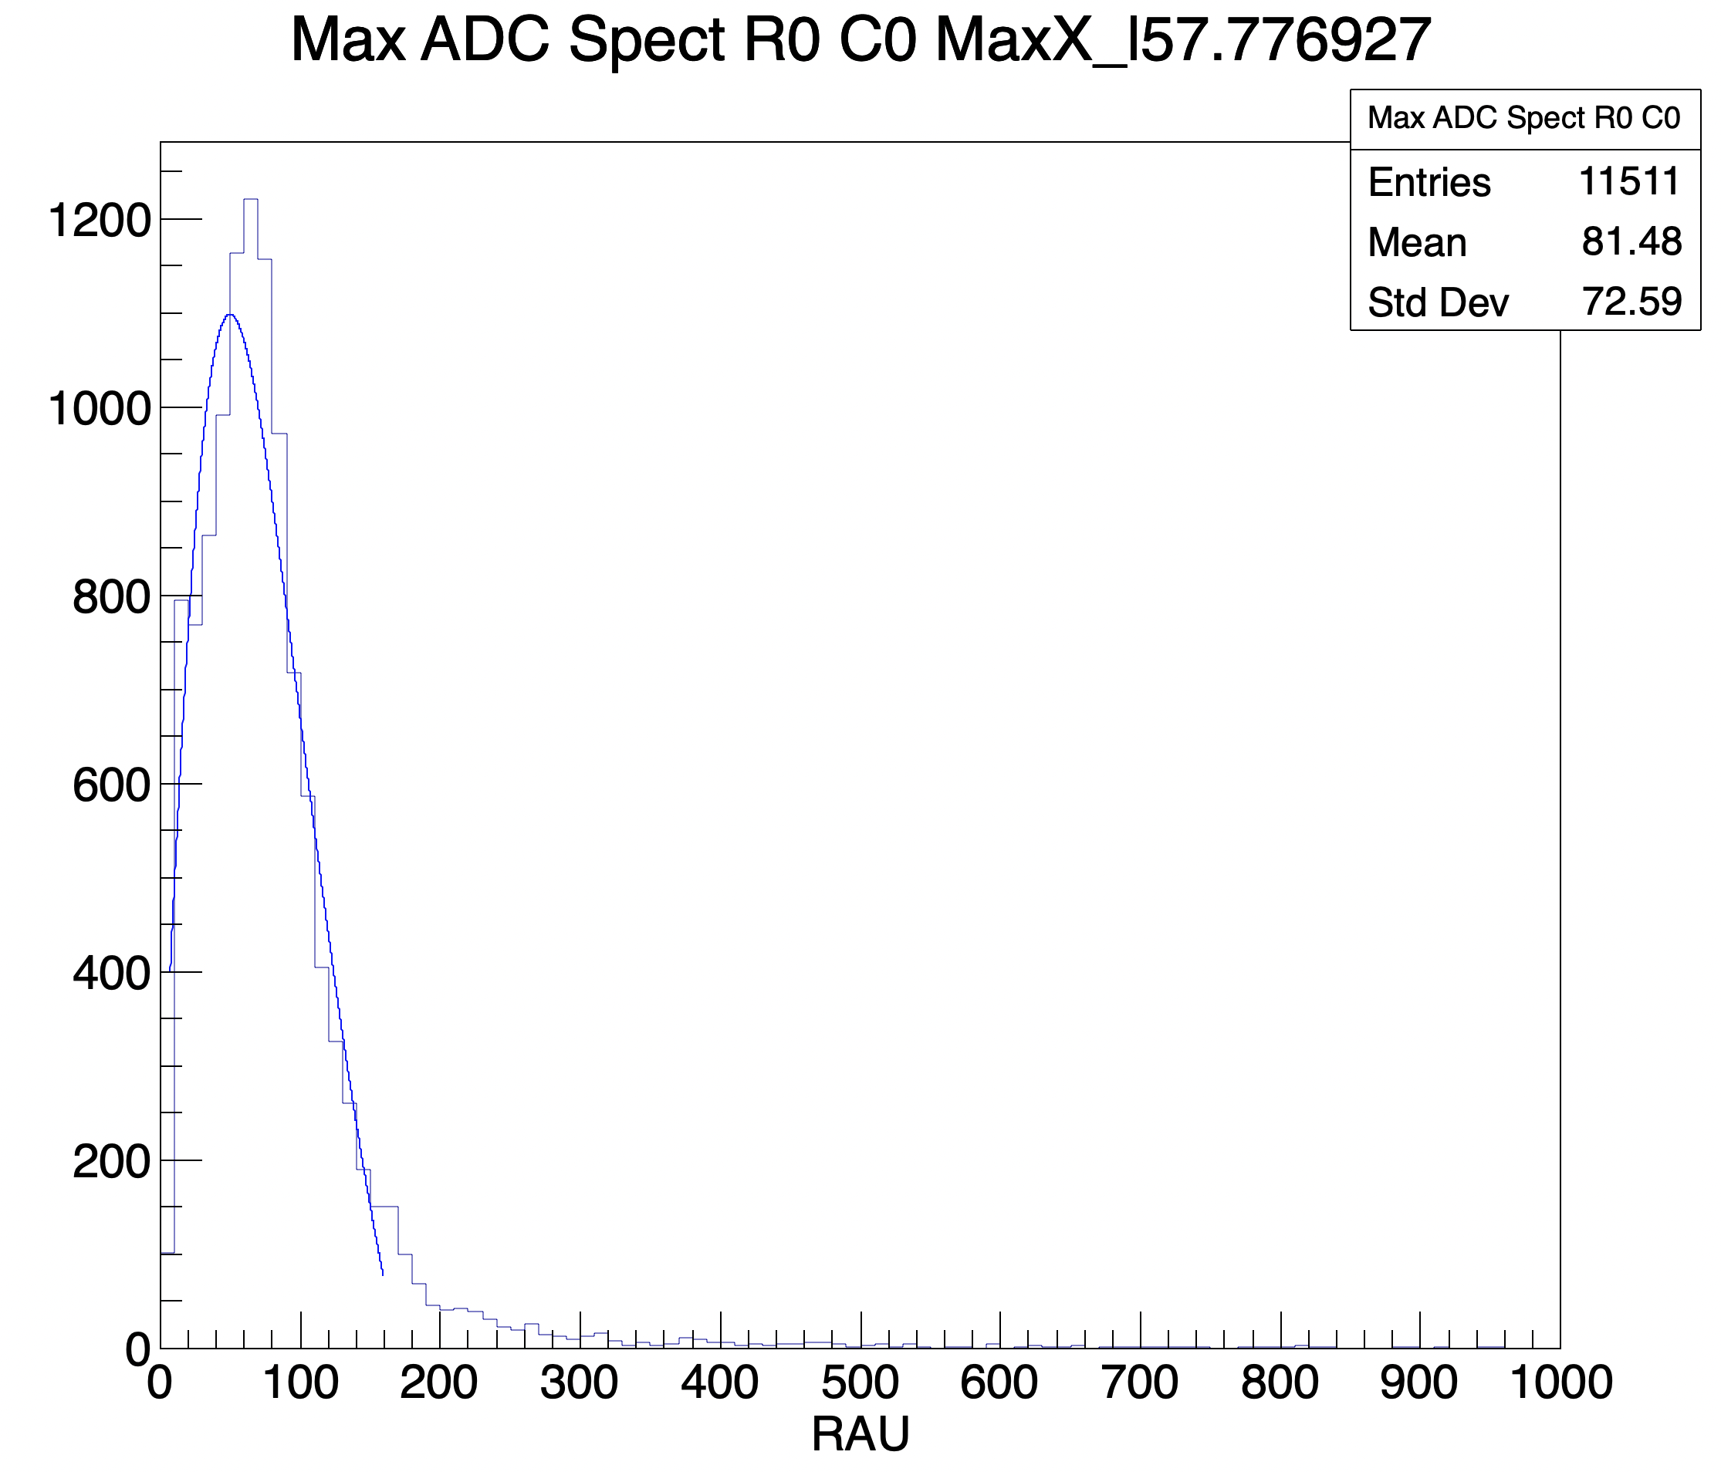
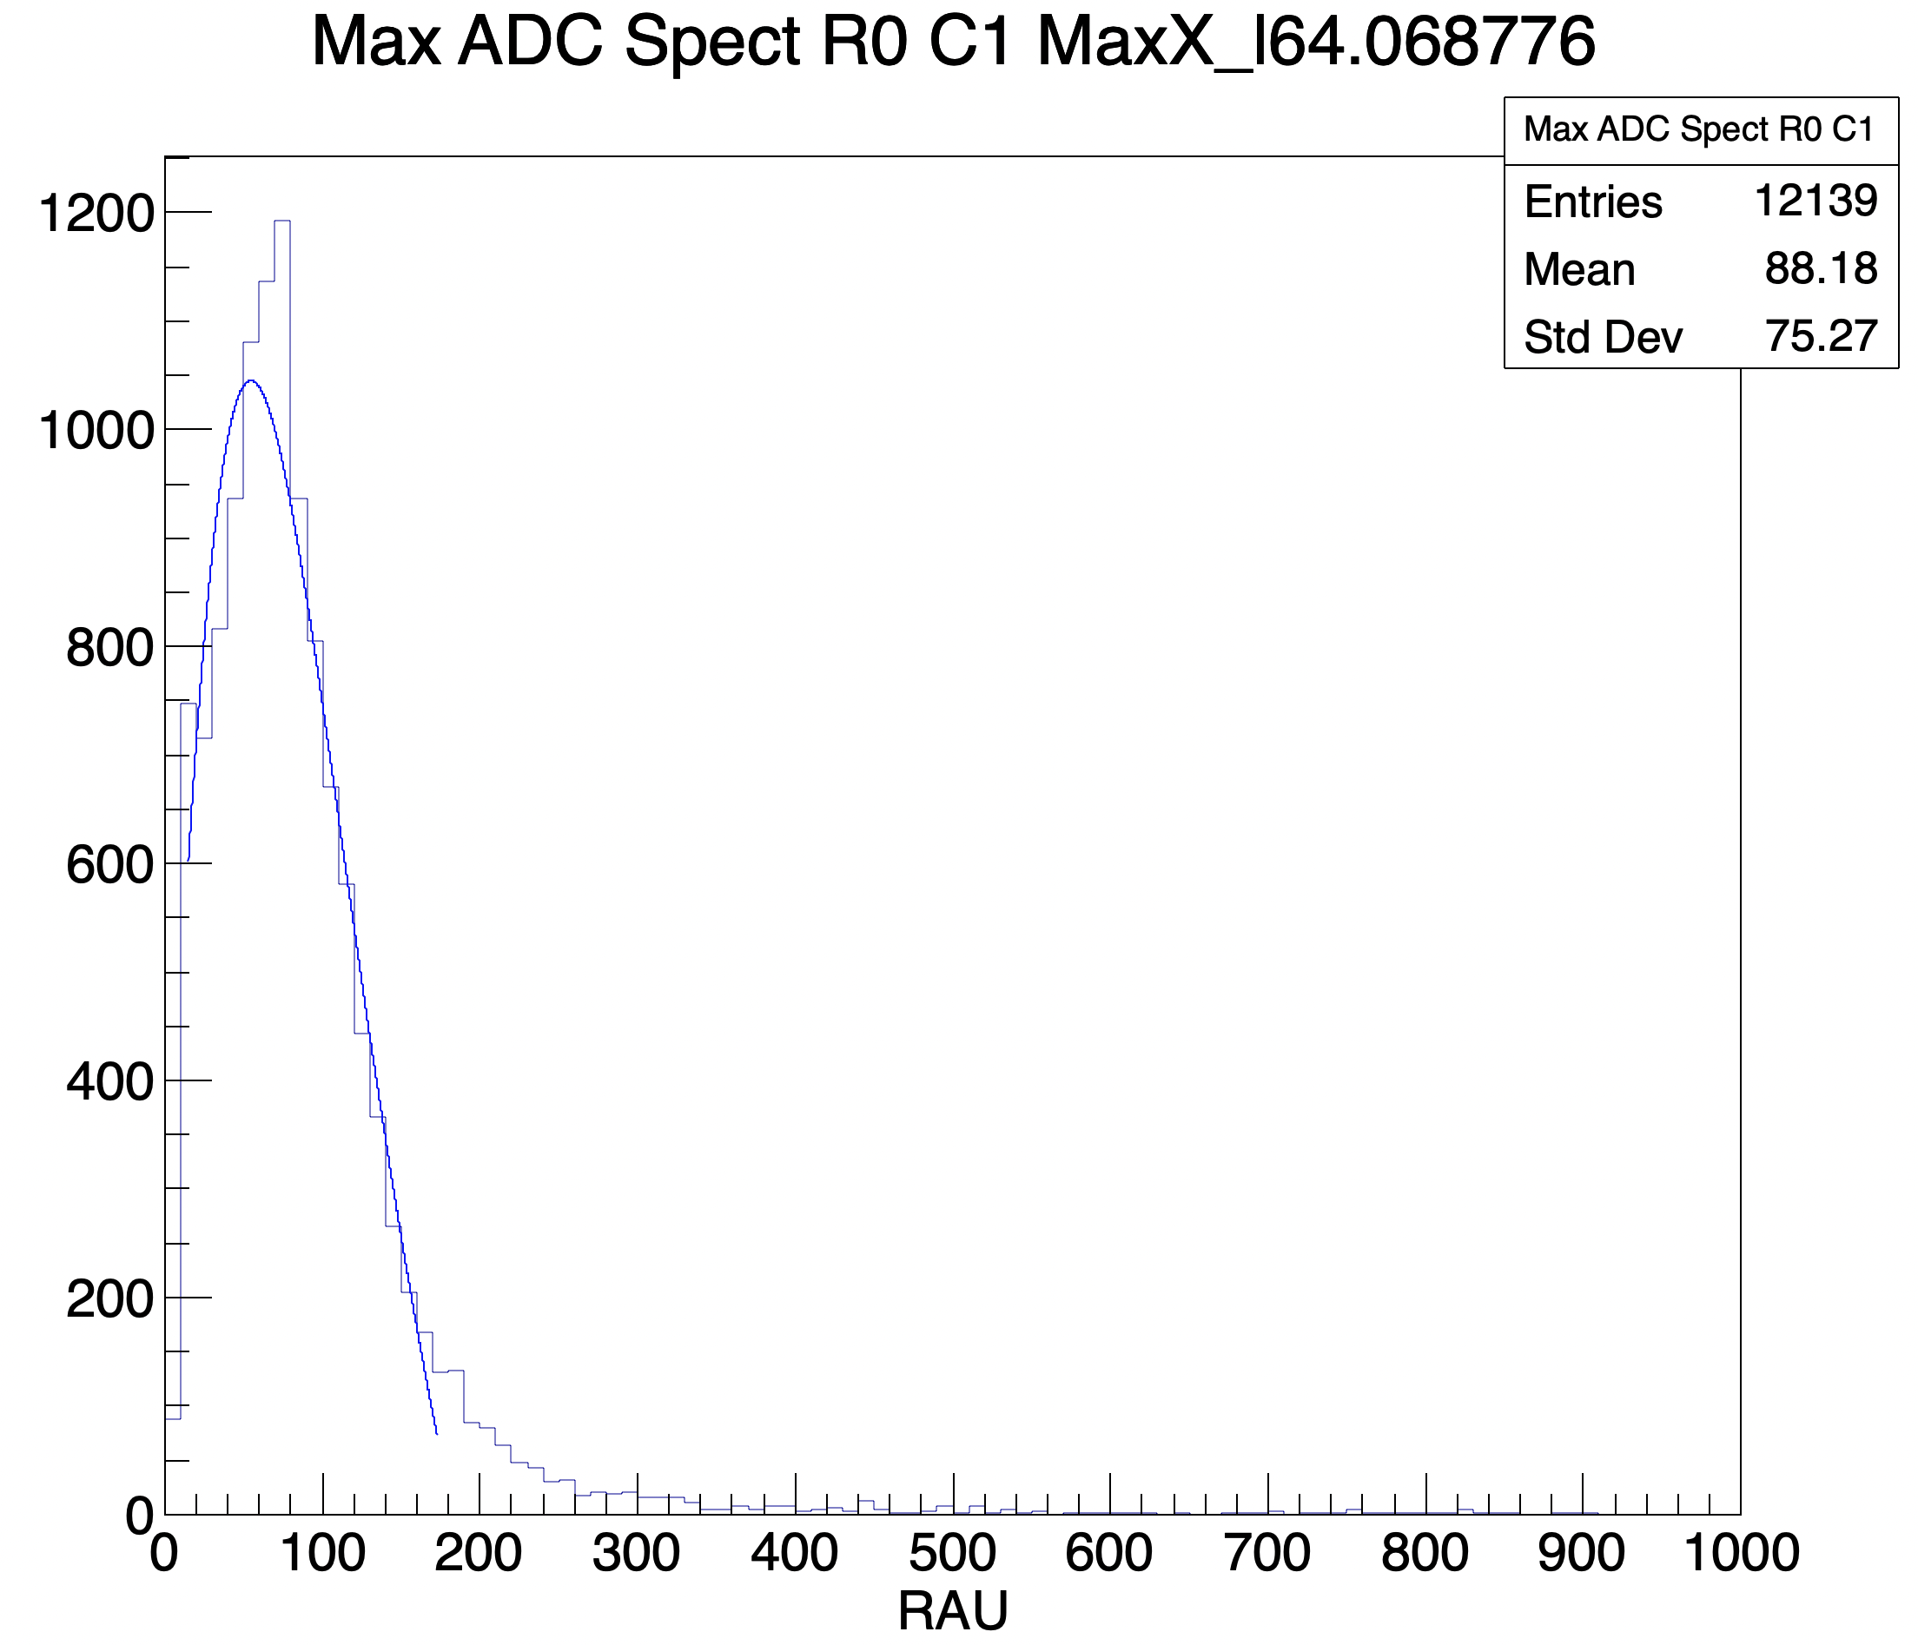
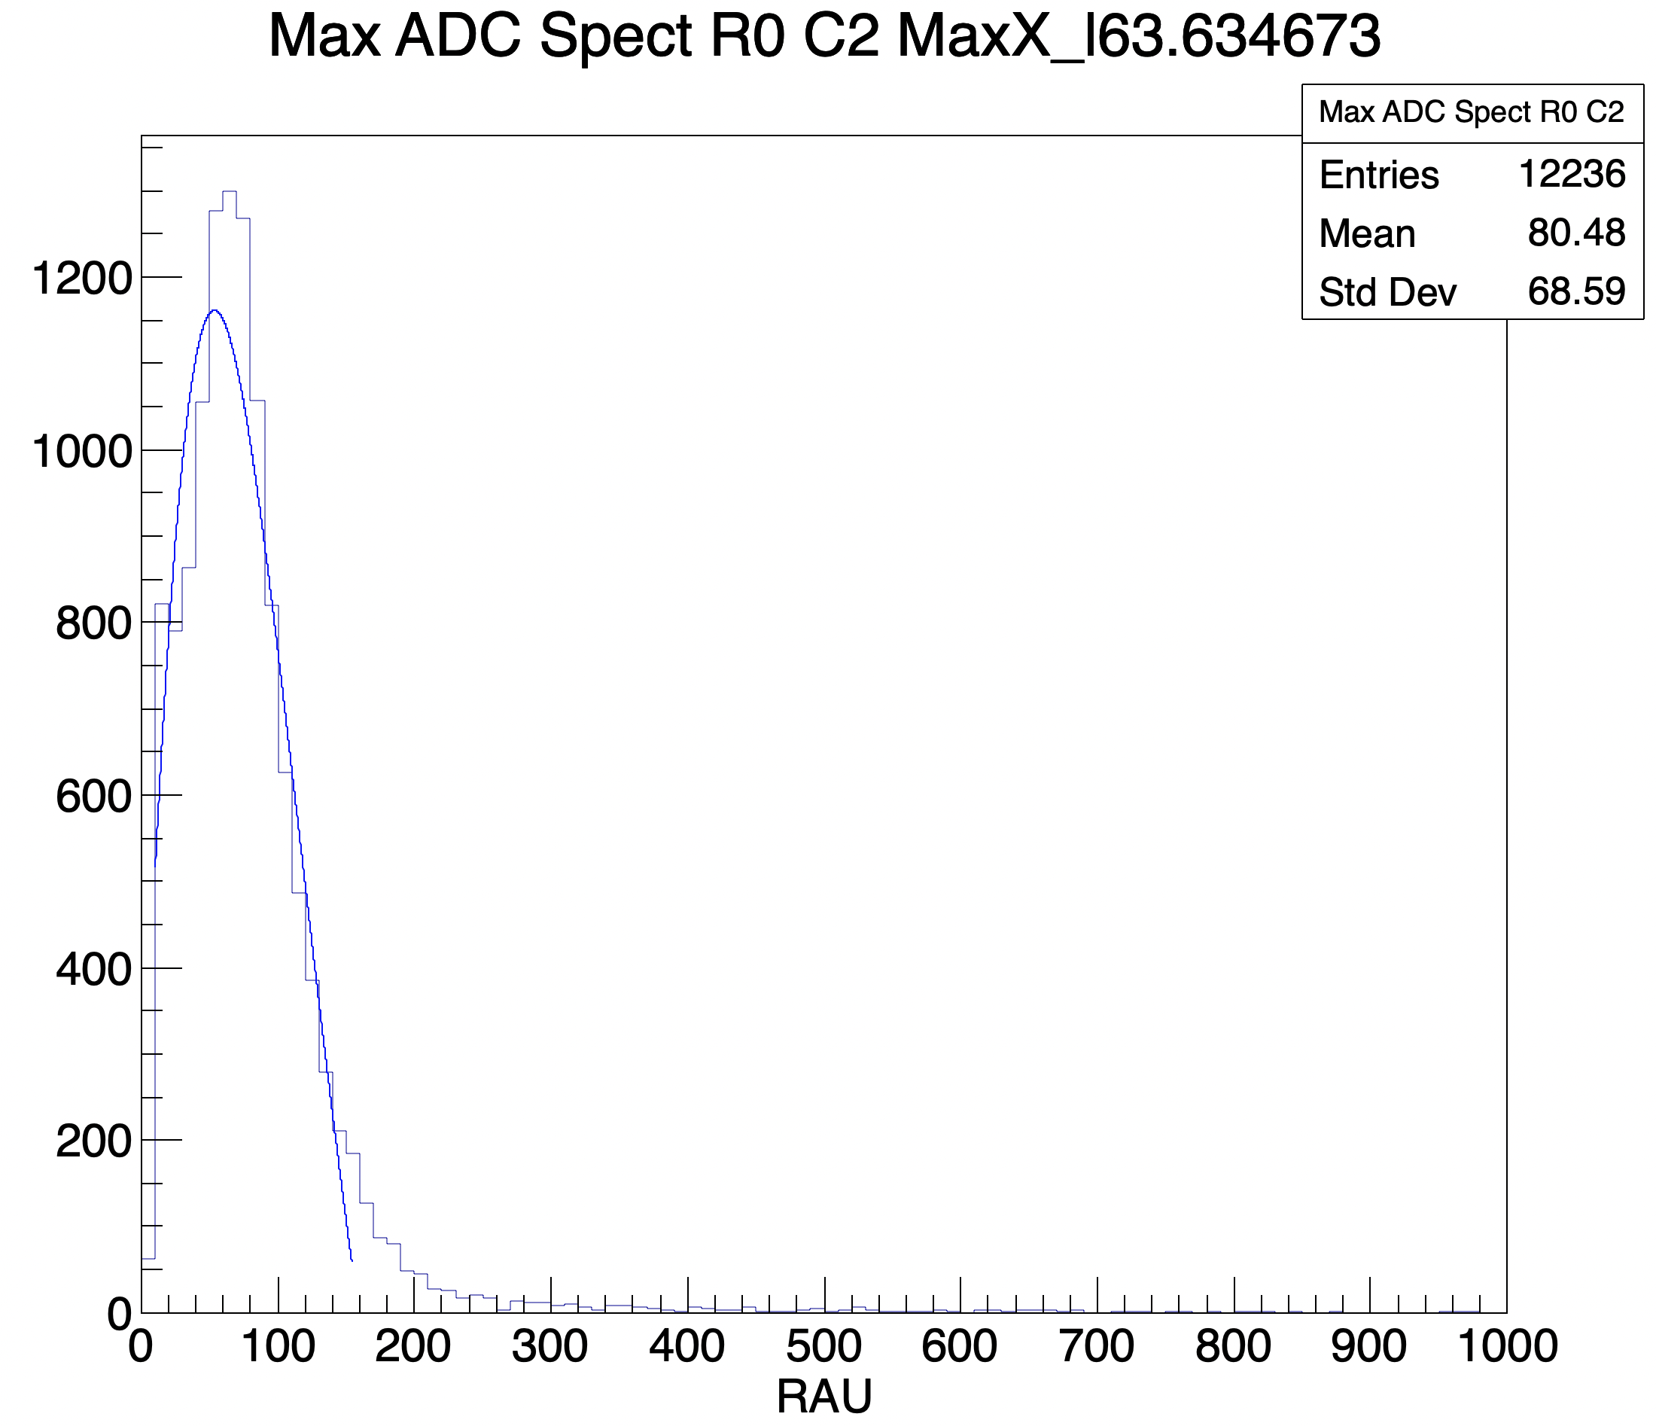
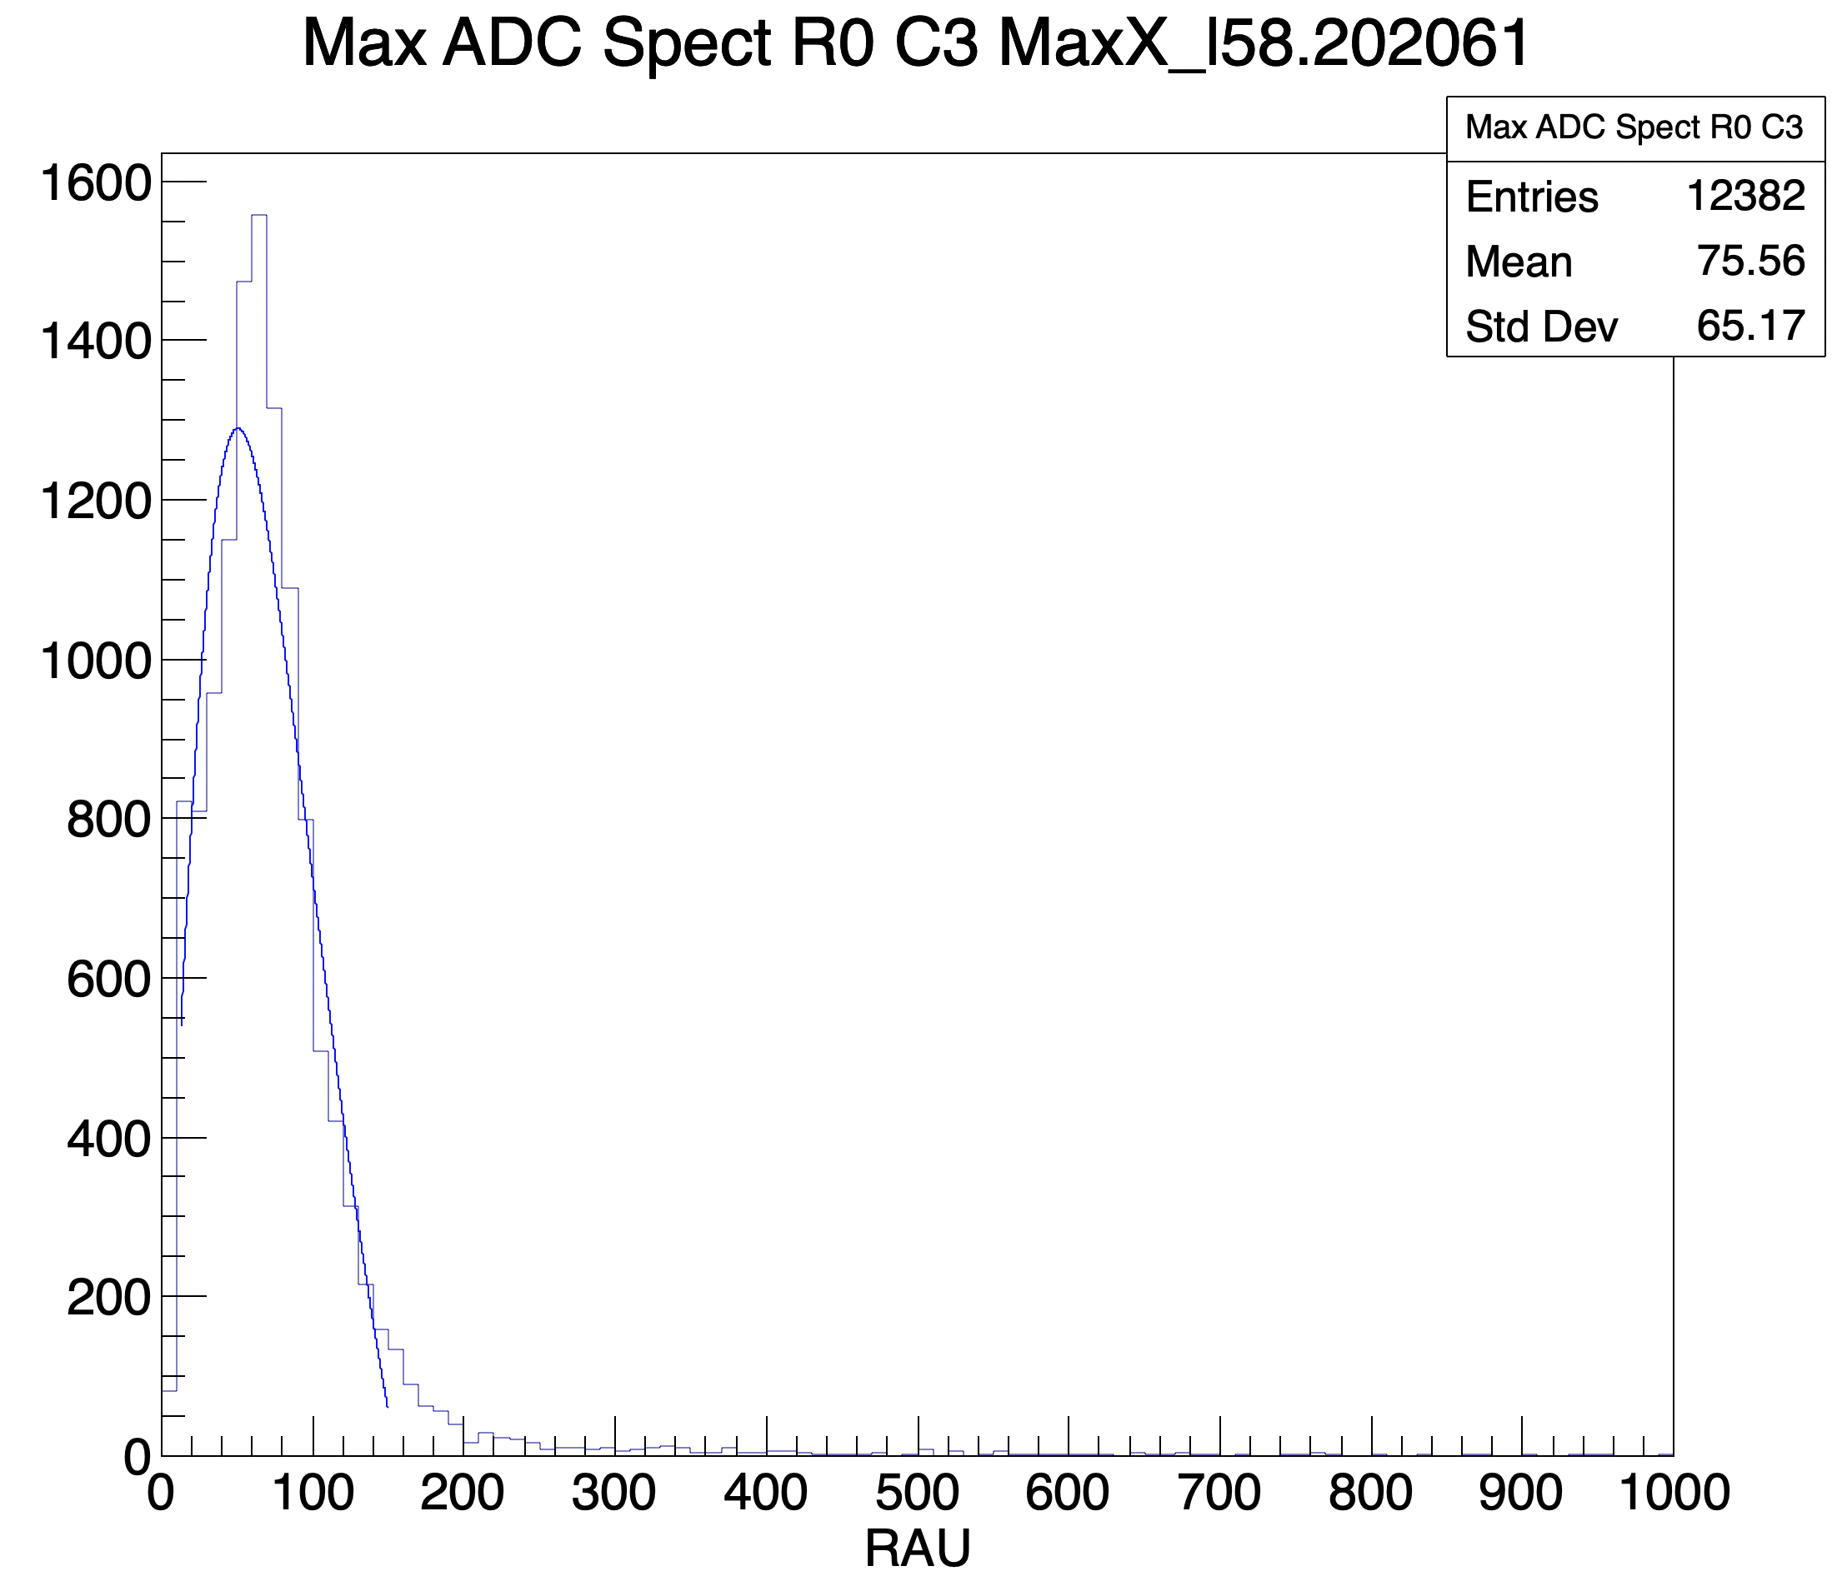
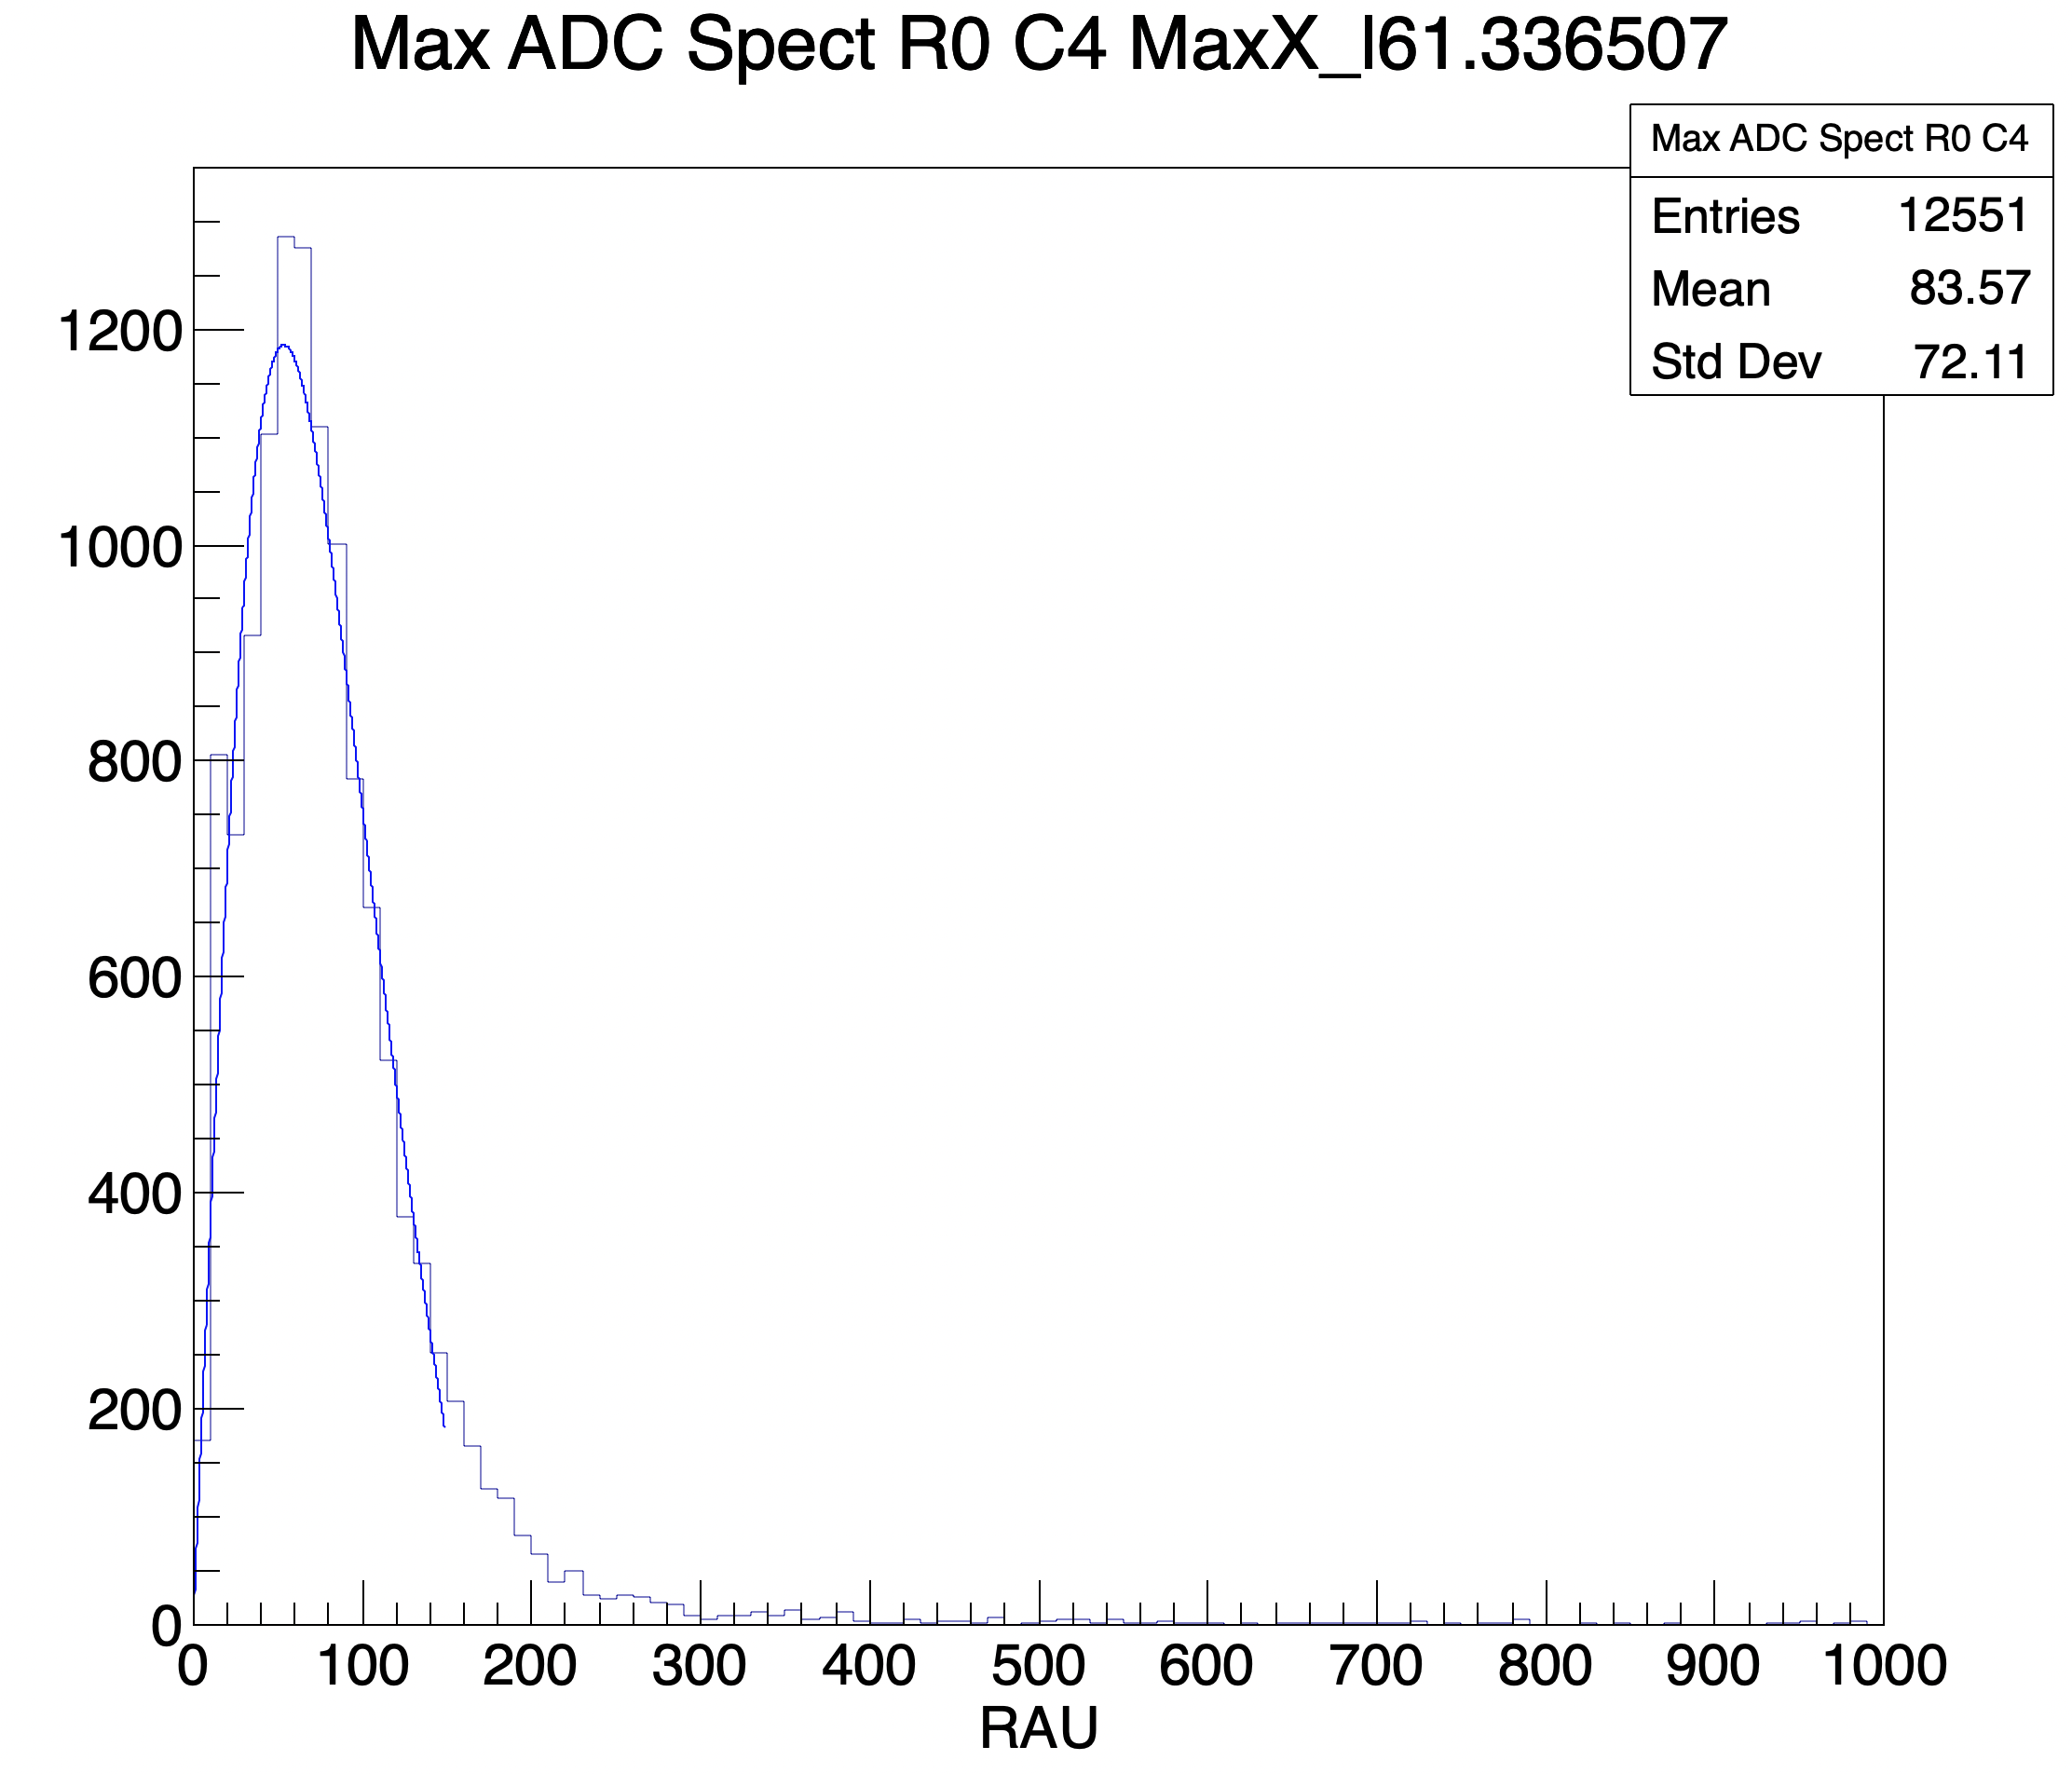
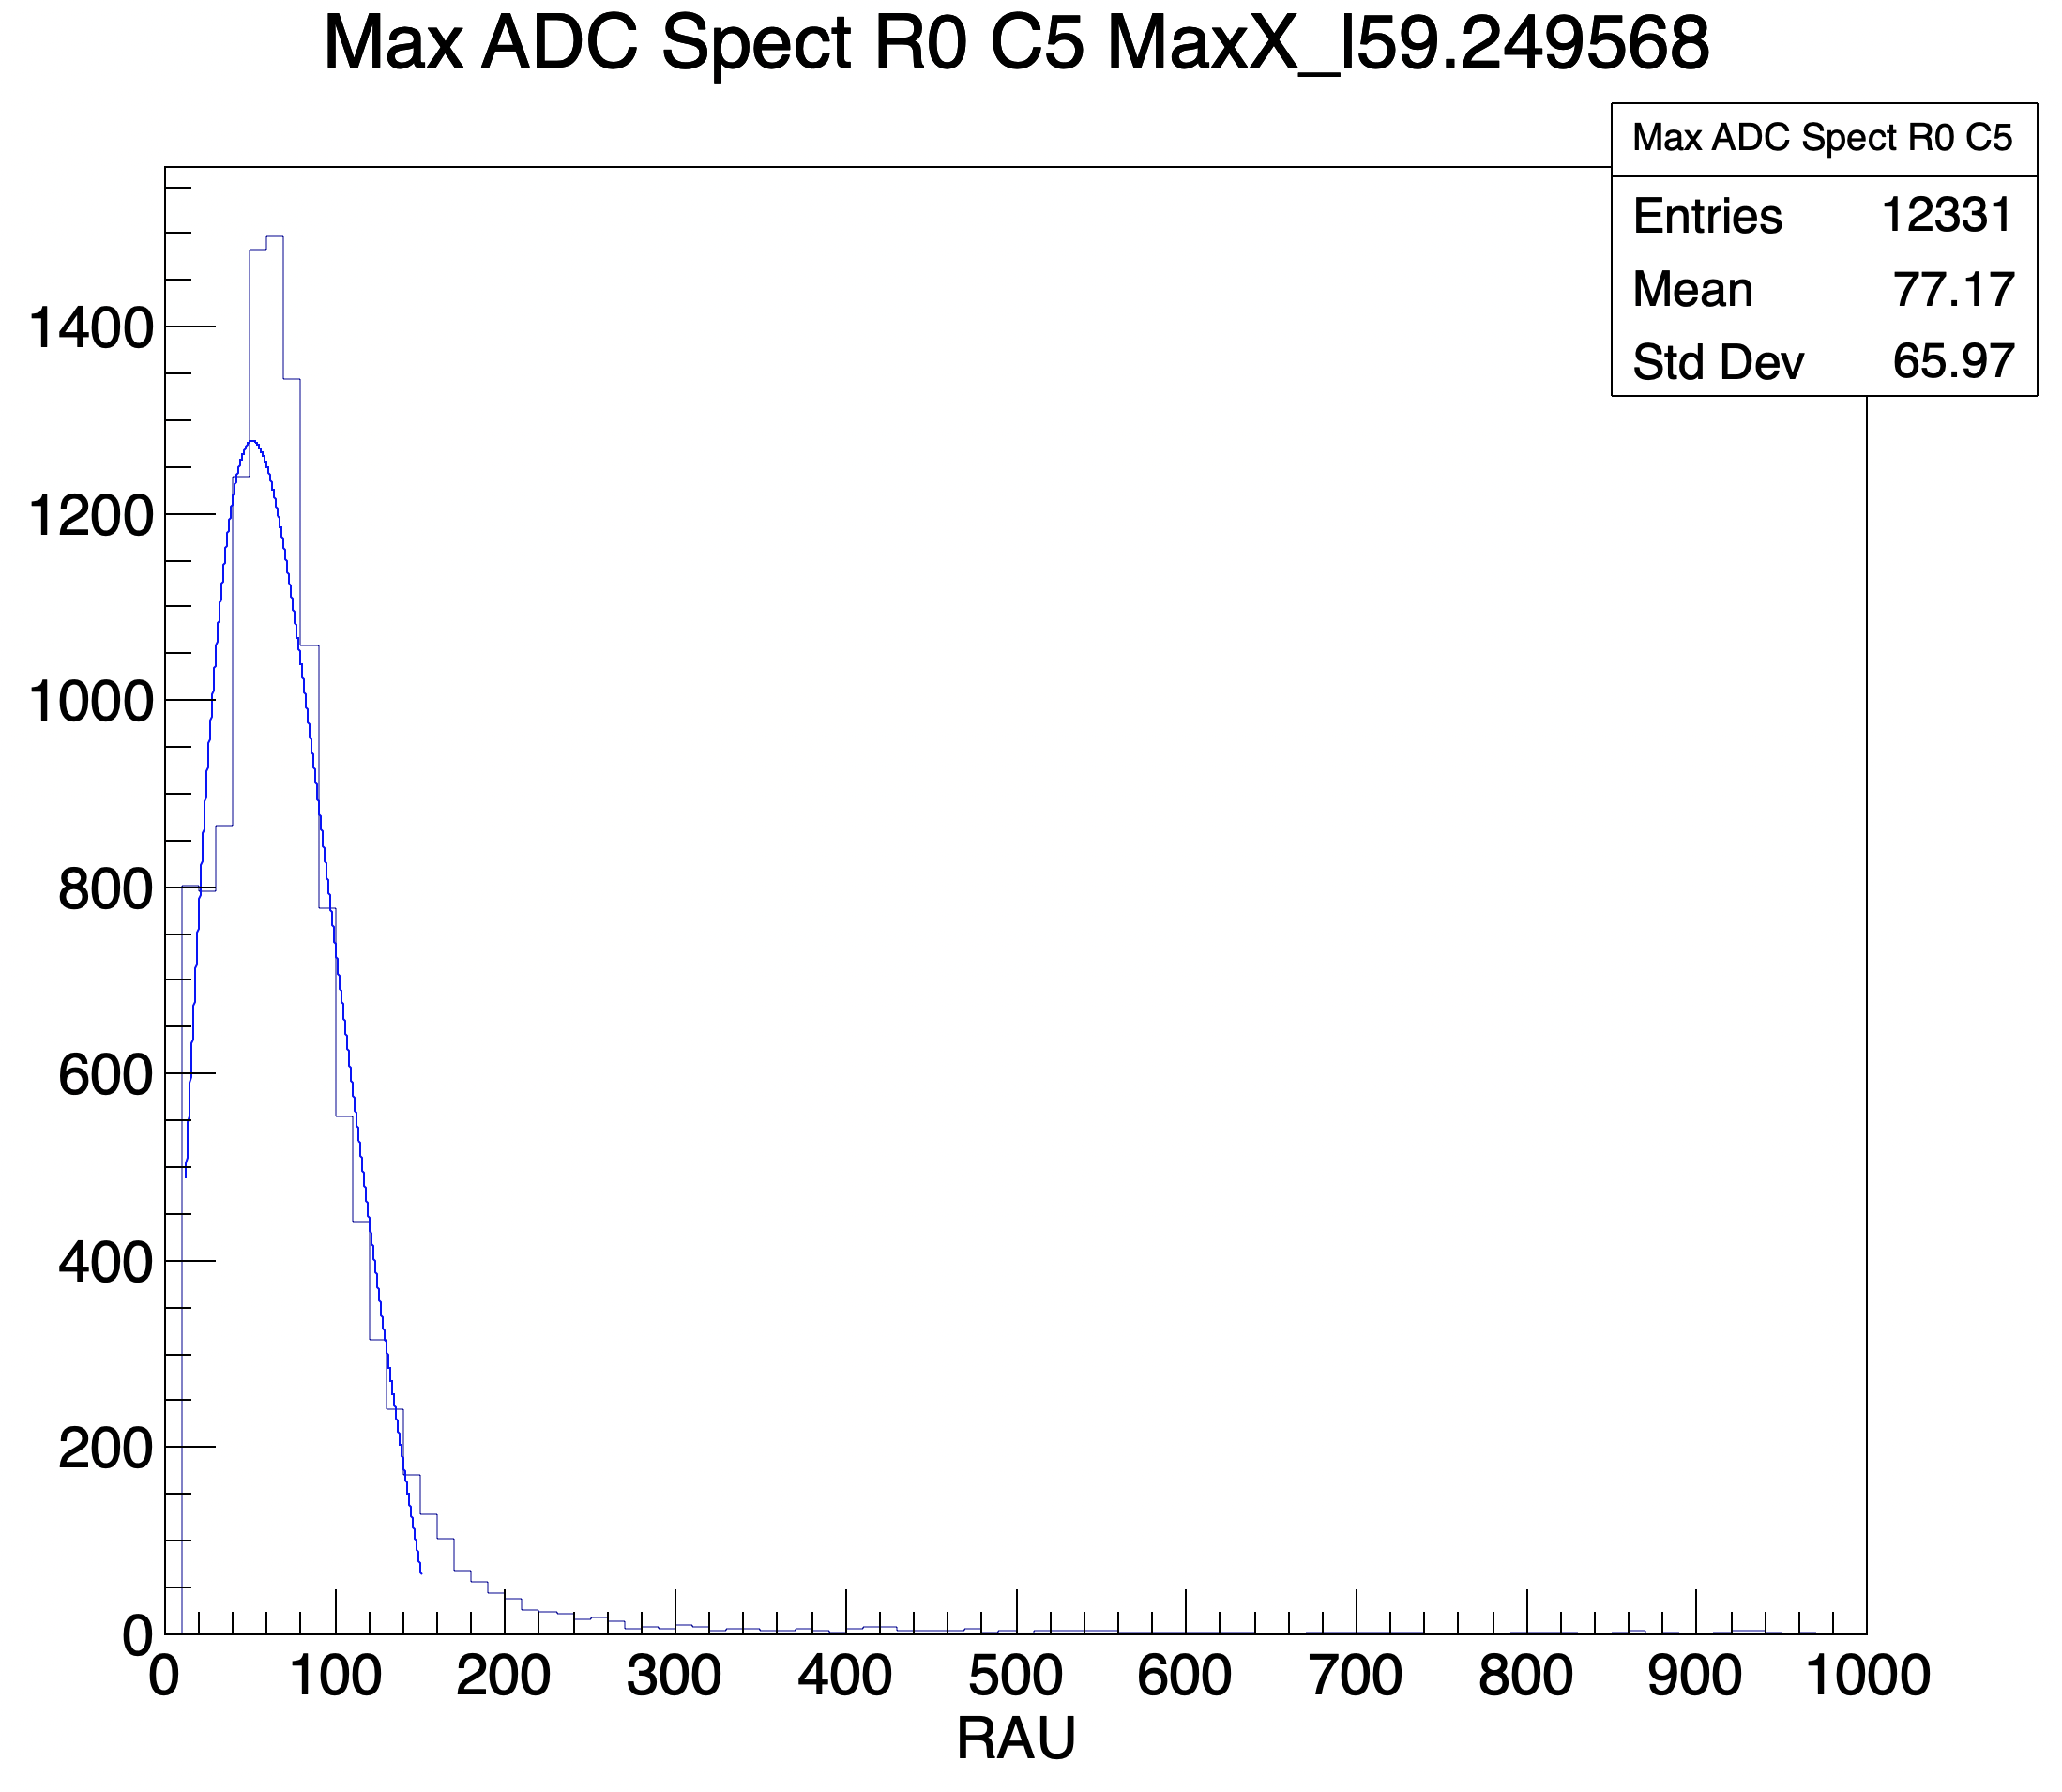
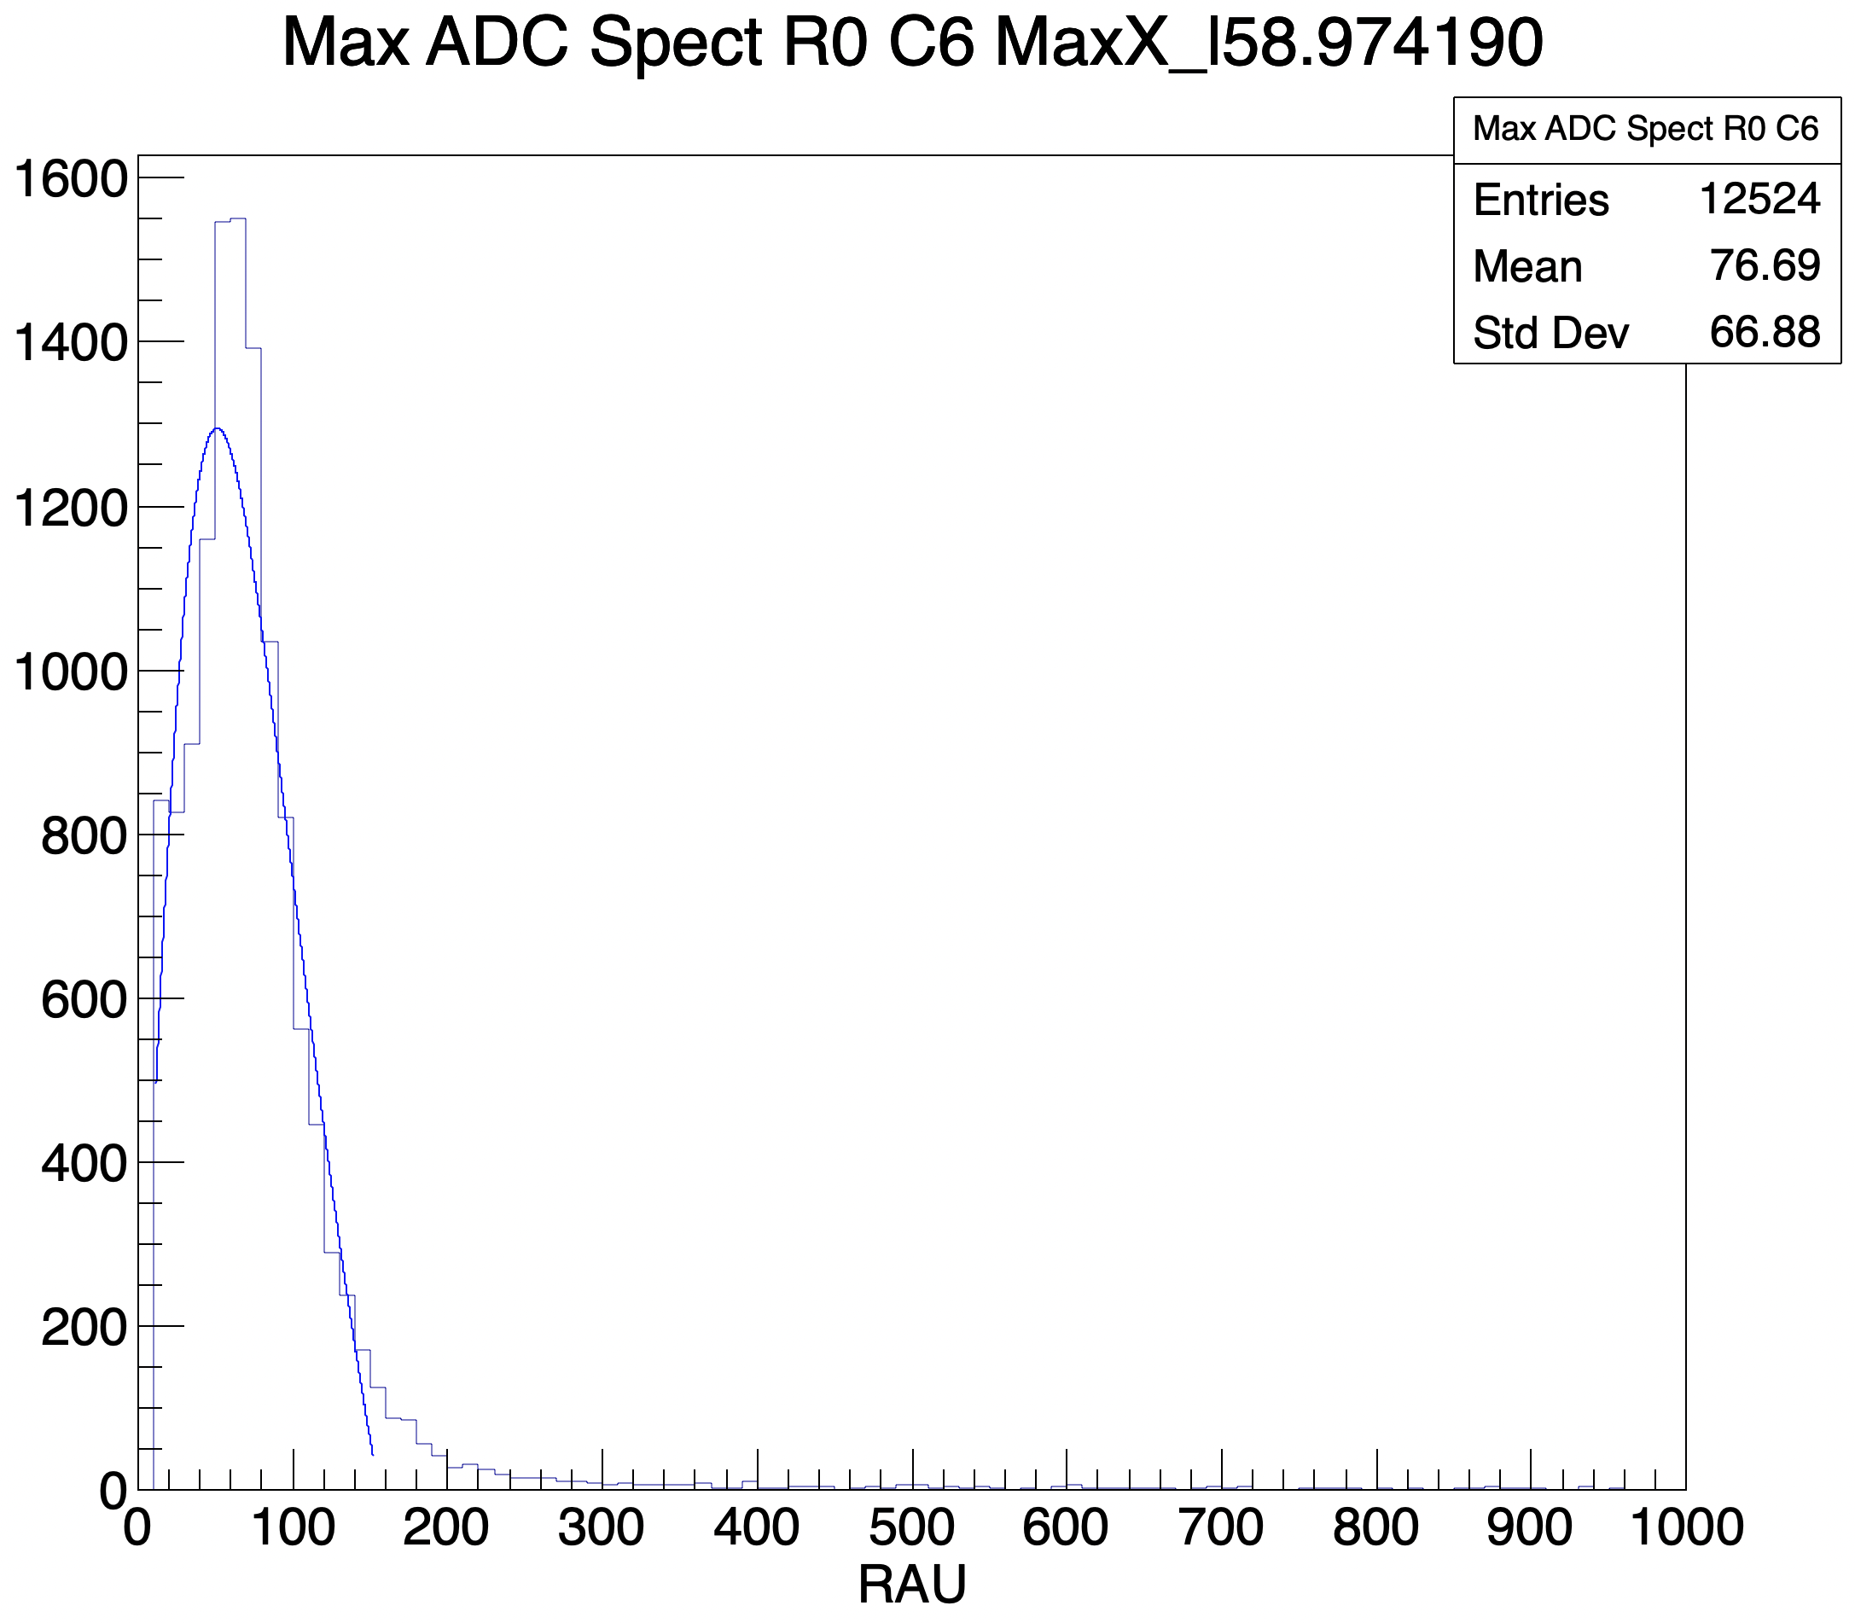
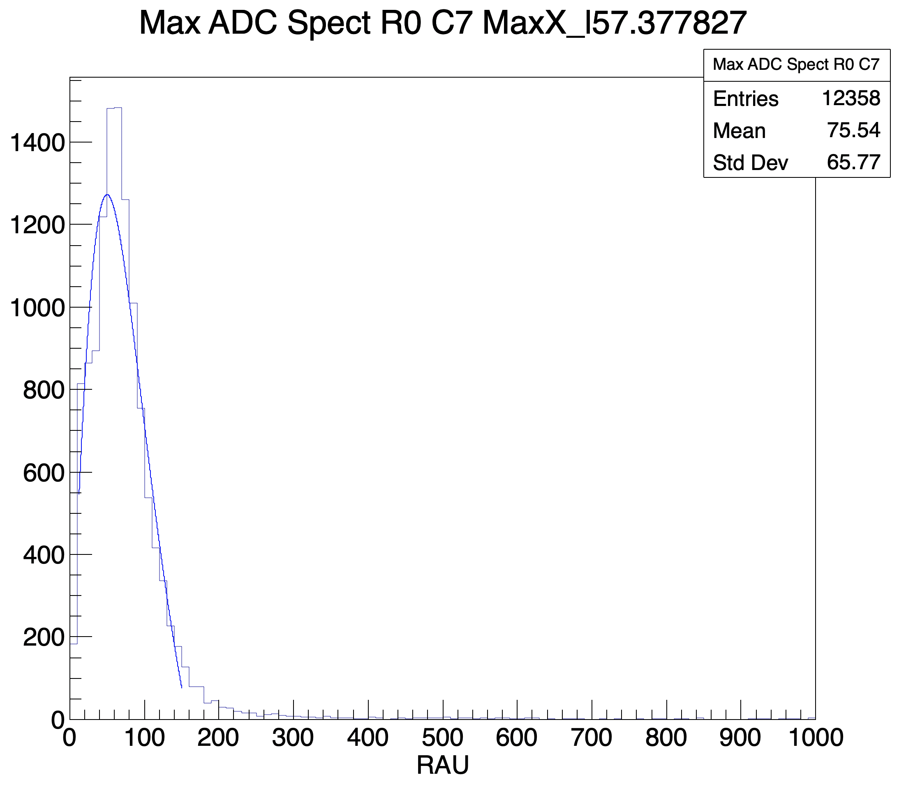
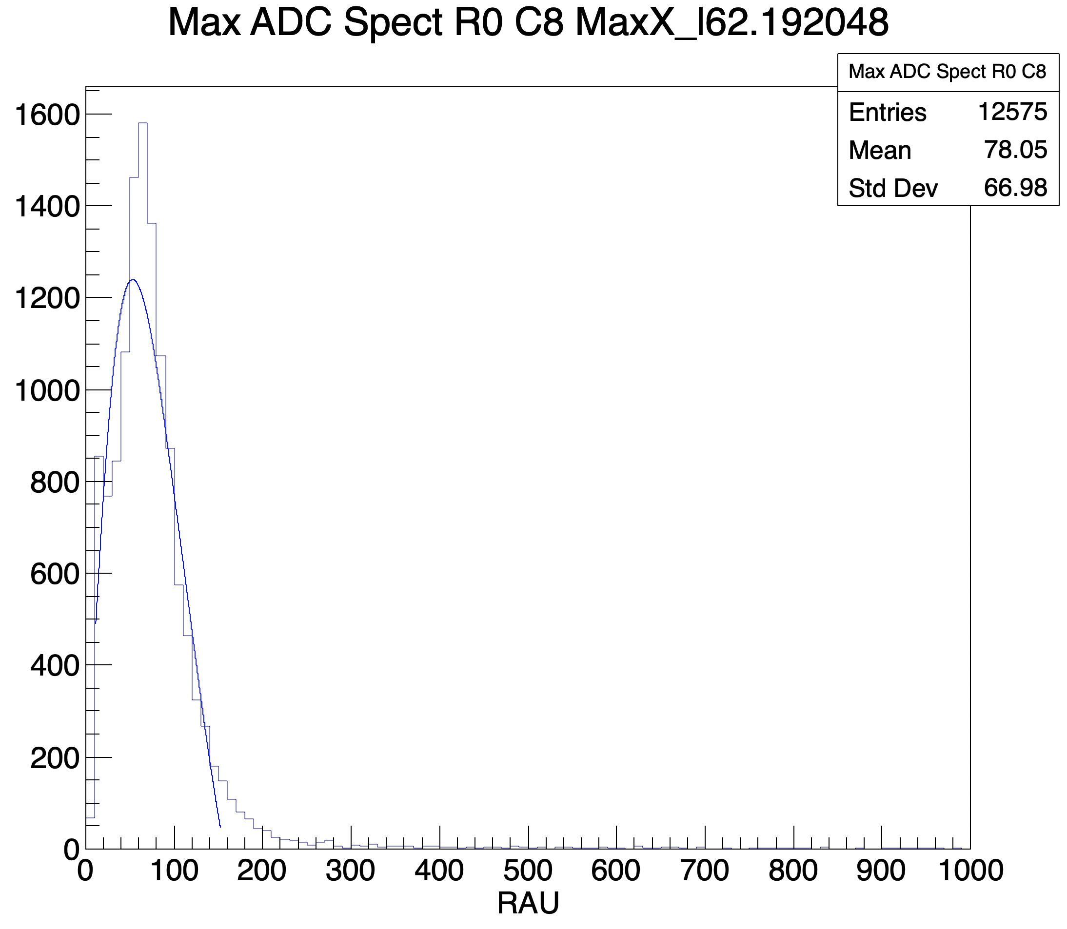
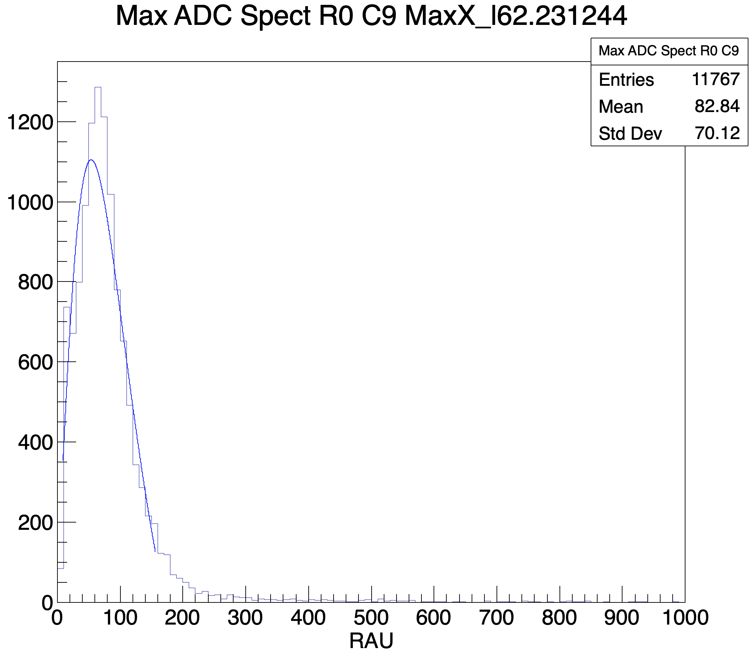
Backup
Several max adc histograms

