Slide 1
Modified PS706 Discriminator Tests
Phillips Scientific NIM Model 706 S/N 21785
Modified to receive a DC voltage from LEMO port on rear face of module
DC voltage to control threshold voltage for discriminator
Tests
Basic functionality of all channels
Effect of bias from rear LEMO port on threshold
Effect of manual threshold setting with bias from rear LEMO port
Current draw of module from rear LEMO port over range of bias voltages

Slide 2
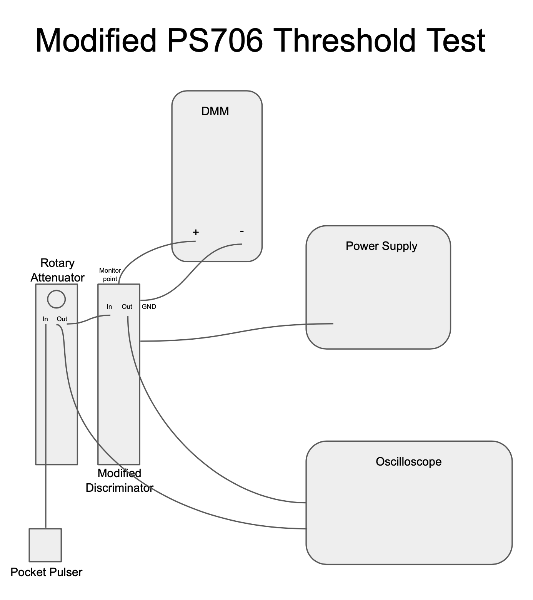
PS706 Test - Setup
Power supply attached to PS706 rear LEMO port
By channel - input signal produced via PS417 pocket pulser attenuated via PS804 Rotary Attenuator
By channel - input signal monitored via oscope
By channel - output signal monitored via oscope
Nominal thresholds monitored with DMM via monitor point on face of PS706 and ground

Slide 3
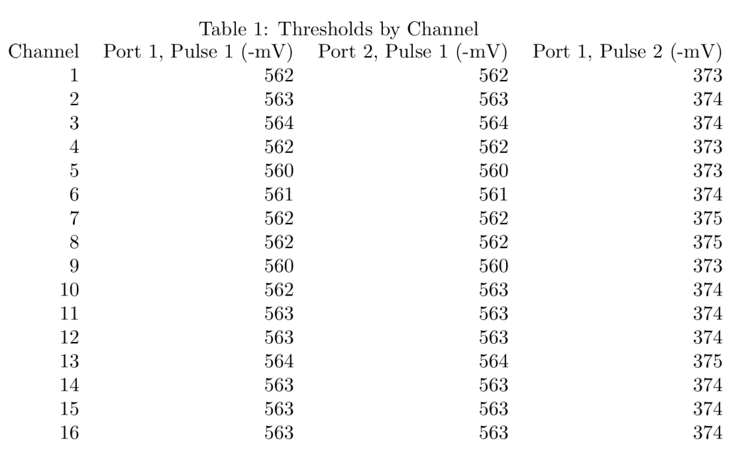
PS706 Test - Functionality Test
Measured values from DMM are the point where a pulse from PS417 of known amplitude disappears when tuning threshold with power supply from high to low
Each channel has 2 output ports
Pulse 1 = -556 mV
Pulse 2 = -376 mV
All channels functional and thresholds correct within estimated uncertainty
Positive voltage into rear LEMO corresponds to negative shift in threshold

Slide 4
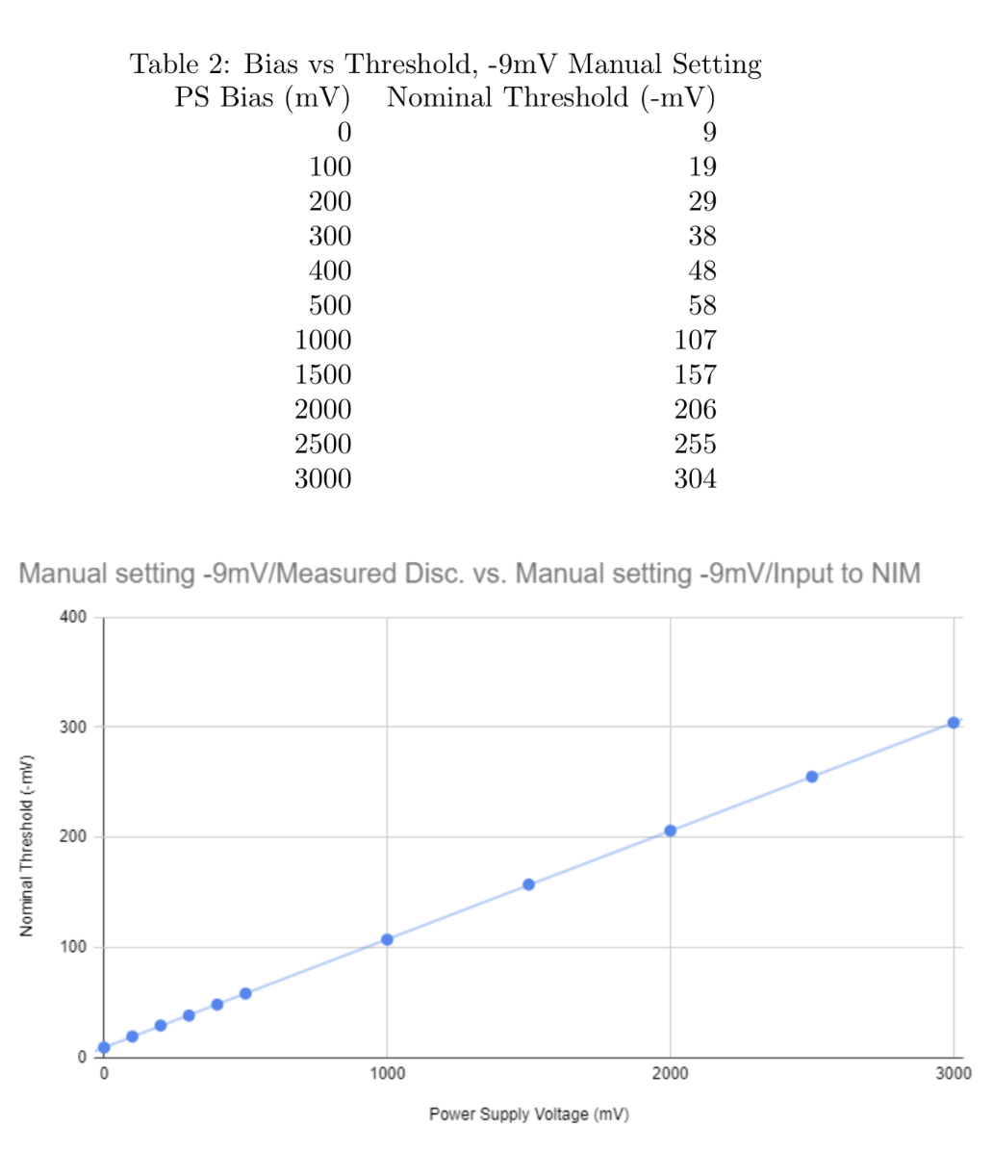
PS706 Test - Remote Threshold Test
Manual threshold adjusted to lowest setting on front face of PS706 (-9mV threshold).
Nominal thresholds as measured by DMM
Power supply bias delivered to rear LEMO port
Similar test performed for manual setting at -50mV
Map from power supply voltage to PS706 threshold:
Th = threshold, Vps = power supply voltage, A = attenuation over cables, Vms = manual setting voltage

Slide 5
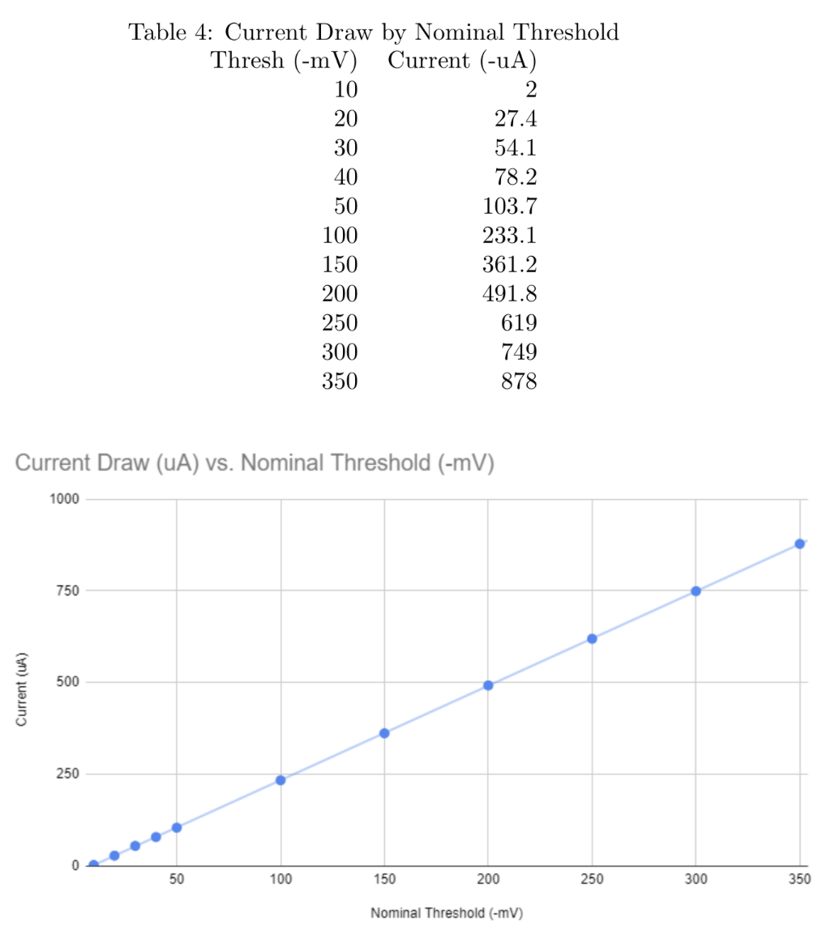
PS706 Test - Current Draw Test
Manual threshold adjusted to lowest setting on front face of PS706 (-9mV threshold)
Thresholds as measured by DMM
Power supply bias delivered to rear LEMO port and tuned up to match values in left column (Table 4)
Current draw linear as expected

Slide 6
Results Summary
Modified PS706 module is functional (all channels)
On range of threshold to -300 mV
Supplied max current to module: 1 mA
Supplied max voltage to module: 10 V
Control to threshold:
A comprehensive write up can be found on the wiki: https://hallaweb.jlab.org/wiki/index.php/HCAL_Reports/Updates

Slide 7
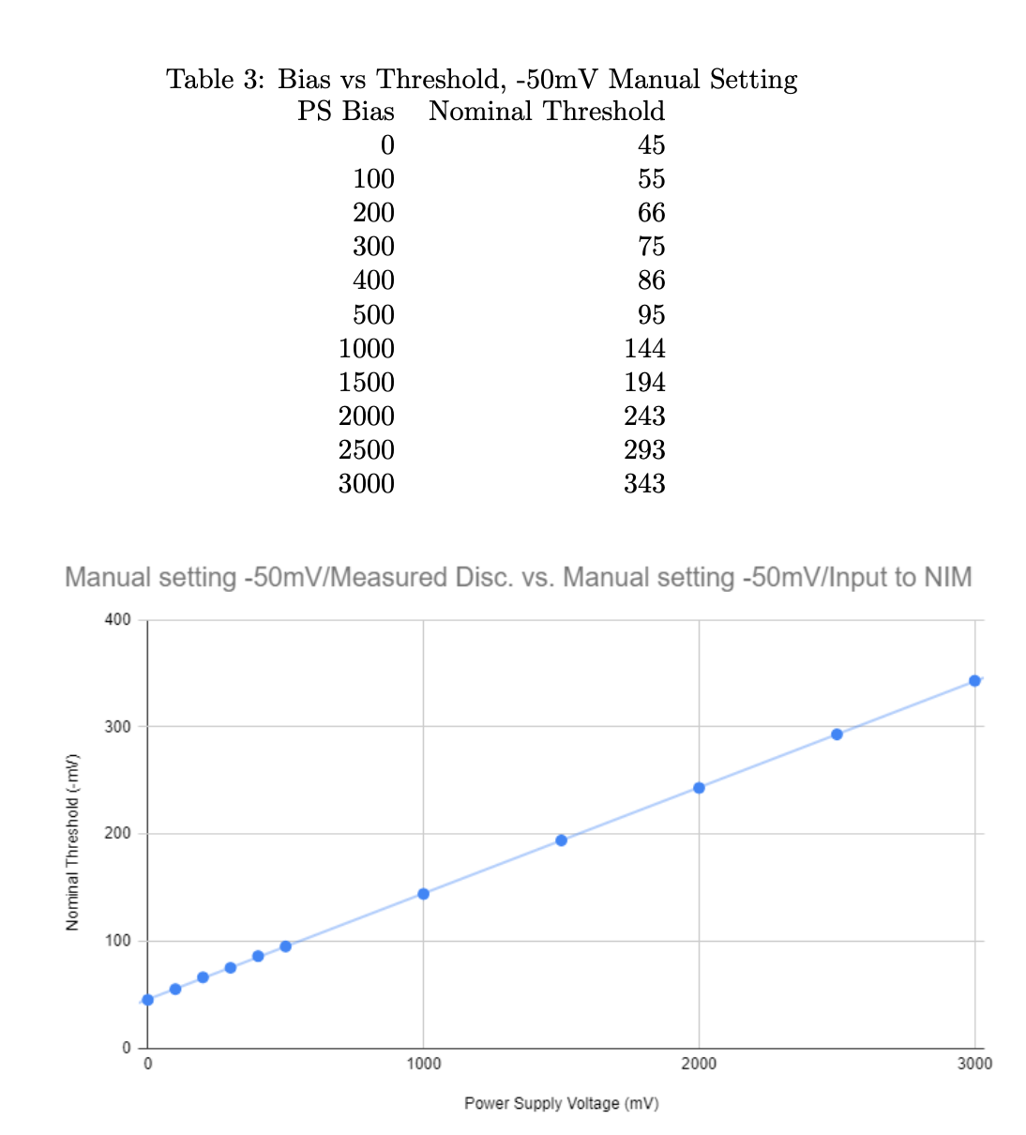
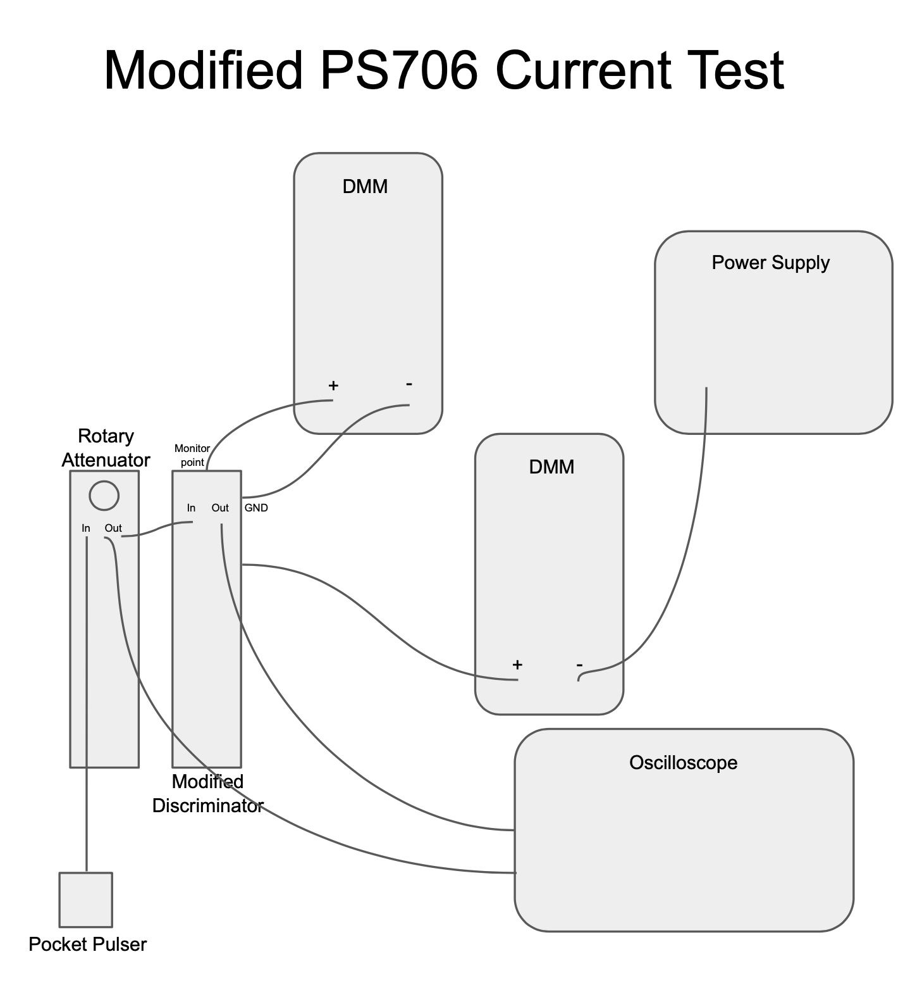
PS706 Test - Backup

Slide 8
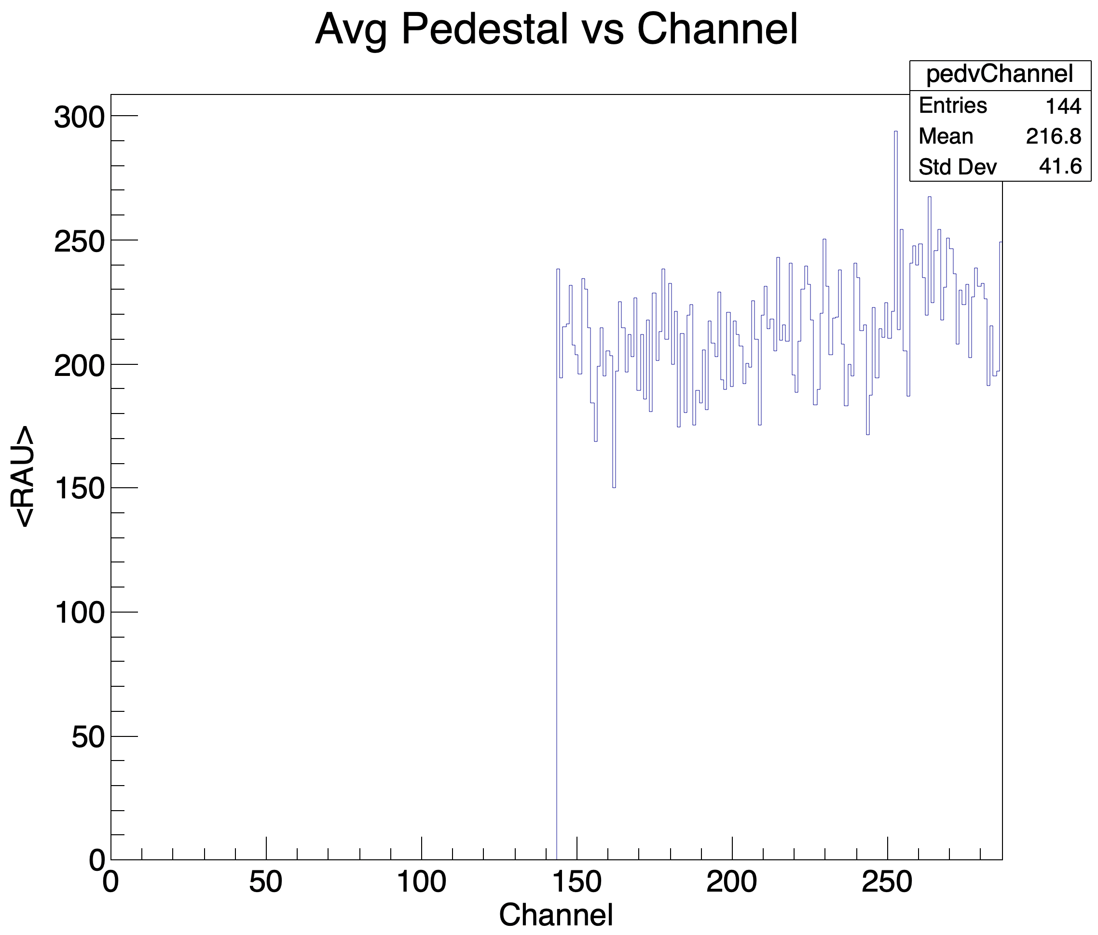
PS706 Test - Backup
Run 1288

Slide 9
Modified PS706 DC Voltage Filter
Motivation
Filter out any parasitic oscillations picked up over long cables from DAQ to discriminator
Preliminary design complete and simulated
Module cases procured
Building the module and practical tests next

Slide 10
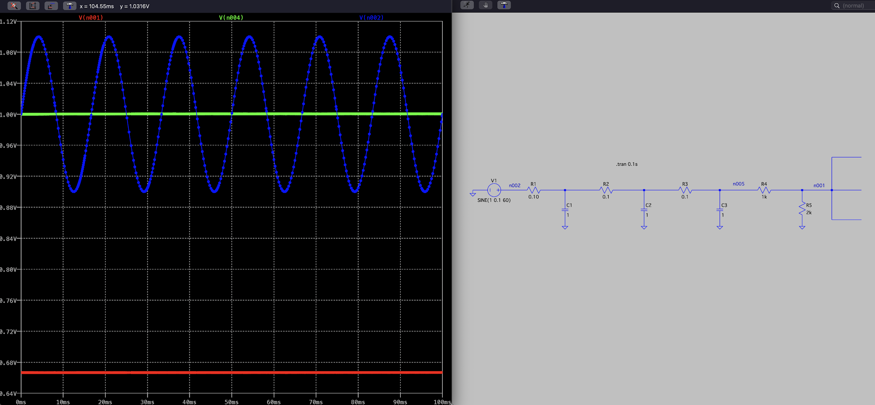
DC Voltage Filter Preliminary Design - 60 Hz Noise
Very simple design: Three low pass filters in series (fc = 1.6 Hz)
Input to circuit -> 1 V DC offset, 0.1 V Amp sine wave at 60Hz
R5 will be a trimpot

Slide 11
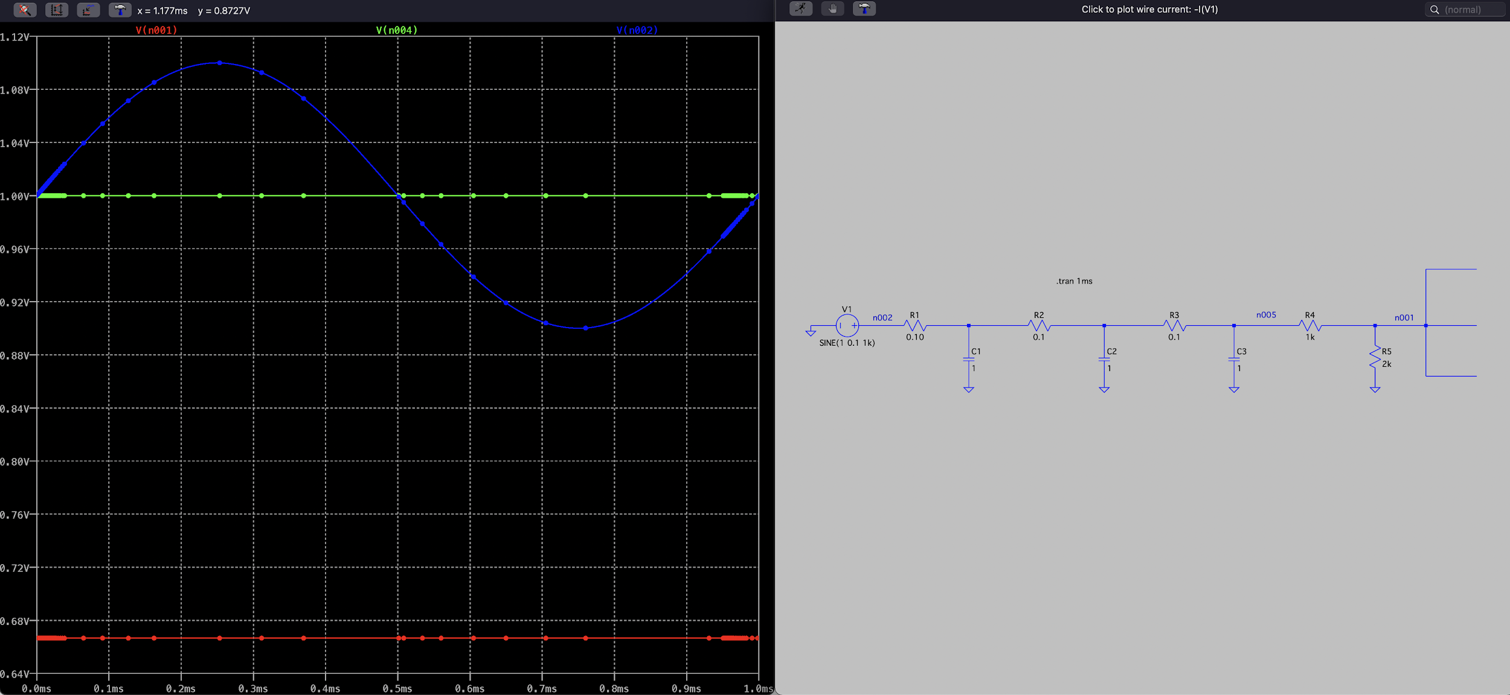
DC Voltage Filter Preliminary Design - 1 kHz Noise
Input to circuit -> 1 V DC offset, 0.1 V Amp sine wave at 1kHz
R5 will be a trimpot

Slide 12
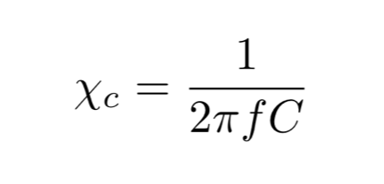
Modified PS706 DC Voltage Filter
Design specifications
Noise reduction factor
60 Hz: 1.86e-5
1 kHz: 4.03e-9

